Slide 1
Healthcare Apprenticeships:
Peer Learning Session
ICCB Apprenticeship Learning Communities
October 1, 2026
Veronica Inselman, Associate Director, Apprenticeships, Heartland Community College
Besa Sadiku, Manager, Workforce Initiatives, Harper College

Slide 2
Welcome!
Agenda
Heartland Community College Healthcare Apprenticeship Model
Harper College Healthcare Apprenticeship Model
Lessons Learned & Key Takeaways
Discussion & Questions

Slide 3
Heartland Community College
Registered Nurse (RN) DOL Registered Apprenticeship Program
Building the Next Generation of Nursing Professionals Through Apprenticeship
The RN Apprenticeship helps address workforce shortages while creating a sustainable pipeline of skilled nursing talent
Program at a glance
3-Year Registered Apprenticeship
Front-loaded Model: RTI in Year 1, OJL in Years 2 and 3
28 RN Apprentices Enrolled Since Spring 2024
Employer Paid Education and Paid Work Experience
Direct Pathway from Nursing Student to Registered Nurse

Slide 4
Program Overview
Registered Nurse (RN) DOL Registered Apprenticeship Program
Competency-based Registered Apprenticeship developed in partnership with our community health care employer.
Designed for students enrolled in the second year of Heartland Community College's RN program.
Addresses healthcare workforce shortages by creating a direct pathway from nursing education to RN employment.
Covers tuition, fees, books, uniforms, NCLEX exam fees, and provides financial support while enrolled.
Apprentices commit to a three-year employment pathway, supporting long-term workforce retention.

Slide 5
Program Model
How the Program Works
Front-loaded apprenticeship model: RTI is completed during Year 1; OJL is completed during Years 2 and 3.
Year 1 apprentices work 4 hours per week while completing nursing coursework and receive a living expense stipend.
After graduation, apprentices work as Graduate Interns until RN licensure and then transition into RN roles.
Recruitment includes nursing student information sessions, employer-led presentations, flyers, Canvas announcements, and direct application links.
Apprentices receive preceptor (mentor) support, funded education costs, and access to employee benefits.

Slide 6
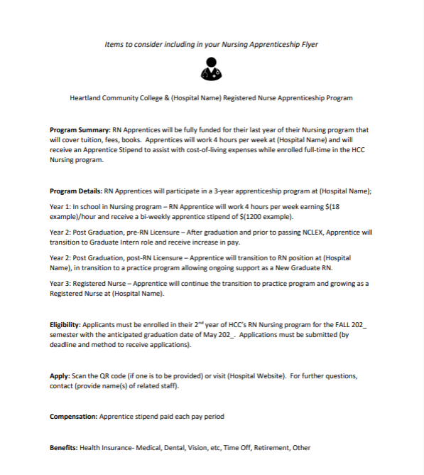

Slide 7
Outcomes and Impacts
Program Results
First cohort launched in Spring 2024 with 6 apprentices; five additional cohorts have brought total participation to 28 apprentices.
21 apprentices have completed RTI and have completed the apprenticeship or are progressing through OJL competencies.
4 apprentices are currently completing RTI and 3 participants exited the program.
The apprenticeship has strengthened the employer's nursing pipeline and provided workforce stability through a three-year employment commitment.
Success of the RN program has paved the way for CNA and Radiography Registered Apprenticeships.

Slide 8
Responsive Program Design
Responding to Apprentice Feedback
Early apprentice feedback revealed that many participants were working second jobs to meet living expenses while enrolled full-time in nursing school.
HCC surveyed apprentices to better understand their monthly cost-of-living needs and shared the results with the employer partner to explore strategies for providing more consistent financial support.
In response, the employer replaced the sign-on bonus with a bi-weekly stipend and reduced Year 1 work requirements from 12 hours to 4 hours per week.
These program modifications allowed the apprenticeship to better align with student needs while supporting academic success, program persistence, and workforce development goals.

Slide 9
Lessons Learned
Challenges and Successful Strategies
Employer staff dedicated to coordination of OJL and preceptor assignments created important program infrastructure and improved communication.
Establishing more consistent preceptor-apprentice pairings enhanced the apprentice experience and strengthened workplace learning.
Coordinating tuition payments, financial aid, scholarships, and workforce funding sources requires close collaboration among apprenticeship, financial aid, and business office staff.
As a competency-based apprenticeship, developing consistent and efficient processes for documenting OJL competencies remains an ongoing area for improvement.

Slide 10
Partnerships and Future Opportunities
Building the Healthcare Workforce Pipeline
Strong collaboration between HCC, employer partner leadership, recruiters, apprenticeship coordinators, preceptors, and nursing faculty were critical to program development.
Regular planning meetings allowed partners to address challenges, share feedback, and continuously improve the apprentice experience.
The RN apprenticeship has become a model for expanding apprenticeship opportunities into additional healthcare and other occupations.
Future opportunities include expanding employer partnerships and developing additional healthcare apprenticeship pathways.
Registered Apprenticeships provide healthcare employers with a structured strategy to recruit, develop, and retain skilled nursing talent.

Slide 11
Closing Takeaway
Key Lessons
Strong employer-college partnership was essential to creating a sustainable program that supports both student success and workforce needs.
Listening to apprentice feedback and using data to inform decision-making enabled HCC and the employer partner to make meaningful program adjustments that strengthened student support and workforce development outcomes.
Reducing financial barriers through tuition support, stipends, paid employment opportunities, and employee benefits helps students persist in nursing education and successfully transition into the workforce.
We recommend keeping the apprenticeship OJL requirements as separate from the nursing program as possible. Apprentices must complete the same clinical requirements as all nursing students. Apprentices do not get paid for their clinical hours. Apprenticeship OJL remains distinct from clinical education to avoid potential accreditation concerns.

Slide 12

Our greatest lesson learned is that building flexibility into the apprenticeship model and listening to apprentice feedback creates better outcomes for both students and employers.
By reducing financial barriers, providing structured workplace learning, and creating a direct pathway to employment, Registered Apprenticeships can help healthcare organizations attract, develop, and retain the next generation of nursing professionals.

Slide 13

Healthcare Apprenticeship Programs at Harper College
Health Care
Certified Nursing Assistant*
Medical Assistant*
Practical Nurse*
Registered Nurse- AAS
Sterile Processing Certificate
Surgical Technology- AAS
* Registered with DOL

Slide 14

Healthcare Apprenticeship Programs at Harper College

Slide 15




Harper College Employer Apprenticeship Partners
Endeavor Health
Clearbrook
Ascension
Advocate Good Shepherd
Rush Hospital
JourneyCare
CNA
LPN
CNA
Sterile Processing
Surgical Tech
CNA
MA
RN

Slide 16
Harper College Healthcare Apprenticeship Programs
Employer & Apprentice Model at Harper College
  These programs primarily serve incumbent workers employed by Harper's healthcare employer partners.
  Apprentices are already working for their employer while completing their RTI and, where applicable, clinical training.
Advocate Good Shepherd follows a different pipeline model:
  Partners with a local high school to identify and recruit graduating seniors.
  Students are hired after completing high school.
  They typically begin employment in June or July.
  They begin the CNA program at Harper in August.

Slide 17
Harper College Healthcare Apprenticeship Programs
Employer Differences in Paid Training Time
Clearbrook
  CNA apprentices are paid for their time at Harper.
  Clearbrook provides 8 hours of paid time for the apprentice to attend Harper.
  This allows the apprentice to attend RTI without losing a full day's wages.
Advocate Good Shepherd
  CNA apprentices are also provided 8 hours of paid time to complete their RTI at Harper.
Ascension
  Surgical Technology apprentices may work part-time or full-time.
  Apprentices are not paid for time spent at Harper for RTI.
  They are also not paid for clinical hours.

Slide 18
Harper’s Apprenticeship Support Model
Candidate Recruitment & Job Postings
Recruitment & Hiring Events
Resume & Interview Preparation
Academic Advising & Coaching
Class registration and textbook ordering
Tutoring & Support Services
Mentor Training & E-Course
Apprentice Progress & Retention Support

Slide 19
Apprentice Success & Completion
Group​ | Graduation Rate %​
Apprentices at Harper​ | 73
Business Administration Apprentices​ | 89​
Non-apprentices in Similar Programs​ | 35.8​
Healthcare Apprenticeships | 57
Surgical Technology | 84
National Graduation Rate​ (AAS) | 43​ (6 years)
Apprentices at
Harper College: 674
24 programs
Graduated: 390
Active: 102

Slide 20
Closing Takeaways: Lessons Learned
Employer engagement is the foundation.
One model does not fit every employer.
Paid time for RTI matters.
Incumbent-worker apprenticeships create a strong pathway for advancement.
Youth-to-career pathways require early employer partnerships.
Flexibility is essential.
The ultimate goal is retention and career mobility - not simply program completion.
Notes:
Employer engagement is the foundation. Apprenticeships work best when employers are actively involved in hiring, training, supporting, and retaining apprentices.
One model does not fit every employer. Even within the same occupation, employers have different staffing structures, wage practices, and approaches to paid training time.
Paid time for RTI matters. When employers compensate apprentices for time spent in classroom training, apprentices can participate without having to choose between wages and education.
Incumbent-worker apprenticeships create a strong pathway for advancement. Apprentices can earn while they learn, build skills within their current workplace, and progress toward higher-level credentials.
Youth-to-career pathways require early employer partnerships. The Advocate Good Shepherd model demonstrates how connecting with high schools can create a pipeline from graduation → employment → apprenticeship.
Flexibility is essential. Healthcare employers have different operational needs, so apprenticeship programs need to be adaptable while maintaining the quality and requirements of the training.

Slide 21

Looking Ahead: Strengthening the Healthcare Talent Pipeline
Let’s work together to build pathways that work for employers, apprentices, and our communities.
Notes:
Healthcare apprenticeships are not just about training workers for today’s jobs. They create a pathway for people to enter healthcare, advance within the industry, and build sustainable careers—while helping employers develop and retain the talent they need.

Slide 22
Thank You
Contact information:
Veronica Inselman Besa Sadiku
Associate Director, Apprenticeships Manager, Workforce Initiatives
Heartland Community College Harper College
Veronica.Inselmann@heartland.edu bsadiku@harpercollege.edu
309 268 8078 847 925 6452

