Slide 1
Apprenticeship Virtual Learning Community
Lavon Nelson, Senior Director for Workforce Education
Angela Gerberding, Director for Work-Based Learning
Bonnie Moore, Director, Center for Business & Industry, Lake Land College
May 8, 2024

Slide 2
Welcome! Please put your names and institution in chat.
Agenda
Overview of Definitions
Panel of Guest Speakers
Open Discussion and Questions

Slide 3
Youth Apprenticeships
Youth Apprenticeship Programs Serve Youth Aged 16-24
In 2022, there were 228,535 Youth Apprentices Registered
Models of Youth Apprenticeship Programs
Pre-Apprenticeship Programs for Youth prepare students to enter an apprenticeship
Registered or Unregistered Apprenticeship Programs that Begin in High School, Community College or Dual Enrollment Opportunities allow youth to start their Apprenticeship while still a student

Slide 4
Elements of Apprenticeship Programs Serving Youth
▶ Satisfy labor market needs of students/career seekers, businesses, local school districts, and colleges.
▶ Address skills matching and individual assessments to promote competencies needed by businesses.
▶ Align with the academic and technical standards in secondary and post-secondary education, as well as with portable, nationally-recognized credentials and certifications.
▶ Provide strong linkages to adult Registered Apprenticeship programs in the community.

Slide 5
Youth Apprenticeship Guest Speakers
Andy Hepburn, Chief Innovation Officer, GPS Education Partners
Stephanie Gomez, Director, Career Launch Chicago at City Colleges of Chicago
Eric Hill, Executive Director for SkillsUSA Illinois

Slide 6
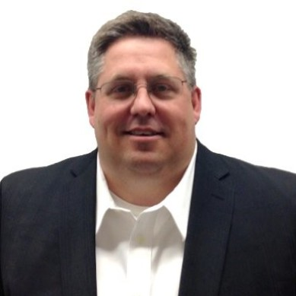
Andy Hepburn, Chief Innovation Officer at GPS Education Partners

Slide 7
ICCB Apprenticeship Learning Community Panel
High School Youth Apprenticeship and WBL Solutions
May 2024
Notes:
Print one pager
Include QR code to slide deck/presentation
ADD Parking lot for the day
Estimated Timing:
Intro (1-6): 10 min (including 5 min table talk)
Definitions (7-12): 8 min
Dupage Program Overview (13-15): 8 min
Workshop Intro (16-17): 5 min
Step 1 (18-26): 20 min (including 8 min reflection)
Step 2 (27-32): 15 min (including 8 min reflection)
Step 3 (33-41): 20 min (including 5 min reflection)
Step 4 (42-46): 15 min (including 5 min reflection)
Recap (47): 5 min
Worktime/Parking Lot (48): 10 min
Closing (49-51): 5 min

Slide 8
GPS Education Partners
(GPS Ed)
VISION
We envision a world where every student can access quality work-based learning to discover a pathway to a productive life.
GPSEd is a WBL Intermediary connecting schools and employers to provide innovative WBL programming for 25 years.
WBL Intermediaries, like GPS Ed, are essential components of a WBL Ecosystem for Education and Employers together to Make School Work.
Key value: connecting education and employers, designing for scale, and designing for impact by focusing on barriers to participation by students and employers.
MISSION
A nonprofit work-based learning solutions provider and advocate, representing our students, businesses, and communities, focusing on access and equity for all students to succeed in careers of the future.
Notes:
Amber
Tom Wendorf introduced the ROE to GPSEd, a non-profit organization whose mission is to have work-based learning become an accepted and essential part of the education system for high schools, closing the gap between education and work and providing equity of opportunity for all students. GPSEd has been doing this work in Wisconsin for over 20 years and has branched out to do this work in other states.
What is a Work Based Learning Intermediary? Resource/Value add to facilitate the programs - I visited D203’s CTE program and although they are well-resourced, said they found the intermediary work of GPSEd to be a highly valued and efficient partnership.
Why are they important partners? They are the connection between the employers and schools. They are also helping to eliminate the barriers that might prevent a student from participating.

Slide 9
Expansion of Work-based Learning Across the Country
★1. Wisconsin | GPS Education Partners - Education Centers & Youth Apprenticeship Programs
Scaled regionally to seven (7) Education Centers in Eagle, Franklin, Fox Cities (Appleton, Kaukauna, Menasha, Neenah), Hartford, Menomonee Falls, Northwest Milwaukee and West Milwaukee
2. Berlin, Eagle, Oshkosh, Whitewater | Generac Power Systems - Manufacturing Youth Apprenticeships
With expansion across Wisconsin and added awareness, exploration and development programming across the WBL Journey
3. West Allis, WI | G.A. Larson Company - HVAC/R Technician Youth Apprenticeship & Expansion Program (IL, MN, WI)
4. Milwaukee, WI | Central City Cyber High School - Charter School and Milwaukee Public Schools (MPS) Pathway Solution
5. St. Paul, MN | 3M Company - Manufacturing & Academic Partnerships (MAP) Program
Scaled nationally to 15 sites in 10 states: Alabama (two sites), Connecticut, Iowa, Kentucky, Minnesota, Missouri, Nebraska, South Dakota, Texas, Wisconsin
6. Hennepin County, MN | Hennepin West - Youth Apprenticeship Program
7. DuPage County, IL | Dupage ROE - Illinois Regional Office of Education - Work-Based Learning & Youth Apprenticeship Collaborative
8. Troy, OH | Hobart Service - HVAC/R Technician Youth Apprenticeship & Expansion Program
9. Baltimore, MD | Baltimore City Schools
10. North Bend, OR | Oregon Virtual K-12 Academy (ORVA)
11. Bay Area, CA | Johnson Controls (JCI) - Service Tech Career Development Programming (pilot for national scale)
12. Dallas, TX | Uplift Education - Public Charter School Network
5
10
2
6
3
4
1
7
8
9
11
12
KEY
Client Project Launched
Scaled to Additional Client Branches or Facilities
Notes:
Russell

Slide 10
Connecting Today’s Classrooms to Tomorrow's Careers
GPS Ed Work-based Learning Journey™
MIDDLE SCHOOL
HIGH SCHOOL
POST - SECONDARY
Students develop professionally through WBL, becoming productive members in their community.
STUDENT BENEFIT
SCHOOL BENEFIT
EMPLOYER BENEFIT
Implement a personalized career-training plan, whether that means securing employment in your desired field and/or continuing education.
Increase the amount of career-ready students graduating.
Gain access to highly motivated employees, trained and developed to meet your company needs.
Notes:
JOURNEY Successful technical career navigation should include a continuum of work-based learning that involves meaningful interactions with businesses and/or community-based organizations. By providing in-depth, hands-on activities, real-world work is integrated into students’ education, preparing them for a valuable technical career.
These experiences may be delivered in workplaces, communities and schools. Activities such as job shadowing and apprenticeships help students create career pathways.

Slide 11
Ed Center and Youth Apprenticeship Program
Hennepin County Minnesota
(launched 2022)
Perkins Collaborative - 13 School Districts/ 2 College Partnerships
Pathways: ADV Manf, IT, Healthcare, Construction
Developing Registered Apprenticeship with Tech College - that will bridge from Youth Apprenticeship and internships.
100+ students engaged
Wisconsin - Eastern Region
(Launched 2000)
State Youth Apprenticeship Collaborative - 8 counties; 36 School Districts & 4 Tech Colleges
Pathways: Adv. Manf, Auto, Construction
1 or 2 year YA can bridge to RA through employer engagement.
1100+ students engaged
DuPage County, IL (launched 2021)
Regional Collaborative; EFE; Regional Office of Education; & College of Dupage - Project Hire Ed
23 High School Districts
Pathways: ADV Manf, IT
Bridge from HS apprenticeship/internships to Registered Apprenticeships Project Hire Ed & Employer
150+ Students engaged

Slide 12
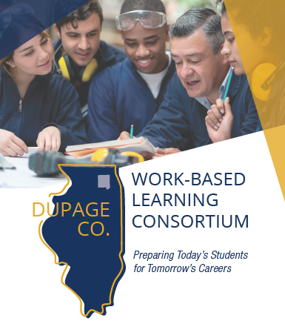
VISION
Design, build and execute a collaborative, sustainable School District driven work-based learning model to support:
Diversity, Access and Equity
Multiple Industry Pathways (Mfg, IT, Healthcare and more)
Curriculum and Credentials
Student Support, Progress and Assessments
Aligned to Post-Secondary
Community supported (DuPage County)
Notes:
JEFF: Welcome/Introductions: Host Welcome, Meeting Welcome

Slide 13
DUPAGE | WORK-BASED LEARNING ECOSYSTEM
Together we’re building an ecosystem of schools, businesses and community partners to provide scalable, quality work-based learning solutions that impact educational systems, talent pipeline needs, and unite and lift local economies by developing the next-generation workforce.
EDUCATORS
Preparing students for technical careers through work-based learning.
COMMUNITY
Creating partnerships to invest in strengthening communities.
INDUSTRY
Empowering businesses to build their future workforce.
Notes:
Jeff

Slide 14
POST GRADUATION
Registered Apprenticeship
Transition to...
Career Exploration
Career Pathway Training
OR
Technical
College Program
University
Program
Direct training on a Career area of interest
Align to post secondary opportunity
Explore Careers
Develop basic skills
Direct Hire
PHASE 2
PHASE 1

Slide 15
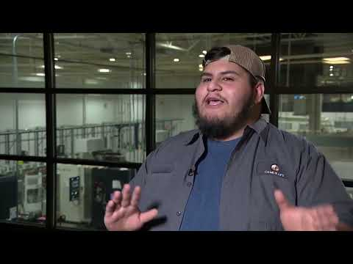
STUDENT TESTIMONIAL
Juan participated in the Youth Apprenticeship program from Lake Park High School and is now with Project Hire-Ed.
Listen to his story here
https://youtu.be/De-vtB4gIUk
Notes:
TESTIMONIAL of Student Impact.

Slide 16
Stephanie Gòmez, Director, Career Launch Chicago

Slide 23
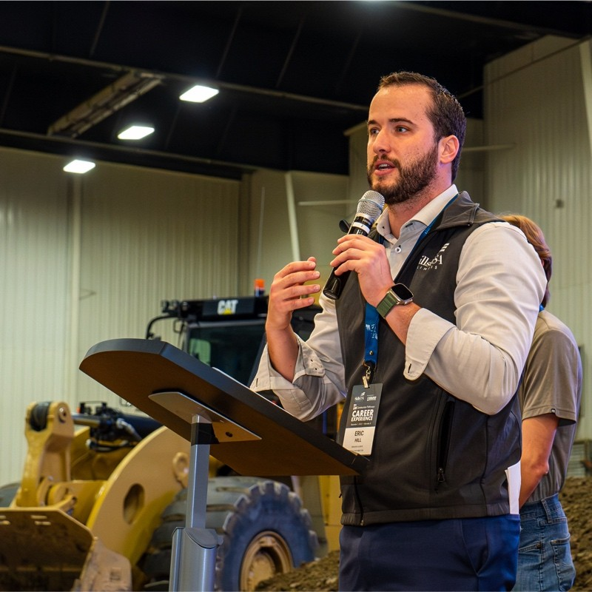
Eric Hill, Executive Director for SkillsUSA Illinois
SkillsUSA’s mission is to empower its members to become world-class workers, leaders and responsible American citizens. We improve the quality of our nation’s future skilled workforce through the development of SkillsUSA Framework skills that include personal, workplace and technical skills grounded in academics.

Slide 24
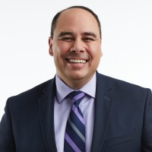
Laz Lopez, Associate Superintendent, Township High School District #214

Slide 25
Discussion and Questions?
Questions on the pros and cons of registering a youth apprenticeship. How did you decide on your model?
What are common challenges in Youth Apprenticeships and how do you address them?
Where do you find the most success in Youth Apprenticeships and how did you accomplish it?
Other comments and questions?

Slide 26
Members of ICCB’s Apprenticeship Workgroup
Bonnie Moore Curt Rendall
Lake Land College Heartland Community College
bmoore71258@lakelandcollege.edu curt.rendall@heartland.edu
Danielle Kuglin-Seago Veronica Inselmann
College of DuPage Heartland Community College
kuglinseagod@cod.edu veronica.inselmann@heartland.edu
Corey Young
City Colleges of Chicago
cyoung163@ccc.edu

Slide 27
Thank You
Contact information:
Lavon Nelson Angela Gerberding
Sr Director for Workforce Education Director for Work-Based Learning
Lavon.nelson@illinois.gov angela.gerberding@illinois.gov
217-557-2742 217-558-2162

