Slide 1


Rev Up EV Community College Initiative – Round 2
Electric Vehicle Technology Grant
Dana Wynn, Director for Clean Energy Programs
Whitney Thompson, Deputy Director for Workforce Education

Slide 2

Questions
Should you have a question during the meeting, please put it into the "chat" so that we can answer it in the FAQ. Questions will not be answered during the meeting.
There is an FAQ posted on the ICCB Grant Opportunities webpage.
Please send all questions to ICCB.cte@illinois.gov
No questions will be answered to individual entities but will be posted to the FAQ page.

Slide 3
Background
Rev Up EV – Round 1 overview
In 2021, Governor Pritzker signed the Climate and Equitable Jobs Act (Illinois P.A. 102—0662) establishing Illinois policy to equitably transition to 100 percent clean energy by 2050.
Electric vehicles (EV) are instrumental to decarbonization, whereas vehicle carbon pollution accounts for one-sixth of global emissions.
Optimistically, electric vehicle sales have jumped significantly, up 14 percent in 2022, more than 10 times their share in 2017.
In order to support the growth of electric vehicles and critical infrastructure for deployment, maintenance, and support, Illinois needs adequate training programs producing more talent in EV priority program areas.

Slide 4
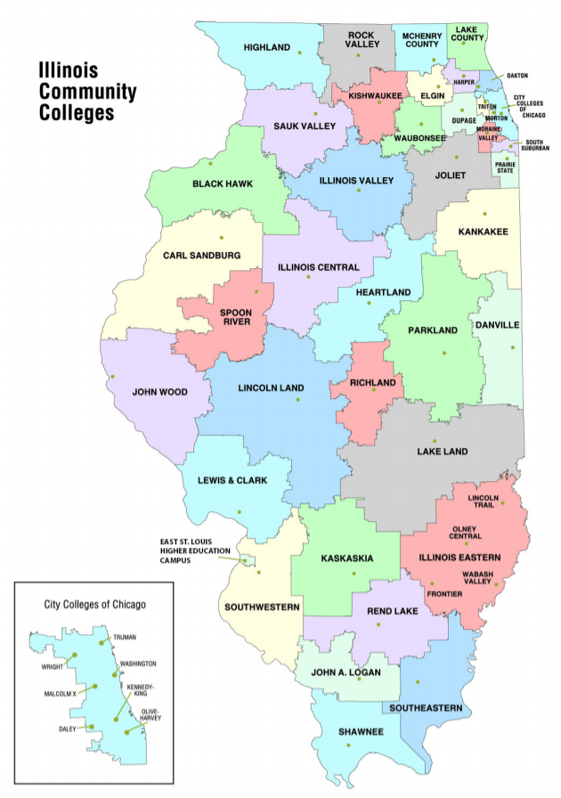
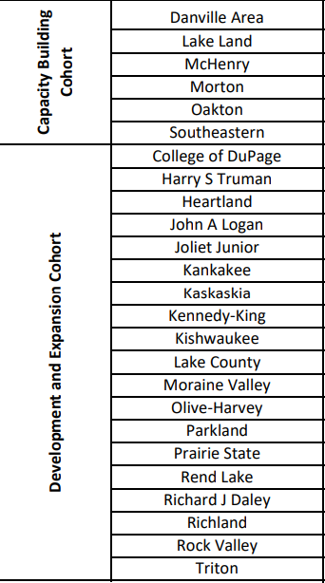
Rev Up EV – Round 1 overview
Notes:
Well distributed but there are gaps on the western side of the state.

Slide 5
Rev Up EV – Round 1 overview cont’d
Programs to be Developed | Number of Colleges | Programs to Revise/Expand | Number of Colleges
Alternative Fuel Technology Technician | 14 | Automotive Technology | 20
EV Infrastructure Installer | 6 | Alternative Fuel Technology Technician | 5
Heavy Duty EV Technology | 4 | Electrical Engineering | 3
High Voltage Battery Technician | 4
Grant Focus and Goals
Number of Students to be Enrolled | Number of Students to Complete | Number of Employers to Engage
1997 | 1732 | 347

Slide 6

Funding Overview
ICCB will provide approximately $6 million in competitive grant funds to promote the scale of EV technology programs, as well as advanced manufacturing programs that support EV infrastructure more broadly by way of two competitive grant opportunities:
  $270,000 for Building Capacity for EV.
  $5.3 million for EV Technology Development and Expansion
Notes:
https://www.iccb.org/grant-opportunities/
Up to 3 Obj. A, Up to 8 Obj. B.

Slide 7

Eligible Applicants
Community colleges in the State of Illinois are invited to submit proposals under this Notice of Funding Opportunity (NOFO).
1 application per college
**Current Rev Up EV grant recipients are ineligible for funding in Round 2.

Slide 8
Specifics
Applicants are able to select from one of two objectives. The objectives differ in funding ranges, allowable activities, and scope.
Each objective will be cohort-based receiving specialized support from the Illinois Community College Board, the Illinois Green Economy Network (IGEN), and other partners through the EV Network.

Slide 9
Objective A: Building Capacity for Electric Vehicles
Objective A is designed to support a cohort of community colleges to build capacity at their institutions and communities for the transition to EV technology.
This objective is intended to prepare and position institutions for future funding opportunities and to build capacity for program development and implementation.
Use of funds could include, but not necessarily be limited to, employer and community engagement, participation in the EV network, curriculum mapping and development, professional development and training for faculty, community needs assessment.
Maximum: $90,000 per college
One year grant (July 1, 2024 – June 30, 2025)

Slide 10
Objective B: Electric Vehicle Technology Development and Expansion
Objective B is focused on developing and/or expanding EV Technology and related programs.
The grant prioritizes education and training programs that span across the EV Technology occupational continuum from development and production to maintenance of Electric Vehicles, as well as installation and maintenance of critical infrastructure
Award range: $100,000-$525,000 per college
1.5-year grant (July 1, 2024 – December 31, 2025)

Slide 11
Priority Programs
Mechatronics
Electrical Engineering Technology
Electrical Technology
Other programs of interest are identified in the Illinois Clean Energy Jobs and Training Program Inventory.
Proposals will be evaluated with a focus on high demand areas, a sound labor market argument for the college’s focus in those areas, and the ability to effectively accelerate training.
It should be noted that the ICCB program approval process requires a labor market focused argument for program approval.
Manufacturing Engineering Technology
Alternative Fuel Vehicle Technology
High Voltage Battery Technology
Automotive Technology
Software Development
Programs aligned to industry certifications (e.g. TESLA Independent Repair Certified).
Programs that advance the development and maintenance of EV charging infrastructure.

Slide 12
Required Activities and Subsequent Definitions
Required Activities | Objective A: Capacity- Building | Objective B: Development and Expansion
Participation in EV Network
Employer and Community Engagement
Pathway Mapping (i.e., dual credit, adult education integrated education and training, non-credit to credit, as appropriate)
Build Capacity and Infrastructure
Develop New Programs (as LMI requires)
Revise or Expand Existing Programs (as LMI requires)
Support Students Enrolled in Eligible Programs
Each cohort of grantees, capacity-building (Obj A) and development/expansion (Obj B), will be supported by ICCB and IGEN through the EV Network and will be required to carry out a specific set of activities.

Slide 13
Grant Deliverables
Carry out
Report on
Report on achievement of performance metrics via required quarterly reporting and other supplemental reports as necessary.
Submit
Submit required programmatic and fiscal reports on a quarterly basis per the schedule below to ICCB.cte@illinois.gov. Reporting templates and other instructions will be made available to grant recipients at a later date.
Participate in
Participate in any required Operational Meetings or learning workshops, including those led by IGEN through the EV Network.
Provide
Provide to the ICCB copies of any curriculum, documents, toolkits, modules, etc., that are developed because of these grant funds.
Carry out deliverables of the proposed scope of work, encompassing all required activities for the selected Objective.

Slide 14

Professional Development and Technical Assistance

Slide 15

Upcoming EV Open House
May 30th
EV Industry Collaborative Meeting
& State Farm EV Lab Open House
Register by May 20
Join faculty and industry colleagues across the state in attending the EV Industry Collaborative & State Farm Electric Vehicle Lab Open House on May 30, 2024, at Heartland Community College in Normal, IL.
Attendance is available in person for the whole event or online for selected portions. Costs for the event are covered by IGEN/ICCB, but for catering purposes, registration must be received by Monday, May 20.
The event will include:
Keynote address
EV & Medium/Heavy-Duty EV Employer roundtable
EV trainers demonstration
EV hands-on instructor lab with faculty from Otago Polytechnic, NZ
Passenger and MHD EV Curriculum Workgroup Meetings
Please forward this invitation as needed.
    Visit Igencc.org for IGEN contact information.

Slide 16
Participation in EV Network led by IGEN:
Grantees are required to participate in the IL EV Network, an industry collaborative of key stakeholders from industry, higher education (faculty, staff, two-year and four-year), and state agencies to guide the development of light and heavy-duty Electric Vehicle training that satisfies industry demand for high-skill individuals.
  Grantees will engage in discussions on industry trends, talent needs in high-priority roles, systemwide strategies, barriers, solutions, and opportunities for collaboration to expand the EV / related advanced manufacturing workforce in Illinois.
  Curriculum development and pathway mapping
  Training and upskilling of faculty

Slide 17
Employer and Community Engagement:
Engaging in strategic partnerships within your region to conduct needs assessments, inclusive of both labor market and community readiness, develop and implement new programs, curriculum, work-based learning opportunities, etc.
Partnerships must include employers, high school districts, labor organizations, and local workforce boards. Other partners could include other institutions of higher education, community-based organizations, industry associations, etc.

Slide 18
Pathway Mapping:
Creating career pathways and programs of study that provide seamless transition from high school to postsecondary education and employment. This includes dual credit and other accelerated onramps such as adult education integrated education and training programs and non-credit to credit pathways, with an EV focus.
Curriculum development and pathway mapping will be facilitated through the EV Network. Grantees should also consider mapping pathways to include relevant CEJA workforce programs and Apprenticeship Illinois frameworks that exist in their regions.

Slide 19
Build Capacity and Infrastructure:
Updating existing programs/programs of study, purchasing or upgrading equipment to meet or exceed current industry standards, providing professional development and training to faculty and staff- including externship opportunities, creating partnerships and identifying efficiencies to maximize capacity.

Slide 20
Develop, Revise, and/or Expand Programs:
Developing new programs to meet the emerging needs of EV technology and related fields; revising existing programs (e.g. automotive technology) to address skills specific to electric vehicle servicing, including the use of stackable and micro-credentials for incumbent workers; expanding existing programs to meet labor market demand, which may include increasing capacity of offerings, offering programs in flexible formats to increase enrollment, hiring additional faculty, etc.

Slide 21
Support Students Enrolled in Eligible Programs:
Providing academic and non-academic support services, such as navigators, coaches, and wraparound support services, to overcome barriers to persistence and completion, including career services to support students’ successful completion to employment; partnering with community-based organizations to braid barrier reduction funding; offering work-based learning opportunities.
While barrier reduction funding (e.g. stipends, covering tuition and fees, etc.) is an allowable use of funds, this grant project models Perkins, whereas most of the funding should be program-oriented.

Slide 22
Examples of Other Allowable Activities
Incentivizing Development and/or Alignment of Curriculum: Furthering the alignment of coursework by contextualizing and integrating basic, safety, and advanced levels of training and education.
Creating non-credit, short-term training programs that support minority students’ transition into EV and Advanced Manufacturing programs.
Engaging in innovative instructional models such as competency-based education, virtual reality, artificial intelligence, and other online modalities.
Implementing innovative and collaborative career exploration activities or programs that increase secondary student awareness of EV opportunities to expand and diversify the pipeline of prospective learners entering these programs, including engaging middle school students in grades 5 – 8.
Developing support services models that include wrap-around services for basic needs including but not limited to housing, financial literacy, and other services that will reduce barriers to educational success for underrepresented students.

Slide 23
The Fine Print
All parts of the application package must be completed by the deadline to be considered. Applications will undergo a merit-based review process and are due, no exceptions, by June 14, 2024, 11:59 p.m. to ICCB.cte@illinois.gov
Applicants…
  Should ensure that all elements are clearly addressed
  Are strongly encouraged to use headers to address all elements or some consistent form of response delineation
  Will receive a receipt of application
  Will not be notified if there are items that are missing from their application
  Funded or not funded, will be notified by June 26, 2024

Slide 24
Application Format
The application must be organized as listed below and applicants must use the templates provided on the ICCB Grant Opportunities webpage.
GATA-Exempt Grant Application (template provided)
Project Overview Template (template provided):
  This template provides a snapshot of the proposed project and is inclusive of program offerings and accountability metrics.
  Applicants are to propose quantifiable outcomes for the performance of their grant projects.
Application Narrative (no template provided)
  Clearly describe the project activities, associated timeline, and person(s) responsible for each activity. Activities should align with the selected objective and should aim to move the needle on your indicators of accountability. A chart or table is encouraged.
Letters of Commitment from external partners.
Uniform Budget (template provided)
Notes:
Will look unfamiliar to some. For those of you who apply for IBT grant or have seen the PATH program grant, this process is very similar.

Slide 25
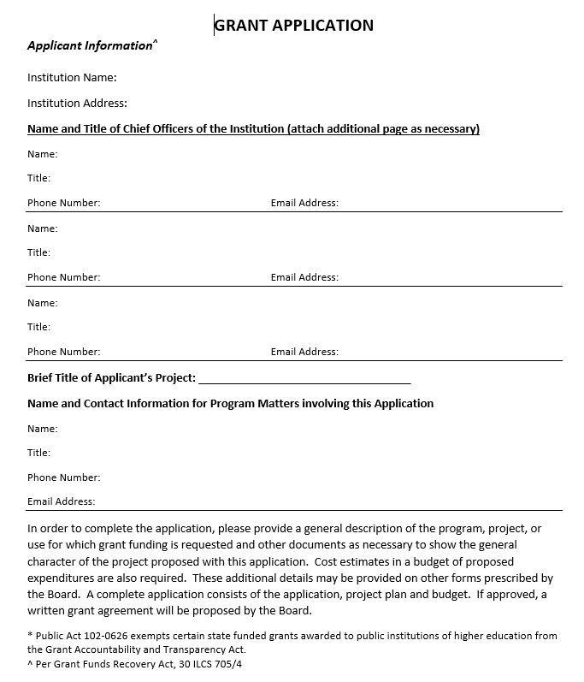
GATA-Exempt Grant Application

Slide 26
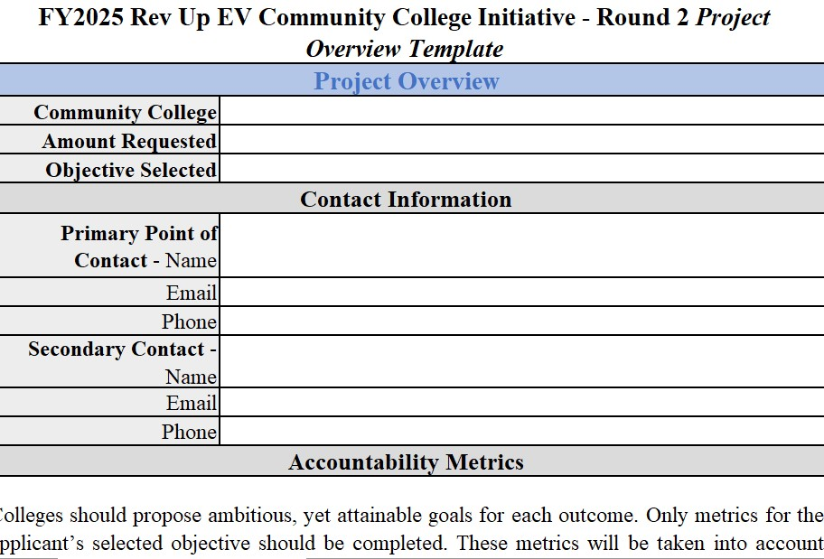
Project Overview Template Deep-Dive

Slide 27
Objective A: Capacity-Building Outcomes
A1. Anticipated number of students to be engaged in this grant project. This refers to students participating in career exploration activities; students enrolled in priority and eligible programs, students participating in eligible adult education bridge programs. For capacity-building grants, grantees will most likely not have students enrolled or may not intend to engage students in the planning phase. However, it is a best practice to engage students and elevate student voice when conducting a needs assessment and/or developing pathways.
A2. Number of programs that will undergo development, review, or revision. For capacity-building grantees, it is not expected that programs will be developed or offered; however, as a part of the planning phase, colleges should be able to identify the programs that they anticipate reviewing, revising, or beginning the development process. The number of programs identified should match that listed on the Program Offerings Chart.
A3. Number of employers engaged. Engagement means contributing to curriculum development and alignment activities, hosting work-based learning opportunities, donating equipment, hosting facility tours, participating in hiring events, hiring students.
A4. Number of education partners (high schools, four-year institutions) engaged in pathway development and alignment.

Slide 28
Objective B: Development and Expansion Outcomes
B1. Number of students to be engaged in this grant. This refers to students participating in career exploration activities; students enrolled in priority and eligible programs, students participating in eligible adult education bridge programs.
B2. Anticipated number of students to be enrolled in priority and related programs. Enrollment is defined as the number of full-time (considered 12 hours or more in a term or 24 hours or more in an academic year) and part-time students enrolled in priority and eligible programs.
B2a. Anticipated number of dual credit students. This metric is a subset of B2. Dual credit is defined in Section 1501.313 of the ICCB Administrative Rules. This is the anticipated number of dual credit students to be enrolled in priority and related programs. (Enrollment is defined as number of full-time and part-time students enrolled in priority programs).
B3. Anticipated number of completers. Students are considered completers for the purposes of this grant if they complete an eligible program in the academic year for which the grant is active. Completion means a student has completed a program that culminates in an industry-recognized credential (e.g. certificate, certification, degree). The count may be duplicated meaning, for example, that if a student completes a 16-week program in the fall semester and then transitions into another eligible program in the spring semester and completes, the student would be counted for two completions. The count will include students completing both credit and non-credit programs, that are on the eligible program list. All programs must be identified in the Program Overview Chart for approval by the ICCB. Completers may include students who began a program prior to the academic year for which the grant is being implemented. The grant program supports districts to implement activities that improve student retention.)

Slide 29
Objective B: Development and Expansion Outcomes Cont.
B3a. Anticipated percentage of completers who will be employed or be retained in postsecondary education two quarters after completion. This is a subset of B3.
B4. Number of programs to be developed.
B5. Number of programs to be revised or expanded.
B6. Number of employers engaged. Engagement means contributing to curriculum development and alignment activities, hosting work-based learning opportunities, donating equipment, hosting facility tours, participating in hiring events, hiring students.
B7. Number of education partners (high schools, four-year institutions) engaged in pathway development and alignment.

Slide 30
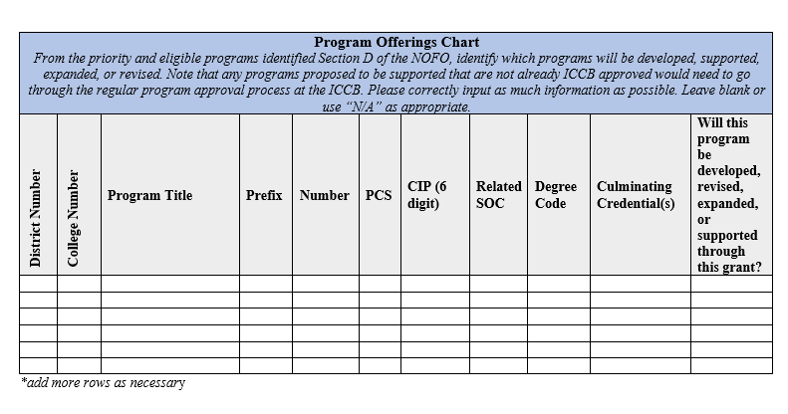
Project Overview Template

Slide 31
Application Narrative Deep-Dive
The applicant must submit a narrative of no more than twelve pages (charts and graphs are a part of the page limitation), double-spaced, 12-point font that must include the following information in the order listed below and utilizing a header for each Numbered Section.
Narrative sections apply to both Objectives unless otherwise noted.
Notes:
The most robust portion of your application where you should spend the most time.

Slide 32
Section I. Project Need and Context
Program Justification: Applicants should provide evidence for selection of the programs identified in the Project Overview, including but not limited to labor market information, listing of relevant employers, anticipated growth in accompanying occupations.
Financial Need: Identify the financial need for these funds.
Regional Context: Provide a description of the region and/or community to be impacted by the grant initiative. Describe anticipated impact on the region. Identify any projects happening in the region that this initiative could be aligned to and how you anticipate coordinating with these efforts (e.g. CEJA Workforce Hubs, federal or local EV initiatives, etc.).
For Objective B only, identify target population of students to be served (e.g., ethnicity, gender, socio-economic status of community, high school district). Applicants should use data as evidence for their selection. This may include but is not limited to dual credit availability and offerings, local unemployment rate, income status of community, racial and ethnic representation of the community being served.

Slide 33
Section II. Project Work Plan
Participation in EV Network: Activities should detail who will participate from your institution; what data will be collected and examined as a part of your needs assessment; and how will grantees internalize and share learnings from the EV Network with applicable partners?
Employer and Community Engagement: Activities should detail what partners will be engaged (and how) during the grant process; preliminary plan for conducting a needs assessment, inclusive of both labor market and community readiness; and any other activities that will contribute to grant goals regarding employer and educational partner engagement.
Pathway Mapping: Activities should detail what partners will be engaged in the pathway mapping; process for which collaboration will occur; and any other activities that will contribute to grant goals regarding education partner engagement, number of students enrolled (including dual credit students), and number of students retained or employed.
Build Capacity and Infrastructure: Activities may include updating existing programs/programs of study, purchasing or upgrading equipment to meet or exceed current industry standards, providing professional development and training to faculty and staff- including externship opportunities, creating partnerships and identifying efficiencies to maximize capacity.
Program Accountability: Activities should detail who is responsible for tracking progress against grant metrics; process for how the grantee will collect all data elements.
All other activities carried out under the grant to support the project goals.

Slide 34
Section II. Project Work Plan (continued)
For Objective B only- Develop, Revise, or Expand Programs: Activities should detail processes for which programs may be developed, revised, or expanded; what staff will be responsible for each step in the process; what partners will be engaged (and how); and any other activities that will contribute to grant goals regarding employer and educational partner engagement and number of programs to be developed or revised.
For Objective B only- Support Students Enrolled in Eligible Programs: Activities should detail the plan for providing support to students, including eligibility, intake, services offered; who is responsible for each activity; what partners are engaged (and how); and any other activities that will contribute to grant goals regarding number of students engaged, enrolled, retained, or employed.

Slide 35
Section III. Partnerships
Description of all partnerships and the role each partner will play in the grant project.
Required
Other Partners
  Employers
  High school districts/area career centers
  Labor organizations
  Local workforce boards
Other institutions of higher education
Community-based organizations
Adult education providers
Industry associations
Letters of Commitment must be included for all external partners for Objective B: Development and Expansion.

Slide 36
Section IV. Contingency Plan
Contingency Plan: Brief description of plan and budget in the event that the program plan must change, and funds are not able to be spent as defined in the original narrative and budget (e.g., unsuccessful in hiring Navigator A). No more than one page.

Slide 37
Letters of Commitment
Letters of Commitment/Support must be included for all external partners for Objective B: Development and Expansion.
MOUs and Charters specific to this project, with signatures will suffice.
Not needed for Objective A: Capacity-Building Submissions
Notes:
The most robust portion of your application where you should spend the most time.

Slide 38
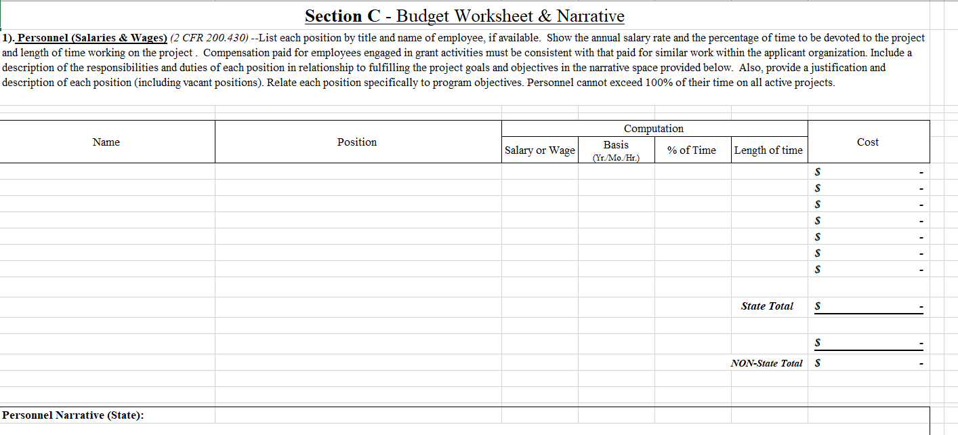
Budget
Notes:
The most robust portion of your application where you should spend the most time.

Slide 39
Budget
Budget should be signed by an authorized signatory.
No indirect cost rate cap.
For Objective B, Treat “Year 1” as the full grant period. Do not split your funding across multiple years on the budget (Section A).
What should we budget for?
  Travel
  Faculty/staff stipends, salaries, etc.
  Training and professional development for faculty and staff (some will be covered through I-GEN)
  Equipment purchases and upgrades; construction and renovation costs (although should not consume full budgets)
Expenses Discouraged: curriculum development costs (most covered through I-GEN); large portions of the grant dedicated to individual student costs

Slide 40
Important Dates
June-July: Grant Negotiations
July 1, 2024: Grant Start Date; Funds can begin to be expended
October 30, 2024: Quarter 1 Report Due to iccb.cte@illinois.gov
January 30, 2025: Quarter 2 Report Due
April 30, 2025: Quarter 3 Report Due
May 30, 2025: Budget Modifications/Extension Requests due for Obj. A
June 30, 2025: Capacity-Building Grant End Date
July 30, 2025: Quarter 4 Report Due
October 30, 2025: Quarter 5 Report Due (For B Grants Only)
November 30, 2025: Budget Modifications due for Obj. B
December 31, 2025: Development/Expansion Grants End Date
January 30, 2025: Quarter 6 Report Due (For B Grants Only)

Slide 41

Questions?
Pop them into the chat!
ICCB.cte@illinois.gov

