Slide 1
Data Center Curriculum Project Grant Informational Meeting
April 3, 2024
Whitney Thompson, Deputy Director for Workforce Education, ICCB

Slide 2
Purpose of informational webinar
To cover details of the Notice of Funding Opportunity
To answer questions as it relates to the Notice of Funding Opportunity
This session is being recorded. The slide deck and recording will be posted on the ICCB Grant Opportunities Webpage in 5 business days.

Slide 3
Funding Overview
Grant Period: May 15, 2024-June 30, 2025
Anticipated Number of Awards: 2-4
Total Program Funding: $1,000,000
Award Range: $250,000-$350,000
Cost Sharing/Match: Not Required
Applications Due: April 26, 2024

Slide 4
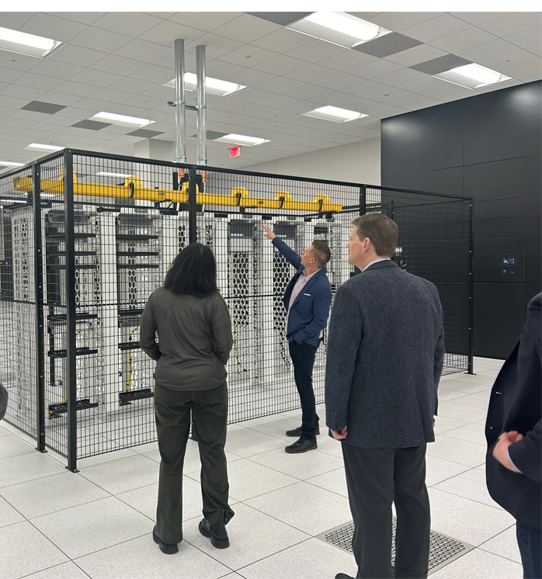
Purpose
To support the development of curriculum and programs that support the talent pipeline at Data Centers in the Chicagoland area, specifically data center operator.
Notes:
Chicago is becoming a secondary market for data centers. Northern Virginia, LA. The data center workforce supports about 2.9-3.5 M jobs annually and that each direct job in the data center creates about 6 jobs in the economy.

Slide 5
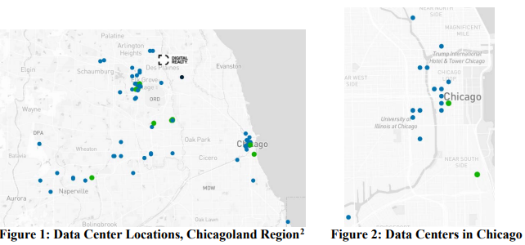
Background: DATA CENTERS
Data Centers are the physical facilities that house computing machines and related information technology infrastructure, such as servers and network equipment, and store the digital data demanded by users.

Slide 6
Background: DATA CENTER ROLES
Data Center Operators/ Technicians
Install, operate, monitor, and maintain critical equipment required to the keep the data center running
$25-$45 hour
Data Center Engineer / Critical Facilities Technician/ Shift Engineer
Operate and monitor the power and cooling systems that keep the data center operational
$35-$55 hour
Notes:
Mission critical roles

Slide 7
Background
The ICCB has been working in partnership with the Data Center Coalition, Chicagoland Chamber of Commerce, and various data centers in the Chicagoland region to design the Data Center Curriculum Project. Through this project, an employer-led advisory committee was developed to examine workforce and training barriers as well as identify solutions toward creating a seamless talent pipeline.
These determined solutions are to partner with community colleges to develop programming, modeled after the Northern Virginia Community College Data Center Operator program, to address these workforce needs as well as investing in the development and infrastructure buildout of required classroom and lab space.

Slide 8
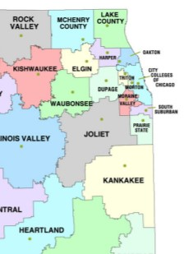
Advisory Committee membership
Community Colleges
ICCB
City Colleges of Chicago
Moraine Valley Community College
Harper College
Triton College
Northern Virginia Community College
Employer/ Employer Representatives
Iron Mountain
Data Center Coalition
Equinix
STACK
QTS
Chicagoland Chamber of Commerce
iMasons

Slide 9
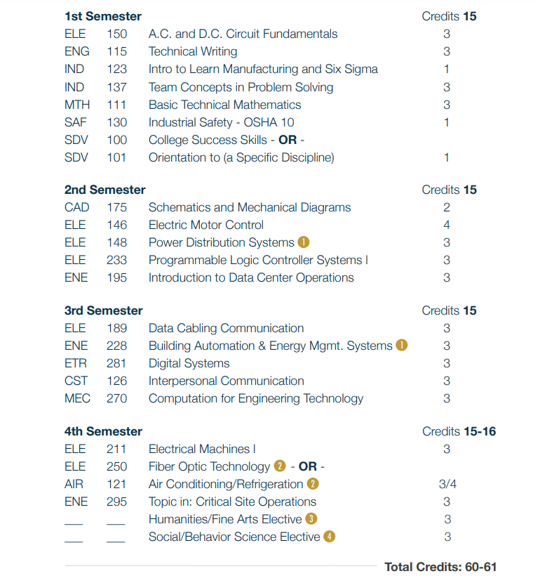
Required Activities
Curriculum Development: Create or modify existing curriculum, based on guidance from the Data Center Curriculum Project Advisory Committee, as well as local employers. Model curriculum will be based on NOVA’s Data Center Operator program.
https://www.nvcc.edu/academics/programs/data-center-operations.html

Slide 10
Required Activities
2) Procure Equipment: Purchase necessary equipment and secure adequate training space or facilities to carry out programming.
3) Advisory Committee: Actively participate on the Illinois Community College Board’s Data Center Curriculum Project Advisory Committee, which meets twice annually. The next Advisory Committee meeting is subject to meet in-person in November 2024.

Slide 11
Technical assistance
ICCB will be contracting with faculty and staff from NOVA to work with participating colleges on the build out of these programs.
Guidance and feedback from the Advisory Committee.

Slide 12
Application Submission

Slide 13
GATA-Exempt Grant Application

Slide 14
Application Narrative
The eligible applicant must submit a narrative of no more than four pages (charts and graphs are a part of the page limitation), double-spaced, 12-point font that must include the following information in the order listed below and utilizing a header for each Numbered Section.
I. Statement of Need:
Briefly describe the need of data centers in your district. Specifically, cite the need for data center operators, but adjacent or other careers that contribute to the growth of data centers may also be noted (e.g. engineers, project managers, sales representatives, various computer and information technology roles, cable and fiberoptic installers, security, and administrative roles).
Describe the extent to which the college has a relationship with various data centers in the district. Does the college have existing partnerships? What employers does the college intend to engage? Specific employers should be named. Colleges do not need to provide letters of commitment from various employers.
Identify any current programming that compliments the DCO program, including courses and faculty who would be available and qualified to teach DCO course.

Slide 15
Application Narrative Cont.
II. Work Plan: Clearly describe the projected activities, associated timeline, and person(s) responsible for each activity to be carried out during the grant period. A chart or table is encouraged. Please refer to the list of required and allowable activities that these grant funds can be utilized for.
The Work Plan should identify Grant Lead, faculty engagement, and specific employers.
All required activities of this grant must be addressed and clearly identified in the Work Plan. Because this grant will include significant leadership and guidance from the ICCB, advisory committee members, and NOVA, the ICCB understands that work plans submitted will be informed by this guidance and may be subject to change.
Applicants should clearly describe each program that will be built, supported, or expanded.
Applicants should describe their plan for staffing and instruction, including the need to hire or upskill current faculty for program implementation.
Activities where other partners are involved should include a brief description of the role each partner will play in the grant project.
III. Budget Narrative: In addition to the Uniform Budget Submission, provide a budget narrative.
Briefly describe the role of any staff/faculty being charged against the grant for personnel, fringe, or contractual/stipends.
Briefly describe the need for any equipment purchases. If specific purchases are unknown, but being budgeted for, describe the process for determining equipment and supply determination.
Applicants should tentatively plan for one in-state travel arrangement as well as a tentative visit to NOVA’s DCO program in Northern Virginia.

Slide 16
Uniform Budget
GATA Exempt, but still using Uniform Budget
Budget should be signed by an authorized signatory.
No indirect cost rate cap.
What should we budget for?
Travel (at least one in-person advisory com- Northern Virginia?)
Faculty/staff stipends, salaries, etc. for curriculum development
Training and professional development for faculty and staff
Equipment purchases and upgrades; construction and renovation costs

Slide 17
Submission Instructions
Submit To: Chris.Blankenhorn@illinois.gov
By: April 26, 2024 11:59 pm CST
Will receive notice of receipt by April 30, 5:00 p.m.

Slide 18
Questions?
Please contact:
Whitney Thompson
Whitney.Thompson@illinois.gov

Slide 19
Thank you!

