Slide 1


Slide 2
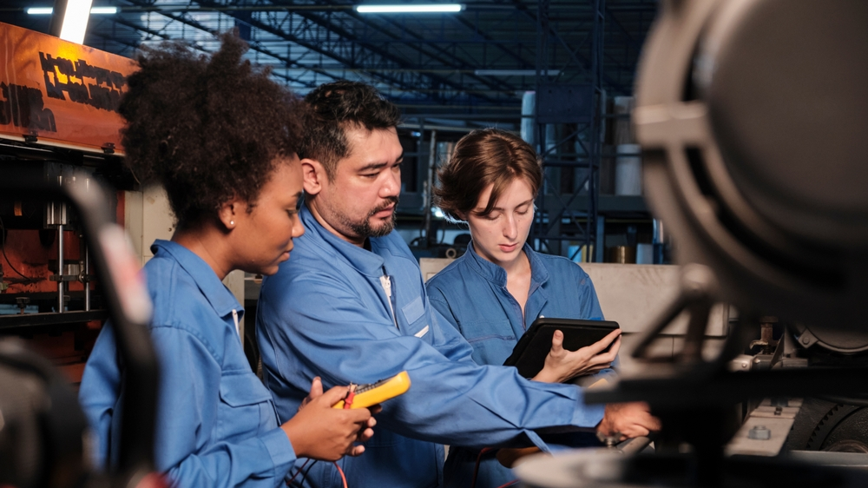
The Illinois Manufacturing Workforce Ecosystem will transform the Illinois manufacturing workforce through innovative, industry-aligned, and inclusive training across community colleges, credentialing 24,000 people
over 3 years for a $155 million investment

Slide 3

Why Illinois Manufacturing Workforce Ecosystem
Provides Innovation and High-Skill Credentials
Addresses Equity and Growing Poverty
Meets Manufacturers’ Need
Demonstrates the Impact of Community Colleges

Slide 4
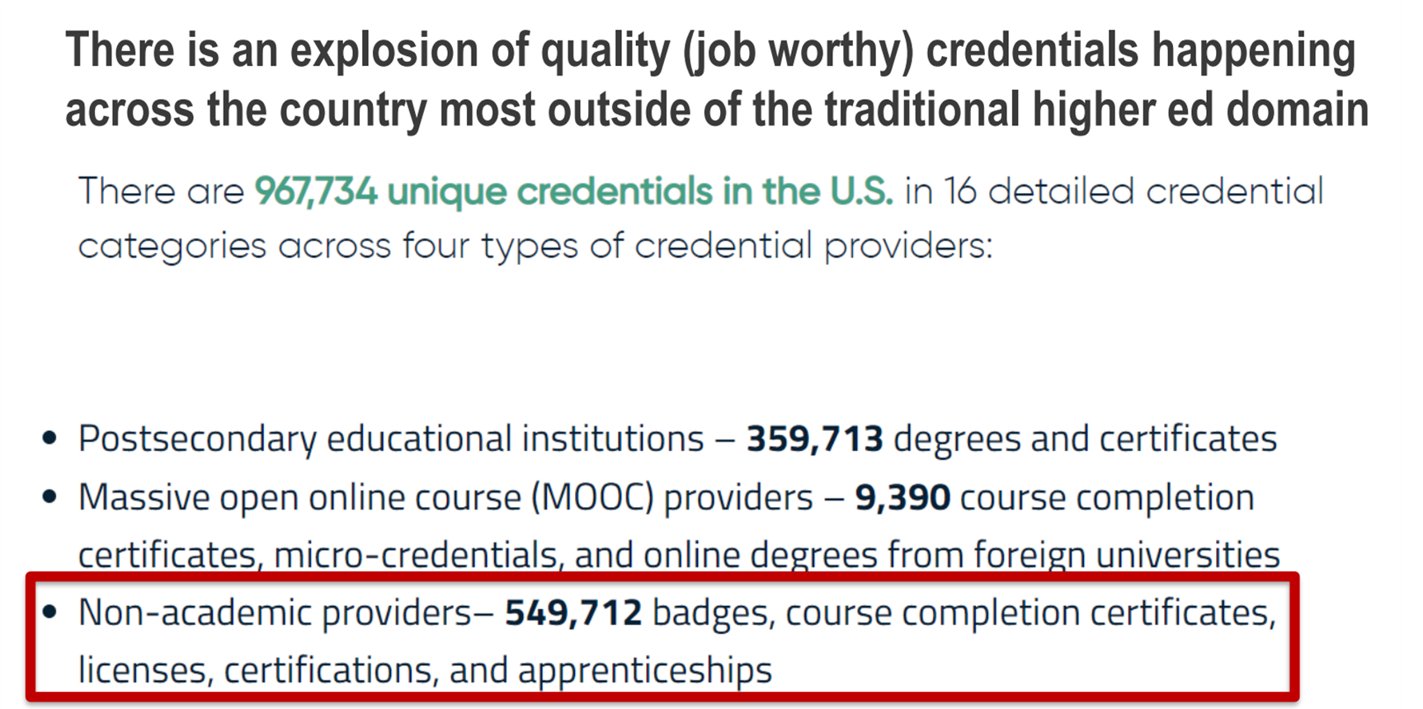
Trends Demonstrate Need For Innovation
Notes:
2021National Student Clearinghouse

Slide 5

Need for High-Skilled Credentials
Community Profile
Stagnant Poverty and Decreasing Population
High skill credentials have been the only effective method
for freeing families from generational poverty
while supplying employers with the required workforce.
NEED
Generally, 65% of jobs in Illinois require a credential past high school.
NOW
51% of adults have a high-skilled post-secondary credential.
Notes:
Without counting income supports, Illinois's poverty rate** increased from 11.5 percent in 2019 to 12.1 percent in 2021 and the Illinois child poverty rate increased from 15.5 percent in 2019 to 15.8 percent in 2021.Sep 16, 2022
Illinois ranked second in the nation for residents packing up and finding a new state in 2022, according to a survey by moving company United Van Lines. People moving out of Illinois made up 63.8% of total migration, meaning 36.2% of those moving were headed into the state. Jan 18, 2023
State of Illinois educational attainment percentage (those with a high-value certificate or greater) for 2023: 51.2%.
Associate's degree or higher: 45.5%
Estimate of population with a Certificate: 5.7
Total: 51.2%
To source these data, you can say, "Determinations based on Lightcast 2023-Q2 and US Census Bureau American Community Survey data. Educational Attainment data cover only the population aged 25 years or more and indicate the highest level achieved."
Georgetown University, Recovery: Job Growth and Education Requirements, 2020
chrome-extension://efaidnbmnnnibpcajpcglclefindmkaj/https://cew.georgetown.edu/wp-content/uploads/2014/11/Recovery2020.ES_.Web_.pdf

Slide 6

Address Equity and Poverty
Community Profile
49% of Illinois adults have no post-secondary credential
Multiple part-time jobs w/no benefits
No family-sustaining wages
No pathway out of poverty
All While Experiencing Record
Manufacturing Workforce Gaps

Slide 7
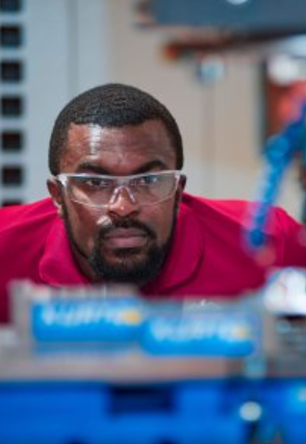
Manufacturers’ Needs
Reduce cycle time to completion
Provide Basic Skill Sets to Industry 4.0
Address workforce gap at scale
Increased credential entry points regionally
Standardized, industry aligned credentials
Embedded essential skills to ensure job readiness
Provide new and expanded modalities (competency based, bootcamps, pre/apprenticeships, and dual credit)

Slide 8

Demonstrate Community College Impact
Demonstrate we can:
Create an ecosystem to provide flexible methods, curricula, and schedules to meet industry standards and the requirements of Illinois manufacturers.
Resulting in:
Strengthened Manufacturers, Revitalized Regional Economies and Changed Lives
Proving that Workforce Development Investment in Community Colleges:
Can position Illinois as any industries state of choice by systemically addressing the workforce gaps by creating a consistent ecosystem for ongoing workforce support.

Slide 9
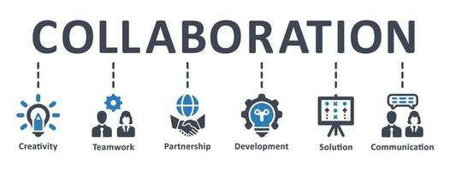
Collaborative Proposal Development
Guidance Manar and Torres
Over 50 professionals
4 Groups
  Curriculum
  Scheduling
  Partnerships
  Budget and Data
  Representing 24 Colleges and ICCB

Slide 10
Benefits
Award 24,000 manufacturing credentials with grant funded tuition.
Address manufacturing workforce gap at scale
Equity focus with at least 20% of individuals served being individuals of poverty with demographics to match district demographics receiving wrap around services to support engagement and completion.
Reducing cycle time to completion (8 weeks or less) with 5 starts a year scheduled regionally
Statewide access to industry aligned credentials in all regions
New and expanded modalities including competency-based training, bootcamps, pre-apprenticeships, apprenticeships and dual credit programs
Embedded essential (soft) skills competencies to ensure job readiness

Slide 11
Outcomes
  Credential 24,000 Illinoisans in manufacturing over 3 years significantly reducing the workforce gap and elevating 4,800 individuals out of poverty
  Establish statewide curriculum aligned with industry credentials leveraging in demand modalities along pathways
  Create an industry based agile ecosystem to systemically address workforce needs producing consistent, sustainable, impactful, cost effective and equity-based workforce solutions
  Demonstrate Community Colleges are Illinois’ premiere
  workforce development system and can deliver in ways and
  times that work for our students and industry

Slide 12

Five Key Audiences
High School Students
Recent H.S. Graduates
Uncredentialed and Unemployed/Underemployed
Incumbent Workers
Credentialed Career Changers
Five Key Audiences
Meeting Citizens
Where They Are
Meeting Citizens
Where They Are

Slide 13



Industry-Based Agile Ecosystem - Modalities
Competency-Based Curriculum
Statewide Curriculum Aligned with Industry Standards
Bootcamps - Face-to-Face or Blended with Job Schedules
Pre and Full Apprenticeships
Standardized, Interactive Online for Flex Scheduling

Slide 14

Industry Based Agile Ecosystem: Curriculum
Statewide Curriculum
Essential Skills/Social Emotional Learning
Micro Credentials
Stackable Credentials
Dual Credit
Credential Pathways Post Employment
Credential Pathways to Bachelors Degrees or Entrepreneurship

Slide 15

Industry Based Agile Ecosystem: Systemic Partnerships
Strategic, Documented MOUs between Community Colleges and:
Industry Organizations
Chambers
Labor Unions
High Schools
WIOA System
Economic Development Organizations
Community Based Organizations

Slide 16
Outcomes
Objectives | Target Outcomes
1. Enrollment | 1.1) 24,000 participants enrolled 1.2) 20% of participants are People of poverty with racial demographics proportional to each college’s district
2. Work-Based Learning | 2.1) xx internships 2.2) xx pre-apprenticeships and apprenticeships
3. Credential Completion | 3.1) 17,000 (71%) participants earn a credential (industry-recognized degree or certificate, credit or non-credit) 3.2) 20,000 credentials earned
4. Employment and Earnings | 4.1) 14,000 (82%) completers placed or retained in full-time jobs with benefits 4.2) 60% of completers earn > 30% above regional living wage 4.3) $2,000 average annual salary increase for upskilled incumbent workers (comparing pre- to post-credential)

Slide 17
Budget Items | Annually | Three-Year Project
State Workforce Realignment: WIOA process impacts, CBO Services Integration, Statewide Industry Input Structure, State levels MOUs with CBOs, Business/Industry Organizations and Unions, Embedded Equity Components, State-wide Outcomes Evaluation/Impact Study, Policy Reviews, Grant Administration, State workforce system recommendations. Implemented through ICCB and system consultants. | TBD | $5 million
Lead College and Regional Support: Exe Director and Lead College Staffing, Regional Support Staffing, Colleges Coaches, Professional Development, Common Industry Promotion and Outreach, College Level Program Evaluation, Initiative Convenings Implemented through Lead College, Regional Hub Colleges and ICCB . | $1 million | $3 million
Curriculum Design and Implementation: Development of Consistent State-wide Curriculum and Modality Delivery Solutions Including: Competency Based, Boot Camp, Online, Pre and Apprenticeships, and Credit for Prior Learning resulting in an implementation model for future industry verticals implemented by ICCB, Curriculum Consultants and Lead College. | $1 million | $3 million
College Funding: Annual average $1 million per college. Tuition support, Equipment, Books, and supplies, Wrap Around Services (for individuals of poverty tied to district racial demographics including stipends, childcare, and transportation), Placement, Advertising, Outreach, Program Staff, and Instructors. | $48 million | $144 million
Total Three-Year Investment |  | $155 million

Slide 18

Preparation for Program Launch
Over 50 CC professionals came together to create proposal
Approved by Illinois Council of CC Presidents
Statewide symposium to scale awareness and support
Support Letters from industry organizations and manufacturers
Legislative Strategy
Next level of curriculum, budget and scheduling detail
College level capacity planning
Ready to launch July 1, 2024

Slide 19
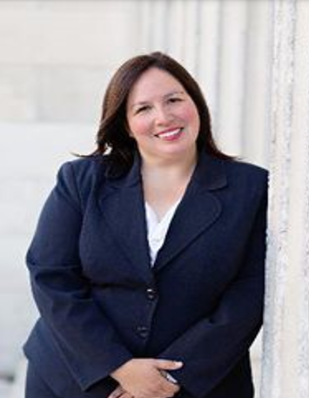


Building the Coalition
Senator Cristina Castro
Representative Jehan Gordon-Booth - Speaker Pro Tempore of the House
Illinois Manufacturers Association
Repositioning the community college role in workforce development

Slide 20

If we all row in the same direction, we will not only change the trajectory of individual lives, but also that of their families, while growing the workforce, manufacturers, increasing statewide economic vitality and demonstrating CC workforce impact.

Slide 21


Questions?
Feedback?

Slide 22



Revitalizing Manufacturing. Changing Lives.
Together.
Thank You!

