Slide 1
Ability to Benefit - Illinois' State-Defined Process
Module 1 – What is Ability to Benefit?
Notes:
Welcome to Module 1—What is Ability to Benefit?
This is the first in a four-part series of mini lectures on Ability to Benefit and the Illinois State-Defined process, which was approved by the US Department of Education in May of 2022.

Slide 2
Module 1 Agenda
ATB information modules
Defining Ability to Benefit
Institutional buy-in/Illinois completion agenda
College responsibilities
Student requirements under Alternative Plan
Notes:
In this module, you’ll get a broad overview of the purpose and conditions required to meet Ability to Benefit.
This module will introduce the core components of Ability to Befit and highlight the state’s alternative plan, connect Ability to Benefit to completion, and outline what is required of students and colleges.

Slide 3
ATB Module Overviews
Background – Module 1
Program Design
Student Eligibility
Required Student Services
Success Rate- Accountability
Data Collection and Reporting
Monitoring
Corrective Action
Termination Clause
Eligible Career Pathways – Module 4
Module 2
Module 3
Notes:
The ICCB has developed four information modules on Ability to Benefit and the Illinois state Alternative Plan.
For deeper dives into student eligibility, college accountability, and career pathways, see modules two, three, and four.

Slide 4
Ability to Benefit
Section 484(d) of the Higher Education Act (HES)
Student who has not received high school diploma or equivalent
Eligible for Title IV Federal Student Aid
Career pathway
Notes:
First, some background on Ability to Benefit.
Ability to Benefit (ATB) is a provision in the Higher Education Act (HEA) that allows a student who has not received a high school diploma (or its recognized equivalent) to be eligible for Title IV Federal student aid, if they meet all other eligibility requirements for aid and are pursuing an eligible career pathway.
For institutions currently implementing ICAPS programs, Ability to Benefit is a natural fit to help students who may need assistance in covering tuition costs.

Slide 5
How Students Qualify for Ability to Benefit (ATB)
Requirements (all options) | Option 1 - test | Option 2 – 6 credits | Option 3 – state-defined process
Must be beyond the age of compulsory education (Can not be dual credit student) | All requirements AND achieve a pre-determined score on an US Dept. of Education approved test. | All requirements AND successfully complete 6 credit hours of college level course work. | All requirements AND follow Illinois’s State Plan
Must demonstrate financial need
Have a valid SSN
Must be a US Citizen or eligible non-citizen
Must be enrolled in an eligible degree or certificate program
Notes:
In order to gain eligibility for Federal student aid through ATB, a student who has no high school diploma must meet the Federal aid eligibility requirements in column one and complete one of 3 ATB options for eligibility featured in columns 2, 3, and 4.
Option 1: The student receives a passing score on one of the Department of Education approved ATB tests.
Option 2: The student completes at least 6 credit hours or 225 clock hours that are applicable toward a Title IV-eligible degree at the college.
Option 3: The college participates in the State’s process approved by the Secretary of Education.
ATB options 1 and 2 are not new, but they tend to be underutilized.
Developing an alternative state defined process aims to increase access to federal financial aid for eligible adults without a high school diploma.

Slide 6
Ability to Benefit Working Group
Angela Gerberding, ICCB
Whitney Thompson, ICCB
Kathy Olesen-Tracey, ICCB
Lisa Jones, DCEO
Andrea Puckett, IECC
Richard Hayes, CCC
Maureen Fitzpatrick, CCC
Lauren Hooberman, CCC
Carmela Ochoa, MVCC
Kerry Urquizo, HCC
Jamil Steel, LLCC
Alison Mills, LLCC
Christina Manchen, RLC
Cheri Rushing, RLC
Ginger Harner, SCC
Chris Warden, Women Employed
Sarah Goldammer, SIPDC
Peggy Heinrich, ECC
Vicky Garcia, PSC
Bianca Perkins, BHC
Notes:
In 2019, the ICCB conducted a survey to understand ATB implementation in the community college system. The survey found that 19 institutions were implementing ATB in limited circumstances. The two most frequently cited reasons for not utilizing ATB were lack of knowledge of who qualified and that the current provisions were too limited.
From this information, it was determined that an Alternative State-Defined Process could enhance ATB implementation in Illinois.
The ICCB convened a working group of community colleges interested in shaping the state’s Ability to Benefit alternative plan.
From this work, the group identified recommendations for implementing the plan and supporting colleges.
This series of informational modules is part of those implementation recommendations.

Slide 7
Institutional Buy-in for ATB
Increase student access to federal financial aid
Increase postsecondary credential and degree completion
Increase enrollment & revenue
ATB and the Illinois completion agenda
Notes:
So, why should you do ATB at your institution? There are four primary reasons.
First, ATB increases student access to federal financial aid:
Second, ATB increases postsecondary credential and degree completion
Third, ATB increases program enrollment and revenues, increasing student volume in approved career pathways.
Finally, ATB is a strategy to help colleges meet the Illinois completion agenda.

Slide 8
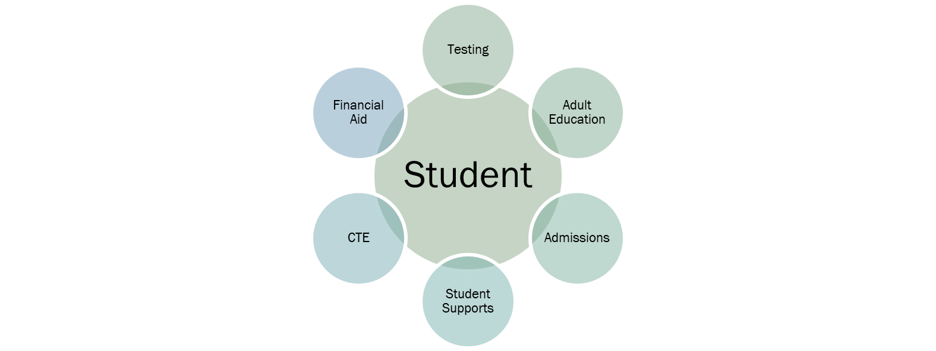
Partnerships for ATB Alignment
Industry partners
Local organizations
Community College
Notes:
For Ability to Benefit to be successful, it requires collaboration across the college and with the workforce system in your region.
Although it’s necessary to have a designated ATB champion to organize the players, no single person can implement ATB alone.

Slide 9
College Responsibilities in ATB
Documentation
Assessment
Wrap around services
Eligible career pathway
Notes:
There are four components colleges need to manage for successful ATB programs:
Documentation
Annual Implementation Reports due August 30 each year, summarizing program outputs and submitting data to demonstrate a success rate that is within 95% of the success rate of students with high school diplomas
Assessment
An assessment utilizing multiple measures is required in the state’s alternative plan. This may include GED practice tests, instructor referrals, HSE and ESL assessments, and writing samples.
Wrap around services
Services must be multi-faceted and holistic in their approach
And all ATB students must attend an orientation to become familiar with college policies and processes
Please note: The orientation required by ATB is not the general orientation the college offers to new students. All ATB students must attend a specialized ATB orientation on the specifics of utilizing Ability to Benefit.
Eligible career pathway criteria will be featured in Module 4, but let’s look at eligible career clusters and career pathway components on the next few slides.

Slide 10
Eligible Career Clusters
1. Agriculture, Food, and Natural Resources
2. Arts (Performing and Visual), Audio/Video Technology and Communications
3. Business Management and Administration
4. Finance
5. Marketing
6. Hospitality and Tourism
7. Transportation, Distribution, and Logistics
8. Education and Training
9. Government and Public Administration
10. Law, Public Safety, Corrections, and Security
11. Human Services
12. Health Sciences
13. Information Technology
14. Architecture and Construction
15. Manufacturing
16. STEM
17. Energy
Notes:
Illinois has identified 17 Career Clusters in the Illinois State Perkins V Plan.
But does this mean that your program is eligible?
To determine this, you need to answer a few questions:
Does the program you’ve selected algin with one of the career clusters on this slide?
Does the program you’ve selected currently have Title IV Financial Aid eligibility? It’s best to confirm this with your Financial Aid officers. Some shorter certificates may not be eligible. Don’t guess. Use the resources at your institution.
Once you’ve confirmed that your career program is in one of the allowable clusters, you need to ensure that it is a complete pathway.

Slide 11
Career Pathway Components
Aligns with industry needs
Range of options
Counseling
Education contextualized and concurrently
Wrap around services
Enables secondary diploma attainment
Enter or advance in career cluster
Notes:
“Career pathway” means a combination of rigorous and high quality education, training, and other services that – aligns with the needs of industry and prepares and individual to be successful in a range of post secondary work options.
Pathways include wraparound services and contextualized instruction, and they enable an individual to attain a secondary school diploma or its equivalent, and at least 1 recognized postsecondary credential.

Slide 12
Student Eligibility for Alternative Plan
Adult learner
Meets all other eligibility criteria for federal financial aid
Does not meet original ATB criteria
Ideal candidates:
are enrolled in an Early School Leaver Transition or an ICCB approved Alternative Methods of Credentialing for High School Equivalency programming OR
have successfully completed a Bridge Program within Adult Education.
Notes:
For students to be eligible for the state’s Alternative plan, they must meet several requirements:
First, they must be adult learners, that is, be beyond age of compulsory education. For this reason, ATB cannot include students in dual credit or students who otherwise should be enrolled in K-12 education
ATB students must meet all other eligibility criteria for federal financial aid (such as demonstrate financial need, have a valid SSN, be a US citizen or eligible non-citizen)
Alternative plan students don’t meet original ATB criteria, of passing a single ATB exam or completing six hours towards a certificate or degree.
For the alternative plan, ideal candidates:
are enrolled in an Early School Leaver Transition or an ICCB approved Alternative Methods of Credentialing for High School Equivalency programming OR
have successfully completed a Bridge Program within Adult Education.

Slide 13
Module 1 Summary
Defined Ability to Benefit
Institutional support
College responsibilities
Student requirements under Alternative Plan
Notes:
Wrapping up Module 1, you’ve learned a broad overview of the purpose , conditions required, and core components of Ability to Befit particularly in the state’s alternative plan.
These topics will be the subjects of subsequent modules: two, three, and four (next slide).

Slide 14
Visit Our Other Modules
Module 2: ATB Program Design
Module 3: Data Collection & Reporting
Module 4: Eligible Career Pathways
Notes:
With Module Two looking at:
Program Design
Student Eligibility
Required Student Services
Module Three looking at:
Success Rate- Accountability
Data Collection and Reporting
Monitoring
Corrective Action
Termination Clause
And Module Four looking at:
Appendix B: Eligible Career Pathways

Slide 15
Resources
Important Links
Questions?
USDOE ATB FAQ
CLASP ATB Resources
ICCB ATB Resources
Illinois’ Letter of Approval, from Dept. of Education
ICCB ATB Resource Guide, coming in Fall 2023
Contact: Whitney Thompson, Deputy Director for Workforce Education, whitney.Thompson@illinois.gov
Angela Gerberding, Director for Work-Based Learning, angela.gerberding@illinois.gov
Notes:
Please reach out to us if you have questions about Ability to Benefit and the Illinois Alternative State Plan. We’re here to help and want you to be successful in your implementation.
Thanks for watching. See you in Module 2!

