Slide 1
Tips for Submitting a Grant in Euna
Angela Gerberding, ICCB
September 8, 2026

Slide 2
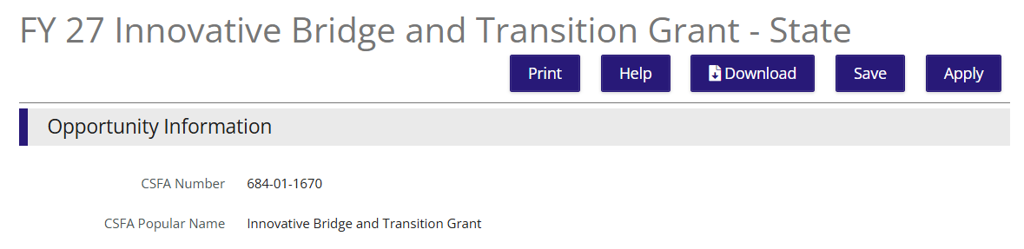

Steps to Submit
Get access to Euna. This happens from your home entity. ICCB does not have the ability to grant access or change passwords.
Use the link from the NOFO - https://il.amplifund.com/Public/Opportunities/Details/89bf2754-c540-4d22-84f7-ce0711c0360f
Click on Apply

Slide 3
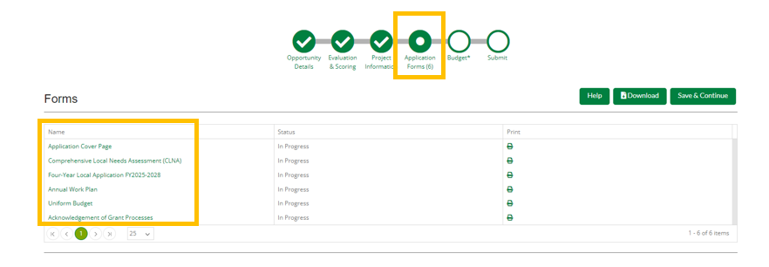
Steps, continued
Click on “Public Account” and enter the credentials provided by your home entity.
From here, you should land on a page with blue targets across the top of the page. The first page should be the “Opportunity Details” page.

Slide 4
More Steps
At the bottom of each Target area, are 3 green buttons – Save, Mark as Complete, Save and Continue. Each section must be marked as complete in order to get the green check mark at the top.
In the Forms section, click on each form listed. Follow the directions. Most have a document that will need to be downloaded, completed, and upload.
NOTE: Euna does not check for accuracy, completion, format, or signature. That is the applicant’s responsibility.

Slide 5
Even more steps
All bullets at the top MUST have a green check mark before you submit. If any check marks are missing, click on that bullet, review that all information is included and then click on the “Mark as Complete” button at the bottom of the page.
There is one target in the process called “Planned Performance Plan.” There is nothing to do in that section. We have noted in that section explaining that. It was a step built in by Euna can not be remove. Do not panic! There really is nothing to do in that section.
Euna is great about giving red dialogue boxes for errors or blue boxes for success.
The final green target is “Submit.” Once you hit submit, you can not make any changes.

Slide 6
Other Information
Application due date and time are not flexible – October 2, 2026, by 5:00 pm. The system will not accept applications at 5:01 pm. DO NOT WAIT until 4:45pm to submit in case you have problems. Applications will not be accepted outside of Euna, so do not email us at 4:59pm with your application. It will not be scored…and not funded!
On each screen, there should be a small “i” n the top right corner. When you click on that, you can send an email to the Euna help desk directly.

Slide 7
More Information
If you have questions about the grant specifically, email those questions to iccb.ibt@illinois.gov and that question will be added to the FAQ on the ICCB website - https://www.iccb.org/grant-opportunities/
Reminder there is a new process for our FAQ document.
If you have questions or problems within Euna, send those questions directly to the Euna Helpdesk. ICCB staff does not see the same screens as grantees so we cannot help troubleshoot issues. On this site (https://il-amplifund.zendesk.com) Euna has many resources that can be accessed by grantees to help with the application process as well.

Slide 8
Budget Information in Euna
There are 2 formats of budgets in Euna that are REQUIRED by each applicant.
#1 - The Excel template is the same that has been used before with IBT. In this, applicants need to include detail about how money will be allocated for each line and provide a budget narrative at the bottom of each tab. This is the one that will be downloaded, completed, and uploaded into Euna. This template is located in the “Forms” section of the application.
#2 – Euna budget. For this budget you need to list general dollar amounts per line. This will be built as you go through Euna as a step in the application process. This is the section following the “Forms” section.
Example:
Excel Budget - $20,000 in personnel line. This needs broken out as Janelle $8,000, Angela $8,000, and Rupa $4,000 with details about each.
Euna Budget – in the personnel line. Applicants should enter “personnel total” for $20,000.
Both of these overall budget totals should match! Again, Euna does not check for completeness and accuracy. That is the applicant’s responsibility.

