Slide 1

FY2026 Noncredit Strategies at Work (NSAW) Grant
Lavon Nelson, Senior Director for Workforce Education
Alex Weidenhamer, Director for Workforce Training

Slide 2
AGENDA
Welcome and Introductions
Please be sure to sign-in to the chat with your name and college!
Grant Overview
PowerPoint and recording of today’s meeting will be made available.
Questions and Answers
As a technical assistance session, feel free to ask questions during the presentation for us to answer.

Slide 3


Funding Overview
A total of $4.84M has been appropriated from the general revenue fund to the ICCB to administer grants that support:
  Noncredit training
  Business solution initiatives
Only one grant application per community college.
Maximum amount per grantee: $110,000
Grant period
  January 1, 2026-December 31, 2026
This is a non-competitive funding opportunity.
Applicants may subcontract for services that enhance program services or reduce barriers for eligible employers or students.
Internal collaboration is highly encouraged.

Slide 4

Target Entities
This grant is intended to provide noncredit training services to:
  Employers by provide business solutions and other training needs.
  Individuals 18 years or older leading to employment in high skill, high wage, and in-demand occupations, with an emphasis on those underserved by education and workforce systems.
  Incumbent workers, by working directly with local employers, to provide specialized training or upskilling.

Slide 5

Grant Objectives and Activities

Slide 6
Objectives
  1. Expand Noncredit Program Offerings: Colleges should aim to prioritize significantly in-demand and emerging occupations for programming built, expanded, or supported through this grant.
  2. Offer Business Solutions to Employers: In addition to customized training, community colleges offer a suite of business solutions to employers.
    Examples of business solutions include quality and safety audits; training workshops relevant to leadership, essential employability skills, and Diversity, Equity, Inclusion, and Access; contract procurement assistance, etc.
    Colleges should prioritize small businesses (500 employees or less) as well as minority or woman- owned businesses for these business solutions.
  3. Increase Affordability of Noncredit Training for Students, particularly those who are low income, un- or underemployed, and or otherwise underrepresented in the sector in which training is be offered.
    Activities may include offsetting costs of training, creating noncredit apprenticeship programs, and increasing efficiencies to sustain affordability.

Slide 7
Required Activities
Offer Noncredit Training
  Colleges are required to utilize grant funds for noncredit training.
  This must not supplant current offerings.
  Funding should be utilized for new training and or expanding current offerings.
  Training can include customized training for incumbent workers and/or training for new entrants to the workforce that culminates in an industry-recognized credential.
  Training must be for an in-demand or an emerging field.
Notes:
This activity is the main activity and contributes to ALL of the grant outcomes. This is where we intend to see the bulk of the funding being spent.

Slide 8
Required Activities
2. Articulate Noncredit to Credit Transitions
  Colleges must identify at least one noncredit offering to articulate/map a pathway and/or process for students to transition from noncredit to credit without duplicating courses or competencies.
  The ICCB will provide technical assistance in this area via the designated NC-C consultant.
    Technical assistance will include webinars, individual consultation, and creation of NC-C resources.

Slide 9
Required Activities
3. Noncredit Data Collection
  Colleges should utilize grant resources to bolster their collection and tracking of noncredit data elements, including upgrading of systems, staff capacity, etc.
  The ICCB will work with colleges over the grant period to identify additional data elements that will be added to the N1 Collection.
*Other allowable activities can be found on Pg.5-6 of the NOFO: https://www.iccb.org/grant-opportunities/
Notes:
CPR trainings should be built into larger programs.

Slide 10

Grant Goals and Outcomes

Slide 11
Grant Goals and Outcomes
  Participant-Level Outcomes:
  Number of noncredit students to be trained
  Percentage of noncredit student completers employed two quarters after completion
  Programmatic Outcomes:
  3) Number of employers to be served
  4) Number of noncredit training programs offered
  5) Number of new services/programs provided to employers (from X to Y)

Slide 12
Grant Goals and Outcomes, cont.
Other information that will be collected on a quarterly or annual basis:
Employer names
  Identify if employer is minority or woman- owned business
  Industry sector by employer
Services provided to employers by program (general description)
Training program names
Certificates and/or credentials completed by students
Student demographics

Slide 13
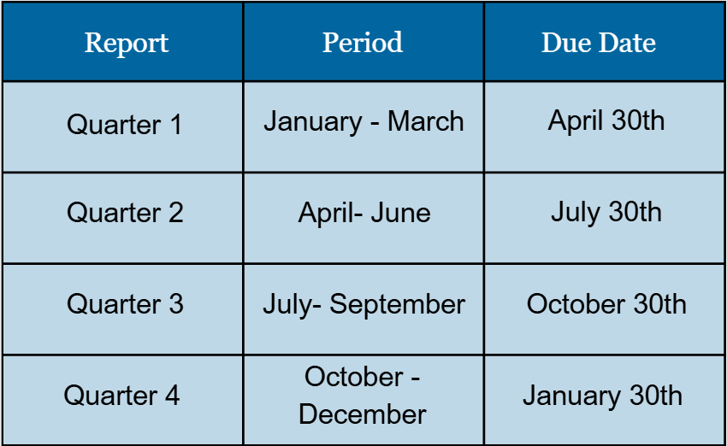
Grant Deliverables
Carry out deliverables of the proposed scope of work as aligned with the objectives of this opportunity.
Carry out and participate in all required activities.
Attend operational meetings as scheduled throughout the year, as well as participate in other meetings, as requested.
Submit one success story for an employer and one success story for a student by February 28, 2027.
Submit required programmatic and fiscal reports on a quarterly basis per the schedule.
Reporting templates and other instructions will be made available to grant recipients at an additional meeting.
  Reporting and data collection will be addressed during this meeting.

Slide 14

Application Package

Slide 15
Overview
Applicants:​
  Must include all parts of the application package in the submission.​
  Must complete and submit the application by the deadline. ​
  September 24, 2025, by 5:00 pm CST​
  Must use the templates provided.​
  One application per institution.​
  Submit to: ICCB.Noncredit@illinois.gov.
Application packet must include a(n):​
  GATA-Exempt Grant Application
  Project Overview (template)​
  Application Narrative​
  Uniform Budget​

Slide 16
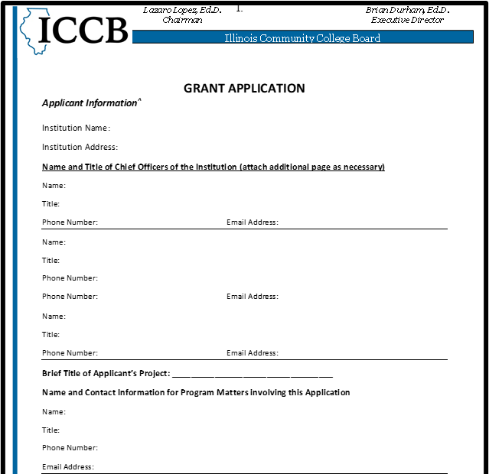
Application Packet
1. GATA-Exempt Grant Application
  Applicants must complete each section of the “Applicant Information” section in the GATA-Exempt Grant Application in its entirety.
  NA, for questions not applicable.
  A template is provided on the ICCB Grant Opportunities webpage.
2. Project Overview (Template)
  The applicant must complete the Cover Page and Application Summation Template (template provided) which encompasses applicant information and a synopsis of the application, including but not limited to:
    Summary of the programs and activities
    Grant Outcomes
  ICCB Templates: https://www.iccb.org/grant-opportunities/

Slide 17
Application Packet, cont.
3. Application Narrative
  The eligible applicant must submit a narrative of no more than 5 pages (charts and graphs are a part of the page limitation).
  Double-spaced, 12 pt font
  Must contain all necessary narrative sections.
4. Uniform Budget
  All applicants must submit a proposed budget on the State of Illinois Uniform Grant Budget Template (template provided).
  Applicants should submit budgets based upon the total estimated costs for the project.
  No cost sharing or matching is required.
  ICCB Templates: https://www.iccb.org/grant-opportunities/
  Please complete the budget narrative for each category and line item and ensure that it is detailed.

Slide 18
Narrative Sections
I. Statement of Need: Briefly provide the justification for the selection of programs to be supported (e.g. industry focus, labor market information, etc.).
II. Work Plan: Clearly describe the project activities, associated timeline, and person(s) responsible for each activity to be carried out during the grant period. A chart or table is encouraged. Please refer to the list of required and allowable activities that these grant funds can be utilized for. Activities should align with the objectives and should aim to move the needle on your grant goals.
All required activities of this grant must be addressed and clearly identified in the Work Plan. Because of the nature of employers’ changing needs, the ICCB understands the need for flexibility and broad timelines.
  Offer Noncredit Training
  Articulate Noncredit to Credit Transitions
  Noncredit Data Collection
Applicants should clearly describe each program that will be built, supported, or expanded.
Activities where other partners are involved should include a brief description of the role each partner will play in the grant project.

Slide 19
Narrative Sections, cont.
III. Impact: Description of the benefits and impact of the project on your institution, community, employers, and students.
IV. Scalability and Replicability: Description of how the various activities could be scaled or replicated by others in the State. All resources and products developed with grant funds will be provided from the grantee to the ICCB to share with the field.
  The Application Narrative submitted under this NOFO should be organized, clear and understandable. Use of charts and bullets are welcomed.

Slide 20
Important Reminders
All parts of the application package must be completed by the deadline to be considered.
Applicants should ensure that all elements are clearly addressed and are strongly encouraged to use headers to address all elements or some consistent form of response delineation.
Applicants will receive a receipt of application. However, applicants will not be notified if there are items that are missing from their application.
Applicants must use the templates on the ICCB website: https://www.iccb.org/grant-opportunities/
Paper copies of the application are not permitted.

Slide 21

Funding Deadlines
Grant funds must be obligated by the end of grant period.
Good/products must be ordered by the end of the grant period/received by 60 days after the end of the grant period.
Services must be rendered by the end of the grant period.
Grant funds must be liquidated 60 days after the end of the grant period.
Final budget modifications are due 60 days before the end of the grant period.

Slide 22

Questions and Answers
Additional Questions can be sent to:
State-Awarding Agency Contact
Alex Weidenhamer
alex.weidenhamer@illinois.gov
Director for Workforce Training
Illinois Community College Board
401 E. Capitol Ave.
Springfield, Il 62701
217-558-5671

