Slide 1
SPRING 2024
ILLINOIS COMMUNITY COLLEGE OPENING ENROLLMENT
Nathan Wilson
ICCB Deputy Director for Research and Information Technology
March 22, 2024

Slide 2
Illinois Community Colleges Spring Term Opening Enrollment Headcount
+12,802
Data Source: ICCB Spring Illinois Community College Opening Enrollment Survey

Slide 3
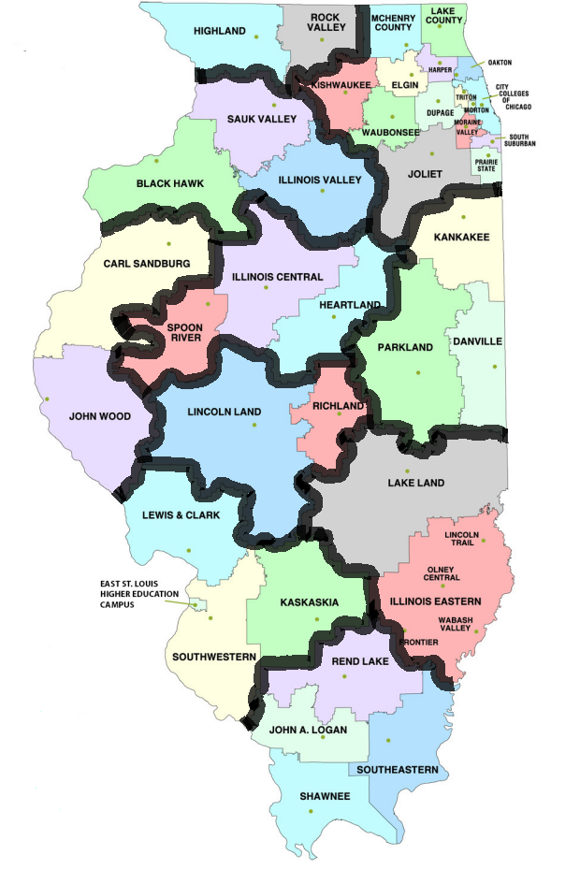
Spring 2024 Enrollment and Proportion of State
Enrollment by Region
Northern Stateline
7,715 (2.9%)
Northeast
181,258 (69.0%)
The ten geographic groupings in the map are closely aligned with the ten Illinois Economic Development Regions.
The Northeast region (with the greatest Illinois population density) has the most enrollments with more than 2/3rd of the Illinois community college student population.
The remaining geographic areas range in proportion of total student population from 1.3% in West Central to 6.4% in the Southwestern region.
Northwest
7,456 (2.8%)
North Central
13,602 (5.2%)
West Central
3,380 (1.3%)
East Central
7,498 (2.9%)
Southeastern
9,439 (3.6%)
Central
8,268 (3.1%)
Southwestern
16,840 (6.4%)
Southern
7,182 (2.7%)
Data Source: ICCB Spring Illinois Community College Opening Enrollment Survey

Slide 4
Illinois Community College Spring 2023 to Spring 2024 Enrollment % Change by Region
Northern Stateline
+ 1.2%
Enrollment shifts from Spring 2023 to 2024 increased in 8 of ten 10 regions.
The region with the highest increase was Southwestern at +8.6% which consists of Kaskaskia, Lewis and Clark, and Southwestern.
City Colleges of Chicago, the Illinois community college district with the largest enrollment (39,432 in Spring 2024), experienced an increase of +9.2% as compared to Spring 2023.
36 of 48 community colleges had an increase from Spring 2023 to Spring 2024.
Northeast
+ 5.6%
Northwest
+ 5.8%
North Central
+ 4.7%
West Central
+ 3.5%
East Central
+ 6.3%
Southeastern
- 4.2%
Central
+ 8.3%
Southwestern
+ 8.6%
Southern
- 0.2%
Data Source: ICCB Spring Illinois Community College Opening Enrollment Survey

Slide 5
Illinois Community Colleges with + 10% Spring to Spring Change, Reasoning for Growth
Growth in dual credit offerings.
Increasing advertisement, outreach, and engagement events.
Strengthening student success initiatives such as onboarding, advisement, and academic support to increase retention and completion.
Expansion of programs offerings and more varied modalities of courses.
More streamlined pathways and offerings for Adult Education students (students with less than a high school diploma and English as a Second Language students).

Slide 6
Spring Student Enrollments by Instructional Area in Illinois Community Colleges
Data Source: ICCB Spring Illinois Community College Opening Enrollment Survey

Slide 7
Spring Student Dual Credit Enrollments in Illinois Community Colleges
Data Source: ICCB Spring Illinois Community College Opening Enrollment Survey
Notes:
Growth over three years:
Proportion of student population.
For Dual Credit, which allows academically prepared high school students to simultaneously earn credits that count toward a high school diploma and a college degree, headcount enrollments increased 10.4 percent in Spring 2023 compared to Spring 2022 and increased 23.9 percent from two years ago.
35 of our 48 community colleges experienced growth from the previous year.

Slide 8
Spring Student Online Course Enrollments in Illinois Community Colleges
Data Source: ICCB Spring Illinois Community College Opening Enrollment Survey
Notes:
While the number of distance education course enrollment (seat count in courses) decreased in Spring 2023 as compared to the previous year and substantially from heigh of the pandemic when many some campuses were closed and there were limited f2f courses available, it remains a prevalent and flexible form of course delivery with 207,858 online course enrollments in the current Spring.
When looking at growth across they system from 2019, 43 of the 48 colleges have experienced growth with the median growth being 61 percent.

