Slide 1
An Overview of the Illinois Community College System funding Formulas
Jennifer Franklin, Deputy Director for Finance and Operations
Illinois Community College Board

Slide 2
System Grants
UNRESTRICTED GRANTS
Distributed for the general operations of the colleges.
Base Operating
Equalization
Small College Grants
Performance-Based Funding
Illinois Veterans/ National Guard

Slide 3
System Grants
RESTRICTED GRANTS
Distributed to the system for special activities.
Adult Education & Literacy
Career & Technical Education
Special Initiatives
*CURES/CARES/CRSSA/ARPA
*Innovative Bridge & Transition
*Workforce Equity Initiative
*Early Childhood Education
*PATH

Slide 4
Base Operating Grants
Base operating grants are unrestricted funds disbursed to community colleges based on credit hours generated in six reimbursable instructional categories.
Base Operating Grants formula =
Funded Credit Hours x Effective Credit Hour Rate

Slide 5
Base Operating Grants
Funded credit hours - Greater of most recent FY certified unrestricted credit hours, or 3-year average.
Credit hour rate - Instructional cost per credit hour, adjusted for inflation*; Less district tuition & fees, and local tax revenue.
Effective credit hour rate – Proration factor applied to the net reimbursable credit hour rate as necessary to equal State appropriations.
*Inflationary adjustments are necessary due to the two-year lag in data.

Slide 6
Base operating grants
CREDIT HOUR GRANT RATES BY CATEGORY FOR FISCAL YEAR 2023
 | Baccalaureate | Business | Technical | Health | Remedial | ABE/ASE | Totals/ Averages
FY2021 Unit Cost | $ 422.57 | $ 456.97 | $ 430.15 | $ 572.29 | $ 300.81 | $ 443.01 | $ 431.56
FY2022 Weighted Cost | $ 505.36 | $ 546.50 | $ 514.43 | $ 684.41 | $ 359.75 | $ 529.81 | $ 516.11
Less:
Tuition & Fees | $ 149.03 | $ 149.03 | $ 149.03 | $ 149.03 | $ 149.03 | $ - | $ 124.19
Local Tax Revenue | $ 193.16 | $ 193.16 | $ 193.16 | $ 193.16 | $ 193.16 | $ 193.16 | $ 193.16
Total | $ 342.19 | $ 342.19 | $ 342.19 | $ 342.19 | $ 342.19 | $ 193.16 | $ 317.35
Credit Hour Rate | $ 163.17 | $ 204.31 | $ 172.24 | $ 342.22 | $ 17.56 | $ 336.65 | $ 198.76
State Adjustment* | $ (125.69) | $ (157.38) | $ (132.68) | $ (263.61) | $ (13.53) | $ (259.32) | $ (153.11)
Effective Credit Hour Rate | $ 37.48 | $ 46.93 | $ 39.57 | $ 78.61 | $ 4.03 | $ 77.33 | $ 45.66
*Proration factor applied to meet State appropriation.

Slide 7
Base Operating Grants
 | Baccalaureate | Business | Technical | Health | Remedial | ABE/ASE | Total
Funded Hours | 2,963,885 | 276,920 | 469,916 | 364,809 | 256,342 | 213,910 | 4,545,782
Effective Rate | 37.48 | 46.93 | 39.57 | 78.61 | 4.03 | 77.33
Total | 111,093,820 | 12,996,187 | 18,592,559 | 28,678,516 | 1,033,965 | 16,542,152 | 188,937,200

Slide 8
Base operating grants
Impacts to annual grant allocations:
Funded Hours
Instructional Cost
Tuition & Fees
Local Tax Revenue
State Appropriations

Slide 9
Base Operating Grants
Annual Deficit in Funding

Slide 10
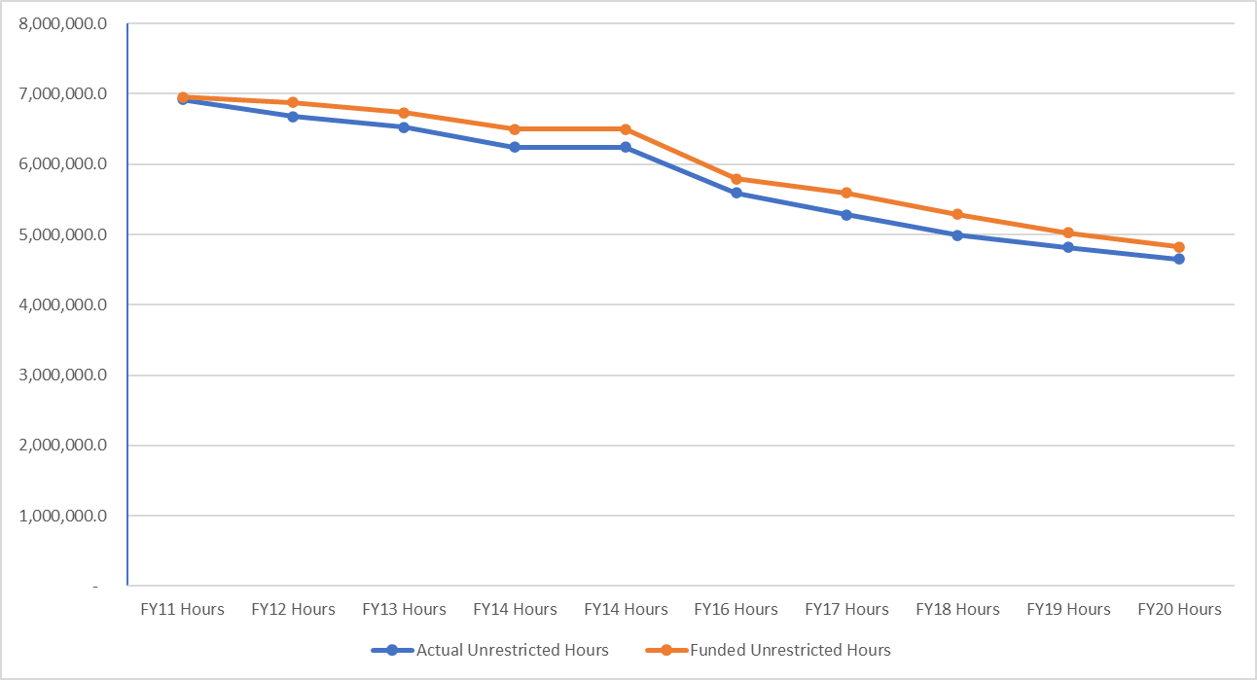
Base Operating Grant
Unrestricted Credit Hours

Slide 11
Equalization Grants
Grants were established by statute to reduce disparity of local property tax funds available per student between districts.
A base foundation level of expected tax revenue per student is calculated from EAV and PPRT.
Districts with EAV PPRT rate below the calculated foundation level are eligible for funding.
Proration factor applied if State appropriations do not meet the fully funded threshold level.
A minimum $50,000 grant is awarded to districts that qualify for Equalization but become ineligible due to the proration factor.

Slide 12
Equalization Grants
Calculation of Grant Allocation
District’s tax revenue per FTE < Base Foundation Level =
Eligible full funding; proration factor applied to Base Foundation Level if necessary.
Minimum $50,000 grant for districts who qualify for full funding, but not under prorated funding.
Notes:
Low 1082 per FTE
High 9375 per FTE

Slide 13
Equalization Grants

Slide 14
Equalization Grants
Statewide threshold is prorated to equal State appropriations.
Districts with a EAV CPPRT rate below the Statewide threshold and Prorated threshold qualify for Prorated funding.
Formula = (District EAV CPPRT rate - Prorated Threshold) x FTE.
Districts qualifying for full funding, but ineligible under prorated funding, will receive a minimum $50,000 grant.

Slide 15
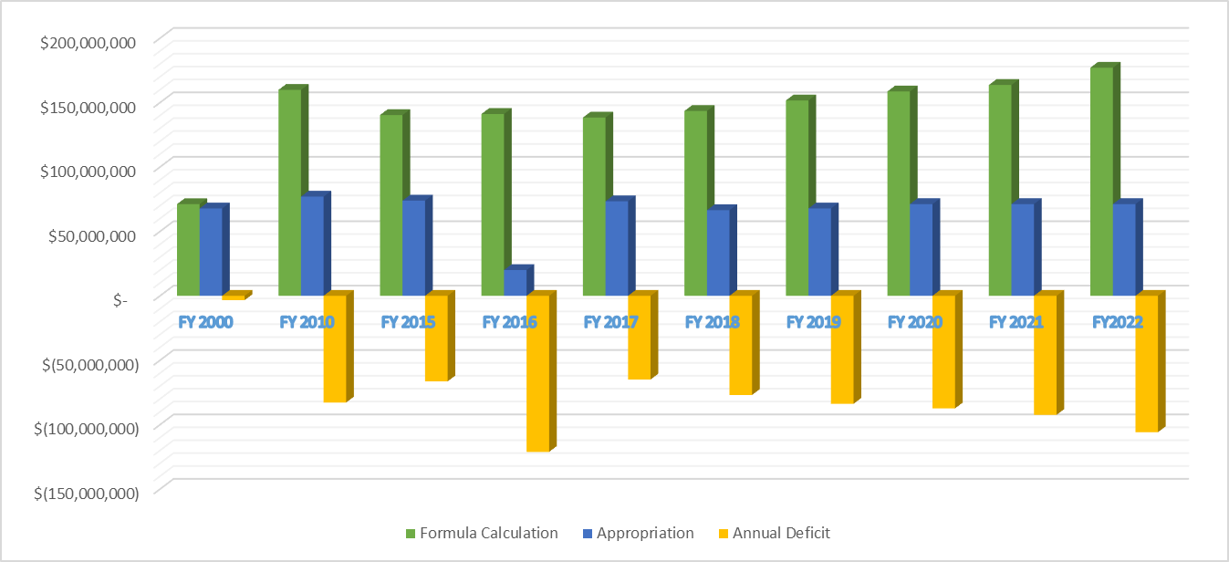
Equalization Grants
Annual Deficit in Funding

Slide 16
Equalization Grants
Impacts to annual grant allocations:
EAV
FTE
PPRT
State Appropriations
Notes:
Low 1082 per FTE
High 9375 per FTE

Slide 17
Other
Unrestricted Grants
Performance-Based Funding:
Beginning in fiscal year 2013, the Illinois public higher education budget is statutorily required to include a performance-based component in the annual funding allocations.
Community college performance funding measures were developed by a group of representatives from the system.
As outlined in Public Act 97-320, the measures award community college performance for advancing success of students who are academically or financially at risk and focus on increasing college course, certificate, and degree completion.

Slide 18
Other
Unrestricted Grants
Measures for Performance-Based Funding:
Degree & Certificate Completion
Degree & Certificate Completion of At-Risk Students
Transfer to a 4-year Institution
Developmental Advancement
Momentum Points
Transfer to a Community College

Slide 19
Other
Unrestricted Grants
Small College Grants:
A flat grant of $50,000 is distributed to districts with 2,500 or less full-time equivalent(FTE).
Districts below 2,000 FTE, below $850 million equalized assessed valuation(EAV), and qualify for an equalization grant, receive an additional $50,000 grant.
These districts have fewer discretionary dollars and a greater percentage of their budget allocated to fixed costs than do larger districts.

Slide 20
Other
Unrestricted Grants
Veterans Grants
Prior to FY20, annual appropriations were line item by institution. The appropriation language did not allow claims for tuition waivers for Illinois National Guard veterans.
In FY20, Public Act 100-0007 was amended to include reimbursement for tuition waivers associated with Illinois National Guard veterans in addition to Veterans grants.
In FY22, Public Act 102-0017 appropriated the full amount to ICCB to be allocated equitably among the colleges.

Slide 21
Restricted Grants
Adult Education Grants
MOE
Allocations based on formula
Grant Agreements
Restricted Accounts
Career and Technical Education
MOE
Allocations based on formula
Grant Agreements
Restricted Accounts

Slide 22
Restricted Grants
Special Initiatives
Federal or State funded
Grant Agreements
Allocations may be formula-based
Restricted Accounts

Slide 23

Questions?
Jennifer Franklin, Deputy Director Finance & Administration
Illinois Community College Board
217.785.0031
Jennifer.L.franklin2@Illinois.gov

