Slide 1
Self-care and Coping During Unprecedented Times
By: Shanya Gray, MA, LCPC
Assistant Professor/Counselor
Coordinator of the Counseling and Career Development Center
MORaine valley community collegE

Slide 2


How have you been feeling these days?

Slide 3
“It can be stated with certainty based on these survey findings that at least a quarter of U.S. adults is presently in a condition of high emotional distress directly attributable to the pandemic.”

Slide 4


Slide 5
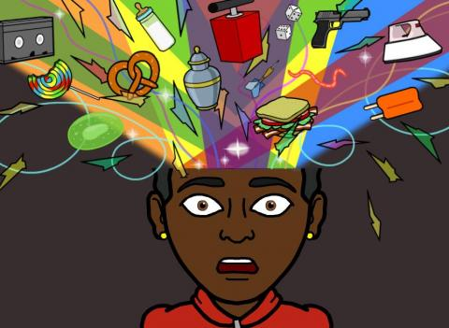
Mind
Impaired judgement
Inability to concentrate
Indecisive
Muddled thinking
Hasty decision making
Constant worrying

Slide 6

Body
Headaches, back and neck pain
Insomnia
Overeating/Undereating
Poor Digestion
Hair Loss/Skin problems
Restlessness
Increased risk for hypertension, heart attacks, stroke

Slide 7
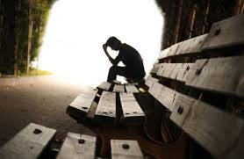
Soul
Discouraged
Feeling overwhelmed
Feeling hopeless/powerless
Sadness/loneliness
Irritable/angry
Loosing hope
Loosing faith
Depression
Anxiety

Slide 8

What Can We Do to Cope During This Time?

Slide 9

Mind
Breathe
Set/Have realistic expectations
Positive self talk and affirmations
Stop negative thinking
Gain perspective
Keep a routine
Do not overload yourself with information

Slide 10
Body
Breathe
Move
Dance
Walk/Exercise
Have good posture
Keep a routine

Slide 11

Soul
Increase meaning
Stay connected
Laugh
Feed your soul
Practice Affirmations
Maintain balance
Extend grace to yourself and others
Don’t be afraid to get help

Slide 12
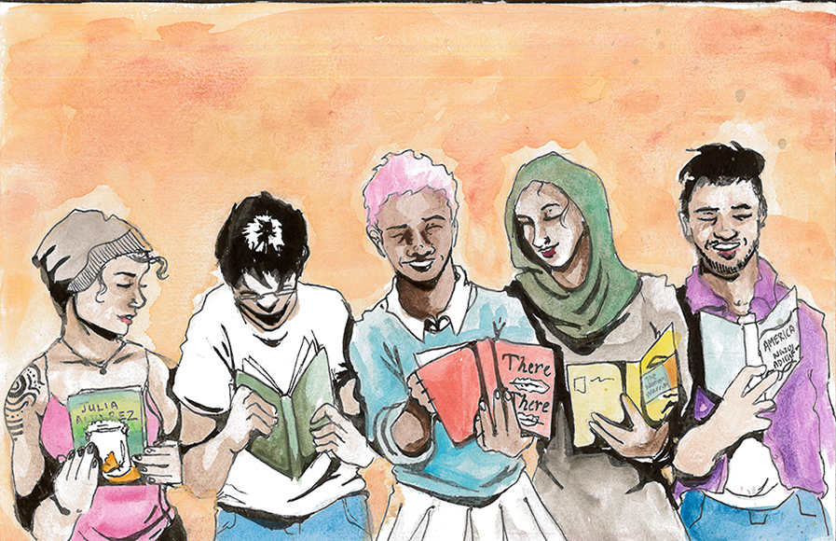
Remember, with our students
They have circumstances beyond their control
We serve a large underserved population
They are experiencing the pandemic +
This is also new to them
They are also struggling and trying just as we are

Slide 13
Questions?
Thank You
Shanya Gray
grays44@morainevalley.edu

