Slide 1
Reading Aloud in College Biology Classes¹
Dr. Oliver Pergams (Natural Sciences, City Colleges of Chicago)
Dr. Charmaine Jake-Matthews (Psychology, Purdue University Northwest)
¹Pergams, O.R.W., Jake-Matthews, C.E., & Mohanty L.M. (2018). A combined Read-Aloud Think-Aloud strategy improves student learning experiences in college-level biology courses. Journal of College Science Teaching, 4(5), 10-15.

Slide 2
What do students hate to do the most?

Slide 3
READING!!!
They will do almost anything to avoid it.
Don’t really know why this is. Common speculation:
  Reduced attention span (perhaps as a result of videophilia)
  Poor preparation in earlier education
  Laziness
  In STEM disciplines, some scientific jargon is simply hard to read for anyone
Reading comprehension has of course a huge, possibly primary impact on students’ comprehension and their success in school and life.

Slide 4

Other factors that led me to try this experiment:
Free Textbook
I had decided to use a free text
  Developed by Rice University
  Funded by several major philanthropic foundations
However, the book made little attempt to reduce scientific jargon or simplify language, and was fairly densely written.

Slide 5
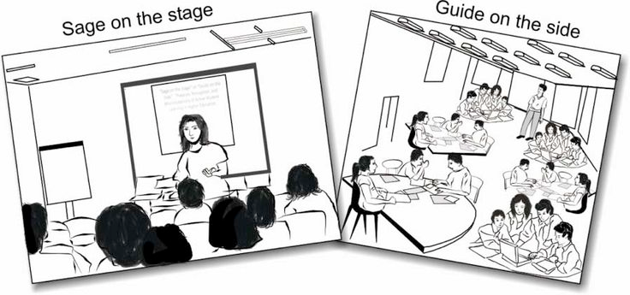
Other factors that led me to try this experiment:
“Sage on the Stage”
I was tired of the standard “sage on the stage” format of a professor lecturing using PowerPoint
  Thought students might be a little tired as well!
Also, when I began the 1st class no prepared slide presentations were offered by the publisher

Slide 6
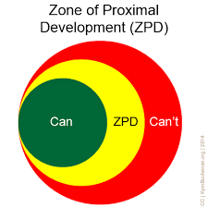
Theoretical Support for the Read Aloud-Think Aloud Approach
Vygotsky’s Developmental Theory
  Zone of Proximal Development
  Scaffolding

Slide 7
Theoretical Support for the Read Aloud-Think Aloud Approach
Goals of Scaffolding in Science Education²
  Content understanding
  Procedural skills
  Metacognition

Slide 8

Theoretical Support for the Read Aloud-Think Aloud Approach
Three Key Elements of Scaffolding²
  Social Interaction
  Visual Representations
  Written or Spoken Prompts
  ²Lin, T., Hsu, Y., Lin, S., Changlai, M., Yang, K,. & Lai, T. (2012). A review of empirical evidence on scaffolding for science education. International Journal of Science and Mathematics Education, 10, 437–455

Slide 9
Reading Aloud
I decided that we would read all of the text assigned for the class aloud in class, taking turns.
  My thinking was that this would force the students to actually read the text.
  The classroom would resemble a study group, with my role as essentially a high‐powered study group leader.
    I would be included among the readers
    Each of us would read 1-2 paragraphs at a time
    I would elaborate upon the readings whenever there was an actual question by a student, and whenever I thought the material needed explaining
      I would use videos, props, other texts, etc. to elaborate & explain

Slide 10
Classes
Three classes were involved in this project:
  Biology 122 (Organismal Biology II) taught Fall 2015 (N = 8 students)
  Biology 119 (Environmental Biology) taught Spring 2016 (N = 14 students)
  Biology 122 (Organismal Biology II) taught Fall 2016 (N = 12 students)
There were a total of 34 students in these 3 classes

Slide 11
Best with small classes
I also tried using the technique with one of my sections of Intro Bio non-major classes, Bio 114
The class had 32 students, rather than the 8-14 in the major classes
This proved to be too many: it took too long to go through one turn for the class, and I lost student focus and attention
My own experience was that the technique worked better with class size <15

Slide 12
Student Buy-In
At the beginning of each class, I explained what I wanted to do
Student objections were basically 2 themes:
  Reading aloud in class is baby stuff
  Reading aloud is not my learning style
It was put to a vote, & all 3 classes voted to give it a 2-week trial
After 2 weeks all 3 classes voted to keep going

Slide 13
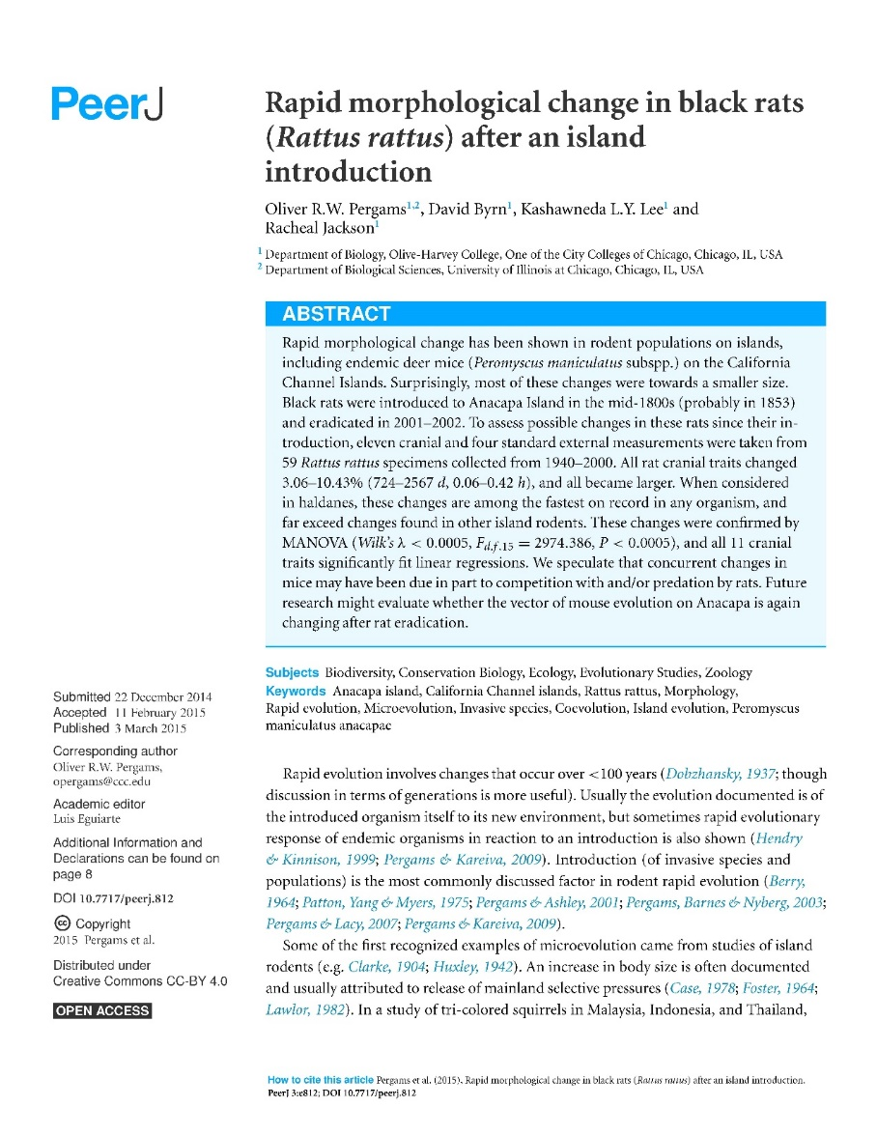
Let’s Give It A Try!
We’ll now point to two handouts:
  A somewhat difficult peer-reviewed scientific article on rapid evolution
    We’ll read the first page or two using RA-TA
    (click HERE for paper)
  The original RA-TA paper for later reference
    (click HERE for paper)

Slide 14
Survey
Please rate the following on a 1-5 scale, with 1 = Strongly Disagree, 2 = Somewhat Disagree, 3 = Neither Disagree nor Agree. 4 = Somewhat Agree and 5 = Strongly Agree.
1. It made me read the text more than I would have otherwise.
2. It made me understand the text more than I would have otherwise.
3. Dr. Pergams elaborating on the text was useful to me.
4. In general, I learned how to read difficult texts with greater comprehension.
5. I prefer a class conducted this way over a class with lecture and powerpoints.
The survey sheets were proctored by a student while Dr. Pergams was out of the room

Slide 15
Results

Slide 16
Student Comments
No longer thought reading aloud was “baby stuff”
However, those who thought reading aloud was not their learning style did not change their minds
Concerning [5. I prefer a class conducted this way over a class with lecture and powerpoints. 3.35, P = 0.04]
  Students preferred STEM classes taught using reading aloud, but not other classes
  This makes sense, considering STEM classes have much more jargon

Slide 17
Conclusions
Students very strongly thought that reading aloud in biology class helped them:
  Read the text more
  Understand the text more
  Thought the instructor elaborating was useful
  Understand other texts more
And to a lesser extent:
  Thought other classes should be conducted this way, but only STEM classes
This technique works better with smaller classes, < about 15

Slide 18

Application in the Online Setting
Especially suited to remote teaching
Difficult to assess student engagement with remote lecture material (or even whether students are actually present)
Students have to stick around and engage so they don't miss their turn reading

Slide 19
If you would like to try this technique we’d be happy to help!
opergams@ccc.edu
cjakemat@purdue.edu
lmohanty@ccc.edu
The authors would also like to thank the 34 brave students!

