Slide 1
Information Literacy & Academic Library Orientation: Online Learning's Dependable Colleague
Pamela Lessner, MLIS MOT
City Colleges of Chicago, Daley Campus

Slide 2
Who Are YOU?
Librarians
What was your Role
Provide materials
Support reference
Information Literacy
What are you doing now?
Online Resources
Databases
Information Literacy
What can you do
Invite yourself to class
Faculty Development Week
Use this as an opportunity
Instructors
What's your Role
Cover the curriculum
Student Support
Assess & Created
What are you doing now?
Online Resources
Support your class
Institutional Support
What can you do
Invite librarians to class
Faculty Development Week
You know your students the best...still

Slide 3
Physical Space Textbooks: calculators/pencil sharpeners/copier
Librarians
What was your Role
Provide materials
Physical Space
What can you do
Determine what textbooks have an eBook version
OER
Library Fines?
Instructors
What's your Role
Select Materials
Academic Freedom
What can you do
Work with the librarian
Choose OER
Long term usage

Slide 4
Information Literacy
Librarian
What was your Role
Visit Classes
In Library Support
What can you do
Invite Yourself
Offer a quick 5-minute Hello the first week
Big Assignment?
One Big Presentation or a few small ones?
CRAAP Presentations
Convert to a low-tech video
Be willing to Share your Screen
Instructors
What's your Role
With remote learning, critical thinking when evaluating sources is even more critical!
CRAAP
Current, Relevant, Authorship, Accuracy, Purpose
Personal Bias
What can you do
Work with the librarian regarding a assignment
Learning Objectives:
Synchronized Meeting
invite for a quick Hello first week
Invite back for a more in-depth

Slide 5
Virtual Library Reference Support
Librarians
What's your Role
Reference Questions
Real Time Chat
Email
What can you do
Make sure you're one click away in the LMS
Brightspace Dropdown
Model the Chat when you visit the classroom
Offer to host a breakout room
Instructors
What's your Role
Prepare them for the next step (4 yr university)
Many didn't have a high school library
Ask your librarian what's the new procedure
What can you do
Eliminate the mystique
Incorporate a small or large interaction
Use the library for your own research/assignments
Taking a class? We support staff too!

Slide 6
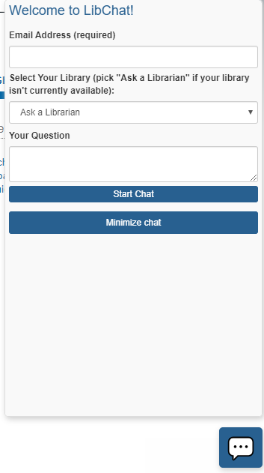
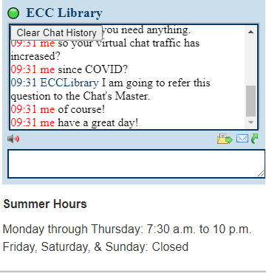
So, Who is Doing What?
https://www.bhc.edu/academics/academic-resources/library/
Email or Call. Very cool Tutorial, that can be incorporated into your class
https://library.parkland.edu/home
https://www.harpercollege.edu/library/index.php
CCC: LibChat
Elgin
Community
College

Slide 7
Virtual Library Support: dependable as always
Librarians
What's your Role
Leadership for Staff
Liaison to Administration
Union Representation
What can you do
Ask your Staff about different shifts
Virtual Chats: opportunity for more hours of service, better for staff and students
We didn't have Sunday hours, but now we do!
Instructors
What's your Role
Prepare them for the next step (4 yr university)
Many didn't have a high school library
Ask your librarian about new procedures
What can you do
Eliminate the mystique
Incorporate a small or large interaction
Use the library for your own research/assignments
Taking a class?
We support staff too!

Slide 8
August is Coming
Librarians
What can you do
Ask for More!
Where are you in the LMS?
Faculty Development Week
Ten Minutes, that's all you need to establish a base with some faculty
Then Follow Up
Instructors may be looking for guest speakers, because lecturing on ZOOM seems a lot longer than in-person!
Instructors
What's your New Role
LMS, not just the Library, Tutoring, Wellness, Career Services
What can you do
Faculty Development Week
Surveyed what you need?
Ask for More
Create online activity with the Librarian
Synchronized sessions: how many do you have to conduct?

