Slide 1
Illinois Community College Board Strategic Plan for Adult Education
October 12, 2017

Slide 2
Today’s Discussion
Understanding the Importance of an Adult Education Strategic Plan
Workforce Innovation and Opportunity Act (WIOA)
Purpose of Adult Education
The Past Adult Education Strategic Plan: Creating Pathways for Adult Learners
Understanding Senate Joint Resolution (SJR) 40
The SJR 40 Taskforce
Meet Our Facilitator
Goal Team Facilitators and Staff Support
Next Steps and Timeline
Questions

Slide 3
Understanding the Importance of an Adult Education Strategic Plan
There will be 55 million job openings in the economy through 2020:
24 million openings from newly created jobs
31 million openings due to baby boomer retirements.
Source: Georgetown University, Center on Education and the Workforce- Recovery Job Growth and Education Requirements through 2020.

Slide 4
Understanding the Importance of an Adult Education Strategic Plan
By 2020, 65 percent of all jobs in the nation will require some postsecondary education and training beyond high school.
70% in Illinois
Only 34 Percent of Jobs Expected to Be Open to High School Graduates or less.
30% in Illinois
Source: Georgetown University, Center on Education and the Workforce- Recovery Job Growth and Education Requirements through 2020.
Notes:
23% of jobs will require a bachelor degree
11% of jobs will require a master’s degree

Slide 5
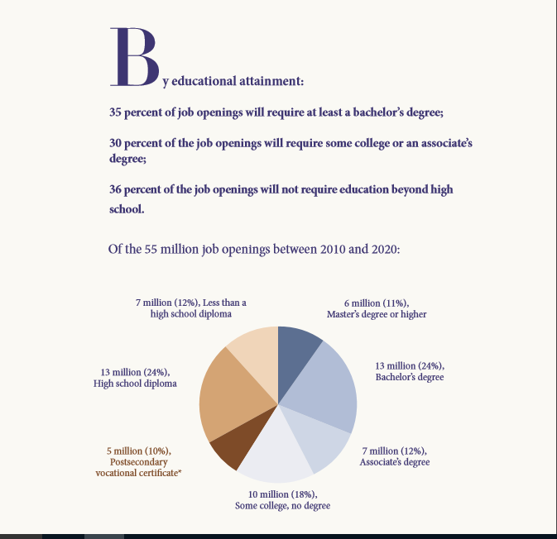
Source: Georgetown University, Center on Education and the Workforce- Recovery Job Growth and Education Requirements through 2020.

Slide 7
Changing Times: The Passport to an American Dream
In 1973, the Passport was a High School Diploma.
72%* of the workforce had no more than a high school degree
In 2017, the Passport is education beyond High School.
Source: Georgetown University, Center on Education and the Workforce- Recovery Job Growth and Education Requirements through 2020.

Slide 8
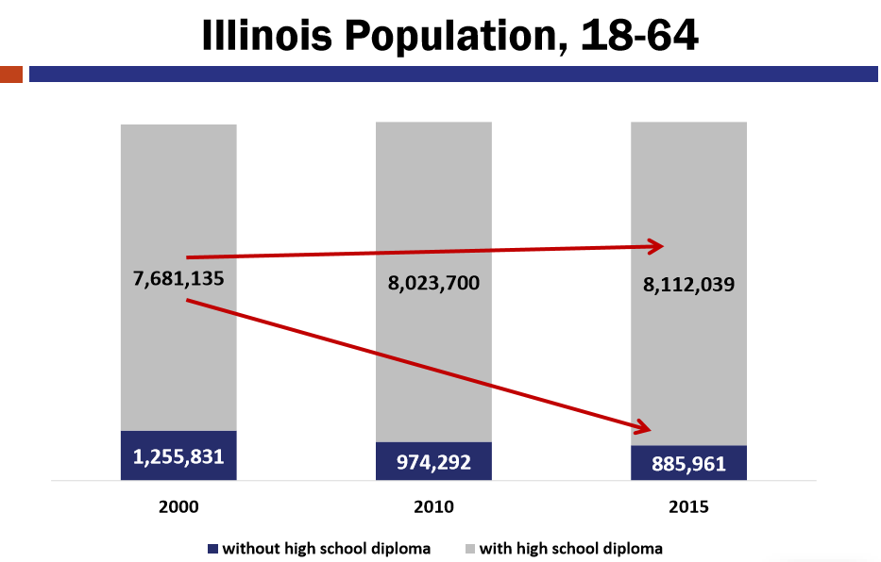
Sources: Census Data, 2000; ACS 5-years estimates, 2006-2010 and 2011-2015

Slide 9
Source: American Community Survey, 2011-15, 5 year estimate

Slide 10
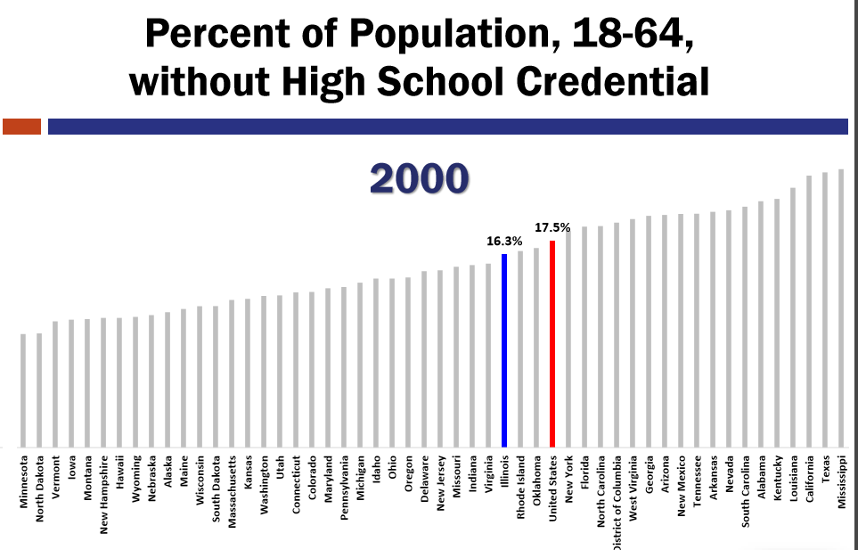

Slide 11
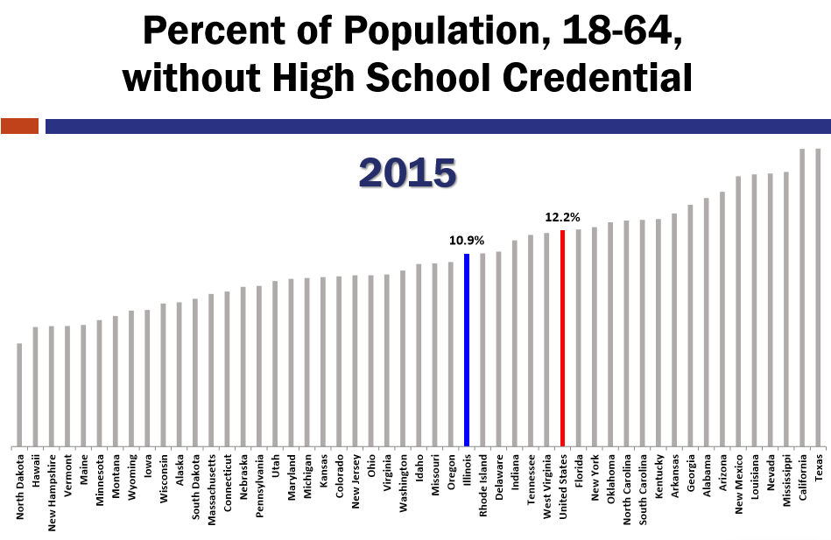

Slide 12
National Reporting System (NRS)* Who are we serving?
*NRS reportable individuals are those with at least 12 hours of instruction. Source: Illinois Community College Board - Preliminary 2017 Data - Illinois Adult Education & Literacy Data System, DAISi

Slide 13
Another Glance: Who are we serving?
*NRS reportable individuals are those with at least 12 hours of instruction. Source: Illinois Community College Board Preliminary 2017 Data - Illinois Adult Education & Literacy Data System, DAISi

Slide 14
Illinois English Language Learners
Approximately 2.8 million Illinois residents speak a language other than English as the primary language in their homes.

Slide 15
Immigrant Population
Approximately 350,000 immigrants reside in Illinois.

Slide 16
Breakdown of the Service Delivery Data FY2015
Source: FY2015 Adult Education and Family Literacy Report to the Governor and General Assembly

Slide 17
Breakdown of the Service Delivery Data FY2016
Source: FY2016 Adult Education and Family Literacy Report to the Governor and General Assembly

Slide 19
Workforce Innovation and Opportunity Act
State of Illinois Unified State Plan Vision Statement
Promote business-driven talent solutions that integrate education, workforce and economic development resources across systems to provide businesses, individuals, and communities with the opportunity to prosper and contribute to growing the state’s economy.

Slide 20
Workforce Innovation and Opportunity Act
Business demand driven orientation through a sector strategy framework
Strong partnerships with business at all levels
Career pathways to jobs of today and tomorrow
Integrated service delivery
Access and opportunity for all populations
Cross-agency collaboration and alignment for developing and/or promoting career pathways and industry recognized stackable credentials
Clear metrics for progress and success
Focus on continuous improvement and innovation

Slide 21
Goal of WIOA: Development of Career Pathways
A career Pathway is defined under WIOA Section 3, as follows:
Career pathway means a combination of rigorous and high-quality education, training, and other services that—
(A) aligns with the skill needs of industries in the economy of the State or regional economy involved;
(B) prepares an individual to be successful in any of a full range of secondary or postsecondary education options, including apprenticeships registered;
(C) includes counseling to support an individual in achieving the individual’s education and career goals;

Slide 22
Goal of WIOA: Development of Career Pathway Programs
(D) includes, as appropriate, education offered concurrently with and in the same context as workforce preparation activities and training for a specific occupation or occupational cluster;
E) organizes education, training, and other services to meet the particular needs of an individual in a manner that accelerates the educational and career advancement of the individual to the extent practicable;
(F) enables an individual to attain a secondary school diploma or its recognized equivalent, and at least 1 recognized postsecondary credential; and
(G) helps an individual enter or advance within a specific occupation or occupational cluster.

Slide 23
(1) assist adults to become literate and obtain the knowledge and skills necessary for employment and self-sufficiency; (2) assist adults who are parents or family members to obtain education and skills that- (A) are necessary to becoming full partners in the educational development of their children; and (B) lead to sustainable improvements in the economic opportunities for their family; (3) assist adults in attaining a secondary school diploma and in the transition to postsecondary education and training, including through career pathways; (4) assist immigrants and other individuals who are English language learners in- (A) improving their reading, writing, speaking and comprehension skills in English; and mathematics skills; and (B) acquiring an understanding of the American system of Government, individual freedom, and the responsibilities of citizenship.
PURPOSE OF WIOA - TITLE II:
Adult Education and Literacy Act

Slide 24
Title II: New Requirements
Alignment with state K-12 standards
Development of Integrated Education and Training (IET) Models
Integrated Education and Literacy/Civics Education (IEL/CE)
Alignment with local and regional labor market data
Alignment with local workforce boards
Increase use of technology in the classroom
Development of Career Pathways
Transitions to Postsecondary Education/Training and Employment
New Performance Measures
New Correctional Education activities

Slide 25
The Past Adult Education Strategic Plan: “Creating Pathways for Adult Learners”
Assessment, Curricula and Instruction
Support Services and Follow-up Services
High Quality Teaching and Professional Development
Partnerships
Research, Data, and Accountability
Program Design

Slide 26
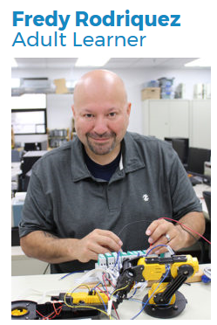
The Importance of a Strategic Plan
Creates a Vision
Utilizes the expertise of Practitioners
Develops Partnerships
Supports Collaboration
Ensures Accountability
Promotes Responsiveness
Encourages Innovation
Establishes Policy
Strengthens Alignment
Advances Career Pathways
Notes:
Fredy Rodriguez came to Joliet Junior College with one need, and that was to pass his General Educational Development test
He explained that mid-way through the semester staff from Adult Education’s College/Career Transition Services came to meet with his class. Michelle Lyman college & career transition specialist met with the group, explained the various services available and asked students what they planned to do next
In May 2016, Fredy earned his Associate in Applied Science degree and Certificate of Achievement in Industrial Electrical/Electronics
He is planning to attend the Southern Illinois University weekend program at JJC to earn his bachelor’s degree. It has taken a little time, but now he will be ready when an opportunity presents itself to advance his career.

Slide 27
Senate Joint Resolution (SJR) 40
Created the Statewide Task Force on the Future of Adult Education and Literacy within the Illinois Community College Board
Notes:
THE SENATE OF THE ONE HUNDREDTH GENERAL
ASSEMBLY OF THE STATE OF ILLINOIS, THE HOUSE OF REPRESENTATIVES CONCURRING HEREIN

Slide 28
Senate Joint Resolution (SJR) 40 Task Force Members:
Chair, Executive Director of the Illinois Community College Board
Chair of the Illinois Community College Board
Secretary of Education
Secretary of State
State Superintendent of the Illinois State Board of Education
Executive Director of the Illinois Board of Higher Education
Executive Director of the Illinois Student Assistance Commission
Executive Director of the Department of Commerce
Executive Director of the Illinois Department of Human Services
Executive Director of the Illinois Department of Employment and Security
Notes:
Or their designee

Slide 29
Senate Joint Resolution (SJR) 40 Task Force Members
Members of the General Assembly appointed by the:
President of the Senate
Minority Leader of the Senate
Speaker of the House Representatives
Minority Leader of the House of Representatives

Slide 30
Senate Joint Resolution (SJR) 40 Task Force Members
Representatives as appointed by the Illinois Community College Board Executive Director include:
Illinois Adult and Continuing Educator’s Association (IACEA)
Illinois Association of Regional School Superintendents (IARSS)
President or Chief Executive Officer of a Community College
Member of the Philanthropic Community
Adult Education Provider - Community Based Organization (CBO)
Adult Education Provider - Community College
Adult Education Provider - Local Education Agency
Postsecondary Career Technical Education Program

Slide 31
Senate Joint Resolution (SJR) 40 Task Force Charge
To create a statewide strategic plan for
adult education and literacy.

Slide 32
Senate Joint Resolution (SJR) 40 Considerations
Demographics of the State's economic and educational conditions;
Current and projected needs of the State's adult residents with low literacy skills, without a high school diploma and those who have limited English speaking skills;
Options for adults without a high school diploma;
Federal Adult Education funding guidelines;
Student pipeline issues, including college and career readiness, transitions to college or training programs, and postsecondary retention, transfer, and graduation rates;

Slide 33
Senate Joint Resolution (SJR) 40 Considerations
Curriculum and instruction, professional development, assessment, and program design;
Productivity and accountability;
Innovation in approaches to teaching and learning for adult learners;
Workforce readiness; and
Partnerships involving, Workforce Innovation and Opportunity Act partner agencies, higher education, nonprofits, and business

Slide 34
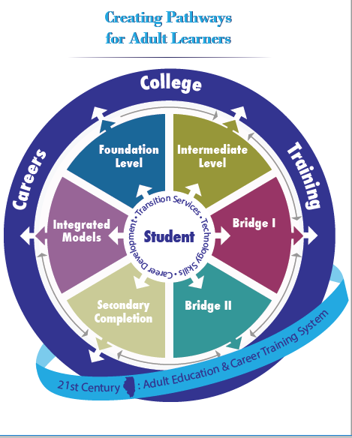

Slide 35
Meet Our Facilitator
Dr. Barbara Endel, Senior Director
Jobs for the Future
Notes:
Barbara Endel is a Senior Director at Jobs for the Future, a national non-profit education and workforce intermediary.
As part of her role, Barbara co-leads JFF's Accelerating Opportunity initiative, which enables entry-level adult learners to complete technical and occupational degrees across more than seven states and 85 community colleges nation-wide, including core state, Illinois. Dr. Endel has coached Illinois as part of Accelerating Opportunity for nearly three years supporting the state’s strategic development of integrated career pathways and expansion from 8 colleges to 20+. Barbara has deep knowledge of the Illinois context by presenting and facilitating at several state and regional adult education, CTE, and community college convenings. Barbara is a nationally noted expert on integrated career pathways;

Slide 36
Goal Team Facilitators and Staff Support
Illinois Center for Specialized Professional Support (ICSPS)
Dr. Aimee Julian, Director
ICCB Staff:
Jennifer Foster, Deputy Director for Adult Education and Workforce
Matt Berry, Deputy Director for Legislative and External Affairs
Jamil Steele, Senior Director for Adult Education and Literacy
Lavon Nelson, Senior Director for Workforce
Ben McDaniel, Director for Program Compliance
Nora Rossman, Office Administrator

Slide 37
Adult Education Strategic Plan Timeline –
Phase I:
First Meeting – October 23, 2017 in Springfield, IL
Second Meeting – January 2018 – Location TBA
Draft document – 2nd week of January 2018
Posted for feedback
Final Meeting Report due to the General Assembly on January 31, 2018
____________________________________________
Phase II:
Activities Committee
Final Report - April 2018

Slide 38
Questions and Comments

Slide 39
Additional Questions and Comments
Contact:
Jennifer Foster, Deputy Director for Adult Education and Workforce
Jennifer.Foster@illinois.gov

