Slide 1


Accessibility: The Road to Success
February 19 – 21

Slide 2

Conference Schedule
Conference Schedule
February 19 12:00 PM | KEYNOTE: Accessibility: A Civil Right | Vance Martin , University of Illinois Springfield
February 19 2:00 PM | Mapping Your Success: Universal Design for Learning | Zach Petrea, Heartland Community College
February 20 10:00 AM | Simple Solutions: Accessibility for Audio and Video Resources | Robin Fisch, Sauk Valley Community College Lori Wendt, Parkland College
February 20 2:00 PM | Moving Down the Road to Success: How to Approach Accessibility | Kona Jones, Richland Community College Scott Rial, College of Lake County Susan Nugent, Lake Land College
February 21 10:00 AM | Moving Down the Road to Success: How Different Learning Management Systems Address Accessibility | Kona Jones, Richland Community College Selom Assignon, Harold Washington College Lara Tompkins, College of DuPage
February 21 2:00 PM | Digital Access and YOU | Becky Benkert & Mike Maxse, College of DuPage

Slide 3
Conference Archives
Recordings of these presentations will be available at:
http://www.ilcco.net/
under Resources & Events
For more information about ILCCO:
jeff.newell@illinois.gov

Slide 4
Mapping Your Success:
Universal Design for Learning
Zach Petrea
Professor of English
UDL Faculty Coordinator
Notes:
PPT content borrowed from
UDL-Universe (Sonoma State & U.S. Department of Education)
CAST
Landmark College

Slide 5
Required Bio:
Professor of English
14 years teaching
UDL Faculty Coordinator
B.S. in Psychology & English
M.S. in English Studies
Certificate in Universal Design: Technology Integration
  Landmark College is the only accredited college in the United States designed exclusively for students with LDs
Ed.D. in Learning Design

Slide 6
Navigation
Comment
Raise Hand

Slide 7
Webinar Goals
Introduce the principles of UDL
Summarize neuroscience foundation
Provide examples and strategies
Offer Next Steps

Slide 8

How many have heard about?
Multiple Intelligences
Learning styles
On Course (affective engagement)
Differentiated Instruction
Adult Learning Theory
Problem Based Learning
Flipped classroom
Mindset
Grit (perseverance)
Notes:
TED talk curse= excitement, overwhelmed, depression, apathy
For me its been trying to organize around all the new and just-learned best practices
UDL makes it easier for me to organize my mind & class

Slide 9
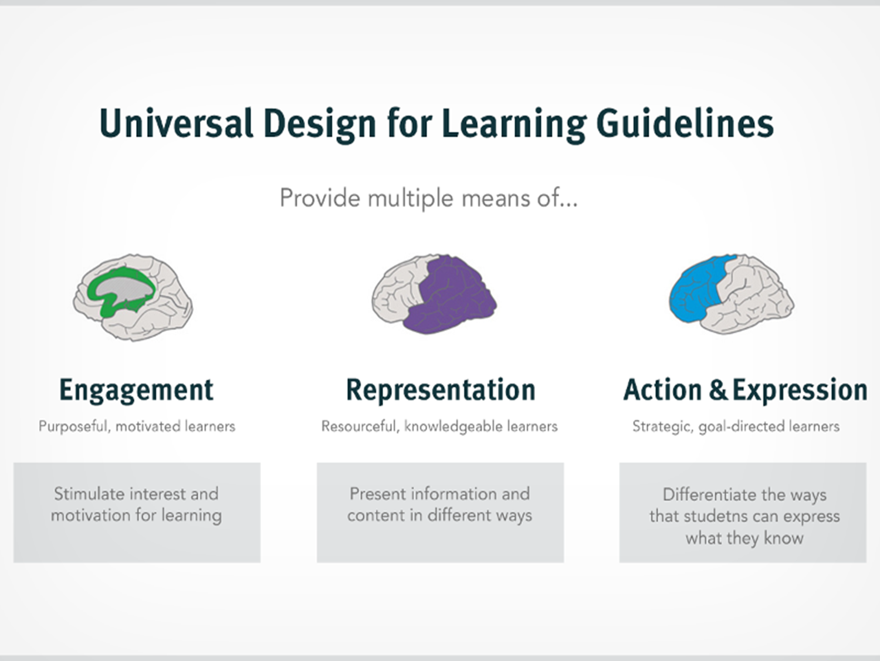
Notes:
Each of these brain regions work together to process, learn and engage with information.
The area of the brain which houses the visual cortex and auditory cortex is shown here in purple. This area helps us see, identify and read words, and process auditory information (Recognize).
The frontal lobe is responsible for critical thinking, decision-making, judgment-making, strategy formation and problem solving (executive function). This area is shown here in blue.
The limbic system houses two important structures, the hippocampus and amygdala, and is the emotional processing area of the brain (Affect). The green designates this area of the brain.
(Rose, Meyer, Hitchcock, 2005)

Slide 10
What is UDL?
A set of 3 principles for creating inclusive and accessible learning environments
Provides a framework to design how you teach in a structured and systematic manner
  Multiple pathways to material
  Stronger connections
  Better memory storage
Increases student participation, persistence, satisfaction and achievement (measurements!)

Slide 11
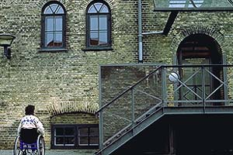
Universal Design
Architectural term coined by R. Mace at NC State
Environment design for
  access without needing adaptation, i.e. barrier free
Retrofitting insufficient
DisWeb © 2000 Karen G. Stone
Notes:
Universal Design is an architectural term that was coined by Ron Mace from NC State University in the 1970’s. UD is the intentional design of our architecture with the intent to be usable by all people so that there is no need for adaptations. In short, UD is “barrier free.”
Source: “Introduction to Universal Design for Learning- 2 hour presentation.” powerpoint. UDL-Universe (Sonoma State & U.S. Department of Education). N.d. http://enact.sonoma.edu/loader.php?type=d&id=397900

Slide 12
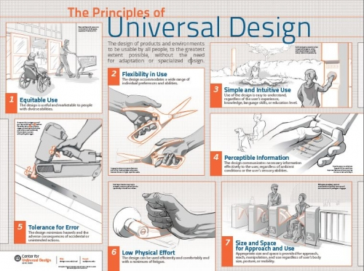
Universal Design in the physical environment
Notes:
Source: https://www.interaction-design.org/ux-daily/47/the-seven-principles-of-universal-design

Slide 13
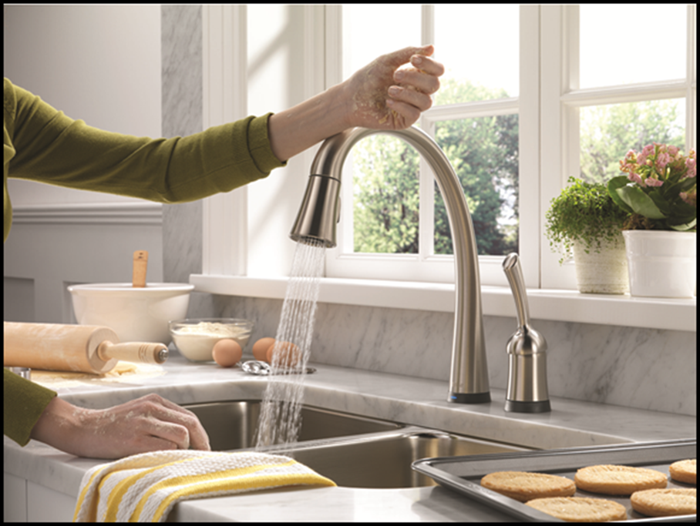
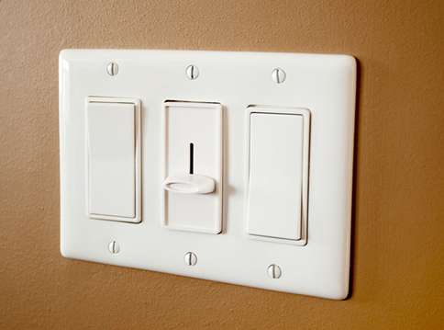
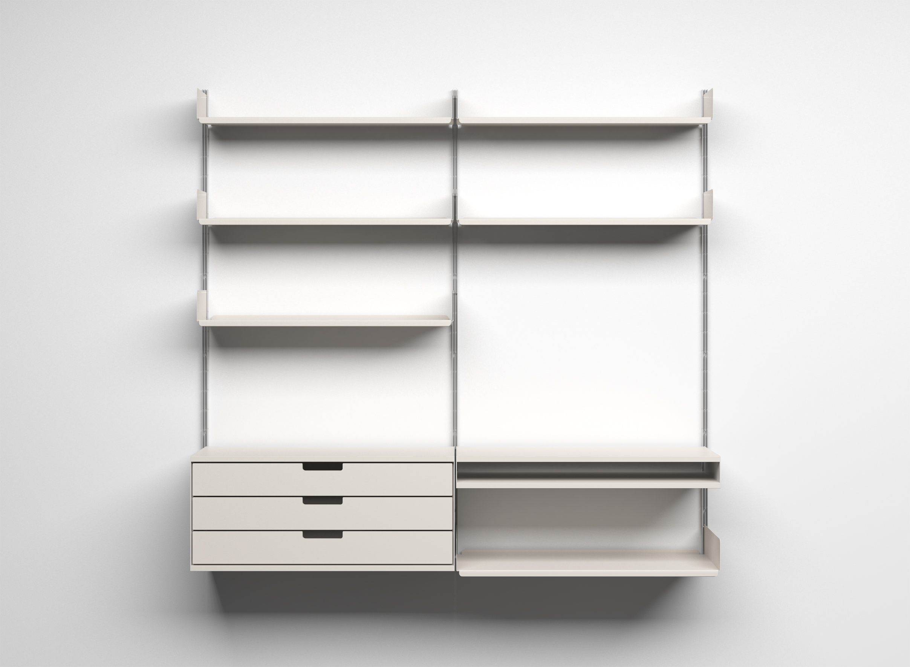
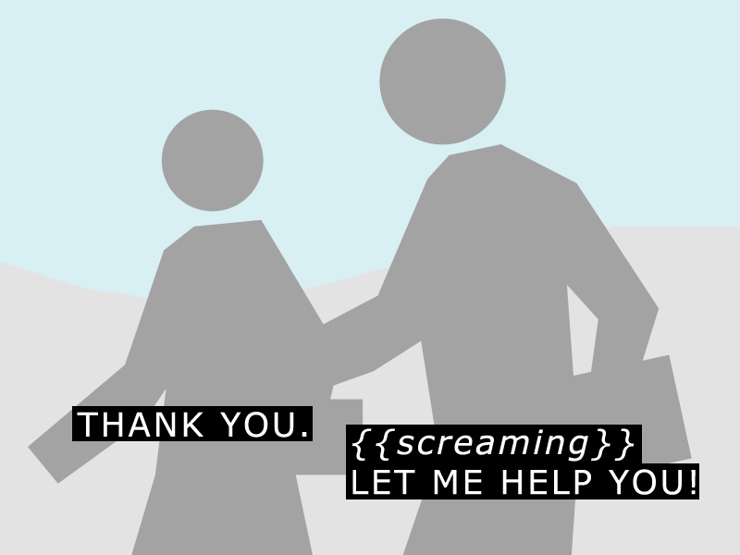
Notes:
Most common UD solutions are “commonsense” in our physical world, but not that common in education. We need to remember that what is “Essential for some, is useful to all”
Just as curb cuts were initially designed for people who use wheelchairs, but they also benefit pedestrians with strollers, luggage, bikes, children, in addition to other types of disability…
Research into spectrum disorders demonstrates that ADD, autism, depression, etc afflict many people to differing degrees, not to mention the physiological barriers the social/cultural, economic, gender, age, sexual orientation, etc.

Slide 14
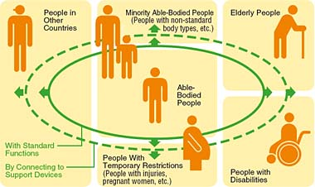
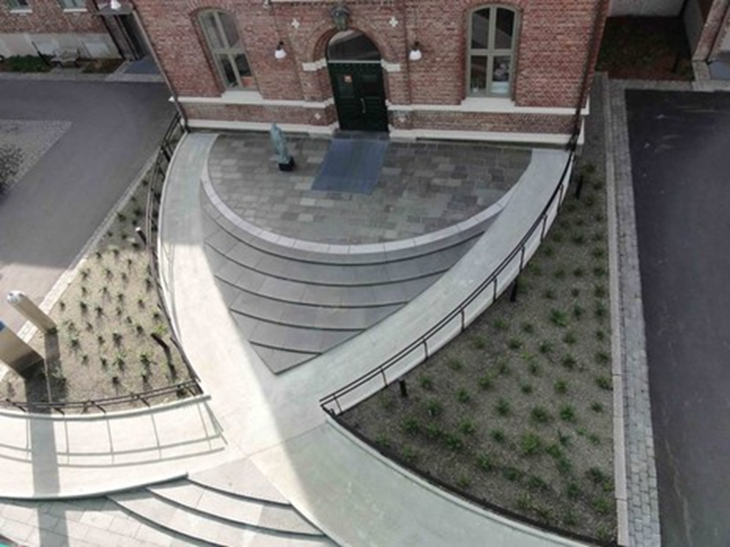
Universal Design Solutions
Intentional design:
More economical
Respects diversity
Broadens usability
Anticipates a variety of needs
Notes:
However, the more I talk about this slide, the more it occurs to me that the choice presented is not either/or, but rather sometimes/and, some of those students would be happy to take the ramp on certain occasions (carrying boxes, pushing a stroller), but other times they would prefer the stairs (pedometers people, etc). Our students are therefore the same as this, we should offer them variable means of learning and demonstrating their learning. Sometimes they’ll take the ramp option, sometimes they’ll take the stairs, but either way, they get to the same door that we want them to exit from. The support we give is just that “support” that helps meet the door. Don’t limit. Provide options.
Source: “Introduction to Universal Design for Learning- 2 hour presentation.” powerpoint. UDL-Universe (Sonoma State & U.S. Department of Education). N.d. http://enact.sonoma.edu/loader.php?type=d&id=397900

Slide 15
Need 1: Disability
Disability is the largest minority population
1 in 5 people in the United States has a disability
11% of Undergraduate students in 2011-2012 reported having a disability
Notes:
Employment rates among people with disabilities do not vary greatly by gender, but are particularly low among blacks and those with low levels of education (both absolutely and relative to people without disabilities)(Table 2). O
Employed people with disabilities are underrepresented in management and professional/technical jobs, and overrepresented in service, production, and transportation jobs

Slide 16
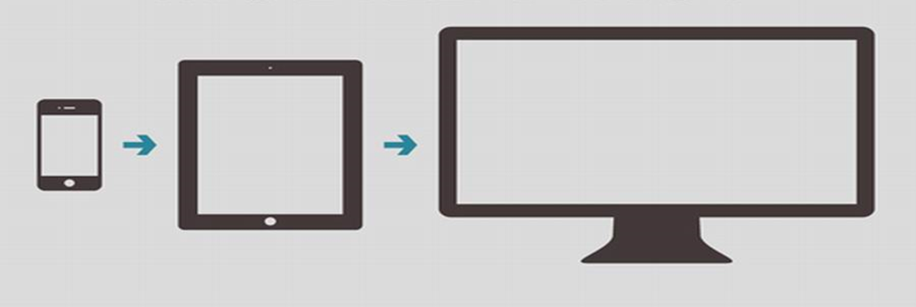
Need 2: Mobility
13% of U.S. households do not have internet
20% of adults are smartphone-only internet users
80% smartphone users use their phones to access the internet at home
82% of students use their smartphone for school tasks
Students spend more time browsing the Internet on their mobile phone than on their desktop

Slide 17
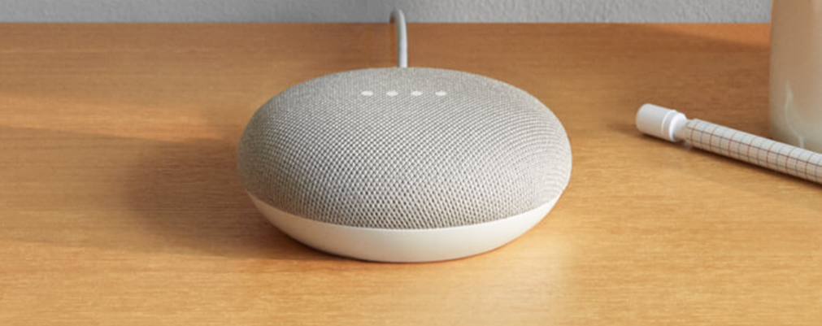

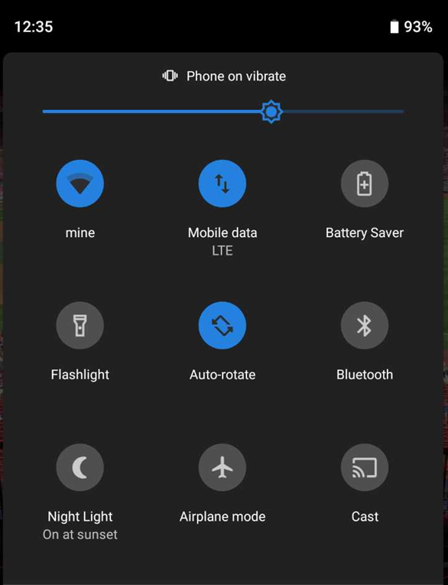

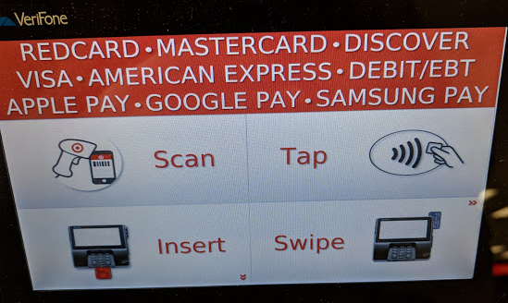
Mobility = Variability
Notes:
Good design, accessible design, has built-in variability

Slide 18
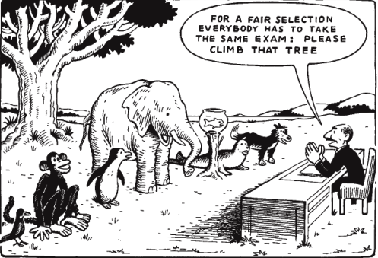
Pedagogically, Does One Size Fit All?
Notes:
Intuitively, instructors know that this is not fair, so we have spent much time, $ and effort to create special accommodations for the “nontraditional”, “below average”, “special needs” students however:
Just as curb cuts were initially designed for people who use wheelchairs, but they also benefit pedestrians with strollers, luggage, bikes, children, in addition to other types of disability…
Research into spectrum disorders demonstrates that ADD, autism, depression, etc afflict many people to differing degrees, not to mention the physiological barriers the social/cultural, economic, gender, age, sexual orientation, etc.

Slide 19
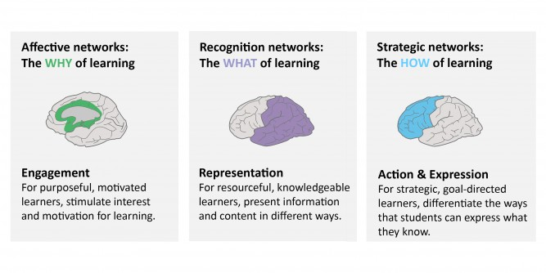
UD for (Learning Networks)
Notes:
Each of these brain regions work together to process, learn and engage with information.
The area of the brain which houses the visual cortex and auditory cortex is shown here in purple. This area helps us see, identify and read words, and process auditory information (Recognize).
The frontal lobe is responsible for critical thinking, decision-making, judgment-making, strategy formation and problem solving (executive function). This area is shown here in blue.
The limbic system houses two important structures, the hippocampus and amygdala, and is the emotional processing area of the brain (Affect). The green designates this area of the brain.
(Rose, Meyer, Hitchcock, 2005)

Slide 20
Questions?
?

Slide 21

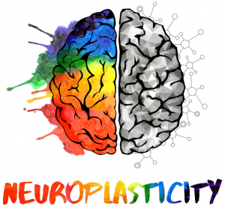
Learning Networks
Notes:
Neurodiversity from https://twitter.com/neur0diversity
Neuroplasticity from https://www.ispinstitute.com/clinical-conference-schedule/

Slide 22

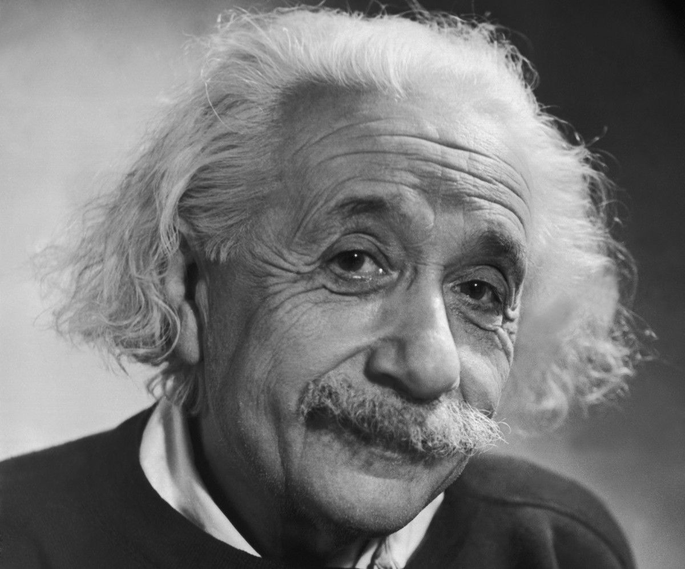
1. Neurodiversity
Diverse neurological conditions appear as a result of normal variations in the human genome
Notes:
“Neurodiversity Rewires Conventional Thinking About Brains” by Steve Silberman. WIRED.
“What is Neurodiversity?” by John Robison. Psychology Today.
“'Neurotypical' in Context” by POV (PBS documentary)
Spectrum disorders from DSM-V

Slide 23
Neurons!
Human brain has ~86 billion neurons (chimps have ~7billion)
~ 100 trillion connects
Notes:
As mentioned, neuroplasticity is based on the connections being made within the brain by individual neurons. The neural connections are where “memories” are stored and how we learn new things. Therefore, if we connect new learning to old learning, it makes the process easier and faster
Source: Howard-Jones, Paul, Michela Ott, Theo van Leeuwen, Bert De Smedt. “Neuroscience and technology enhanced learning.” Futurelab. October 2010. http://www.nfer.ac.uk/publications/FUTL19/FUTL19_home.cfm

Slide 24
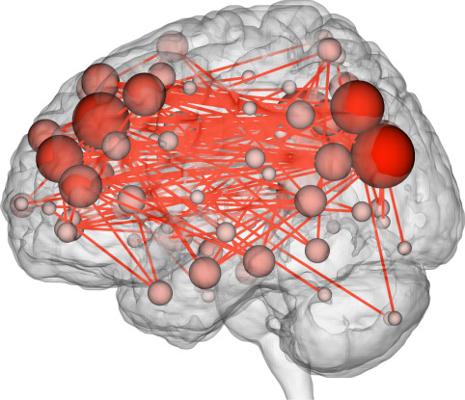
“connectome”
Notes:
Furthermore, according to recent research, the processing differences of individuals as mapped by connectome maps shows that every person’s neural pattern is unique to them alone. Just like fingerprints, no two people have the same neural networks.
Source: http://www.wired.com/2015/10/scientists-can-now-predict-intelligence-brain-activity/

Slide 25
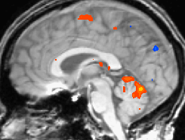
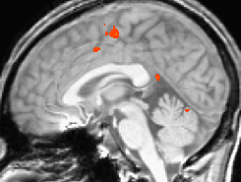
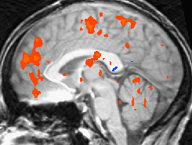
Brain Imaging
These three functional magnetic resonance images (fMRI) show brain activity patterns of three different people performing the same simple, finger tapping task.
CAST: Teaching Every Student
© 2002-2009
Notes:
All of this is meant to demonstrate the different connections possible in individual brains. For instance, differences in brain activity on same task clearly demonstrate that we are not all “wired” the same for learning.
Source: “Introduction to Universal Design for Learning- 2 hour presentation.” powerpoint. CAST. Boston, Ma. 2010.

Slide 26
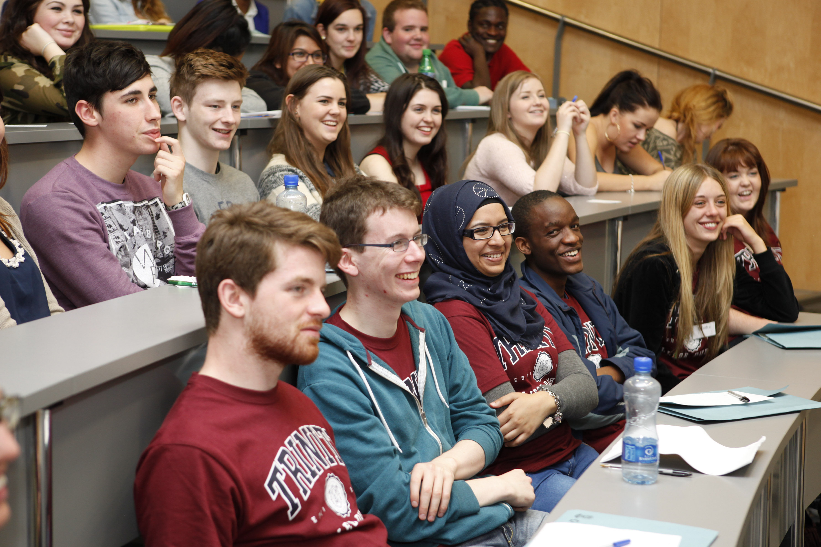
Neurodiversity = Diverse Abilities
Notes:
However, it is important to note that such compensation and specific deficits in information processing are not debilitating as seen in the famous case of Albert Einstein.
Einstein was a “late talker” and, throughout his career, had difficulty with mathematics facts (hypothesized to be automatically processed by the temporal lobe), in contrast to his unusual ability to visualize complex spatiotemporal relationships processed in the parietal lobe.”
Source:
Leonard, Christiana M. and Mark A. Eckert. “Asymmetry and Dyslexia.” Developmental Neuropsychology. 33.6. (2008): 663–681. doi: 10.1080/87565640802418597
http://www.ncbi.nlm.nih.gov/pmc/articles/PMC2586924/#!po=57.8125
https://academic.oup.com/brain/article/136/4/1304/356614

Slide 27
2. Neuroplasticity
  Brains are plastic throughout our lives
  Reorganized by stimuli
  Structure changes over time
Connectivity
    Neurons are highly connected
    Structural and functional differences visible before the onset of symptoms

Slide 28
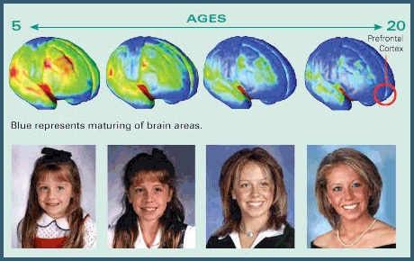
Brain Maturation

Slide 29
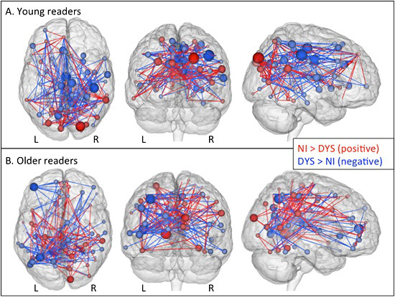
Neuroplasticity
Notes:
Plasticity = What Maryanne Wolf calls “Open Architecture” where the brain rearranges itself to meet demands of environment
Source:
Wolf, Maryanne. Proust and the Squid: The Story and Science of the Reading Brain. Harper Perennial, 2008.
“Neuroimaging Study Shows Disrupted Networks In The Brain Of Dyslexic Readers.” Health Innovations. http://health-innovations.org/2014/08/29/neuroimaging-study-shows-disrupted-networks-in-the-brain-of-dyslexic-readers/

Slide 30
Brain Imaging
(Posner & Raichle, 1994)

Slide 31
Brain Imaging
Kim, S. and T.W. James (2010)
Notes:
A more recent image shows the connections being made when physical & visual learning styles are used
YELLOW= visual recognition
BLUE = haptic recognition
GREEN = overlapping
Source: Howard-Jones, Paul, Michela Ott, Theo van Leeuwen, Bert De Smedt. “Neuroscience and technology enhanced learning.” Futurelab. October 2010. http://www.nfer.ac.uk/publications/FUTL19/FUTL19_home.cfm

Slide 32

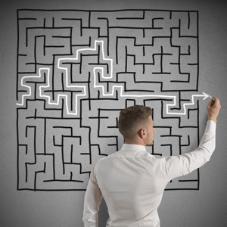
Planning Activities NOT Directions

Slide 33
Questions?
?

Slide 34
Backwards Design
ENGL 101: Demonstrate theoretical and practical understanding of the relationship between audience and purpose, and produce texts that address a variety of audiences effectively

Slide 35
Backwards Design
ENGL 101: Demonstrate theoretical and practical understanding of the relationship between audience and purpose, and produce texts that address a variety of audiences effectively
1 = Define
2 = Identify
3 = Apply
4 = Analyze
5 = Create

Slide 36
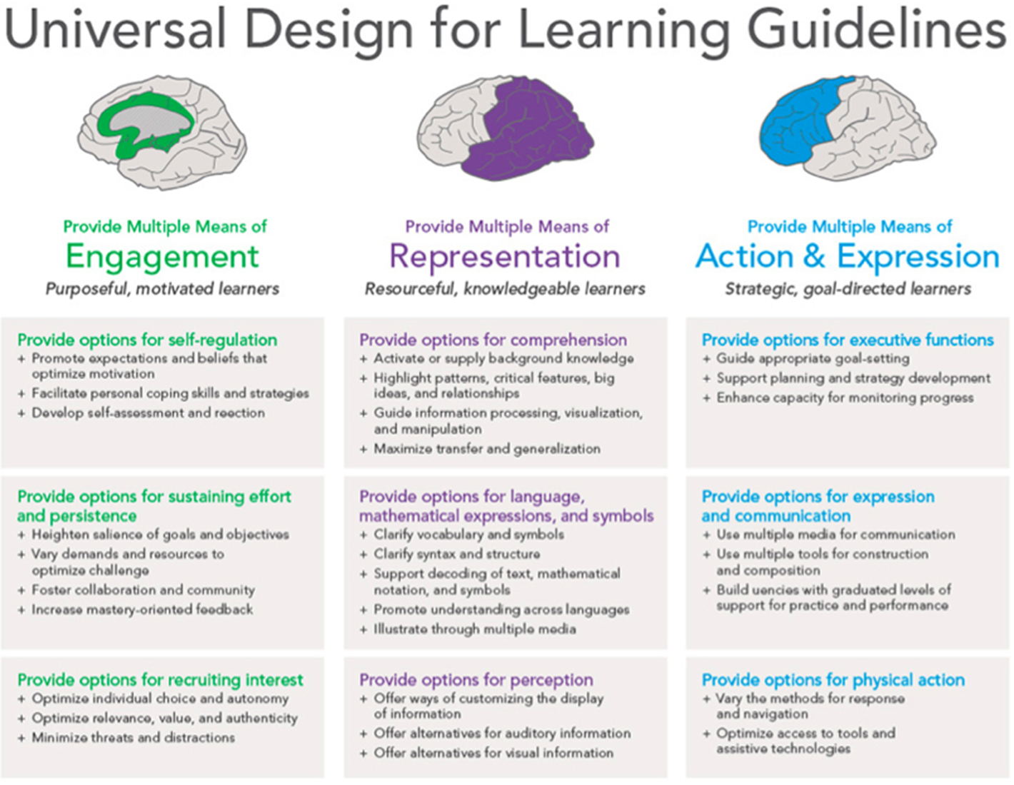
Notes:
Each of these brain regions work together to process, learn and engage with information. According to Rose and Meyer (2002), these three areas of the brain can be classified as three learning networks: recognition, strategy, and affective networks. The three UDL principles (Multiple Means of Representation, Multiple Means of Expression, and Multiple Means of Engagement) parallel these 3 areas.

Slide 37
What is ENGAGEMENT?
“How do I involve my students in the learning process?”
  Relevant and Meaningful Goals
    Interest
    Motivation
    Self-regulation
Notes:
What is Engagement?

Slide 38
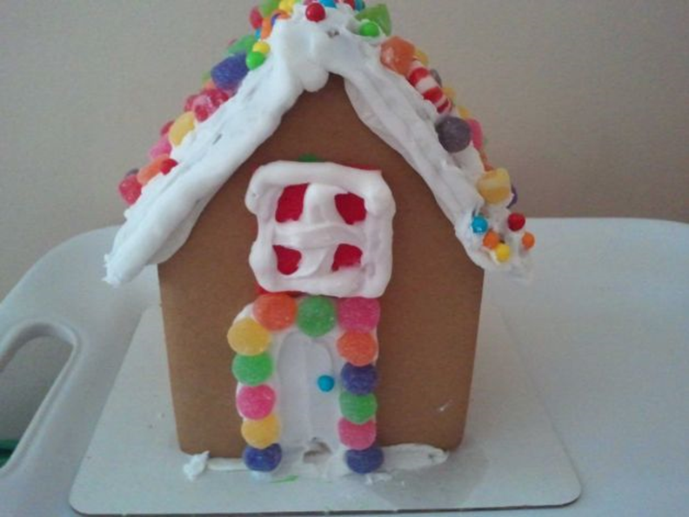
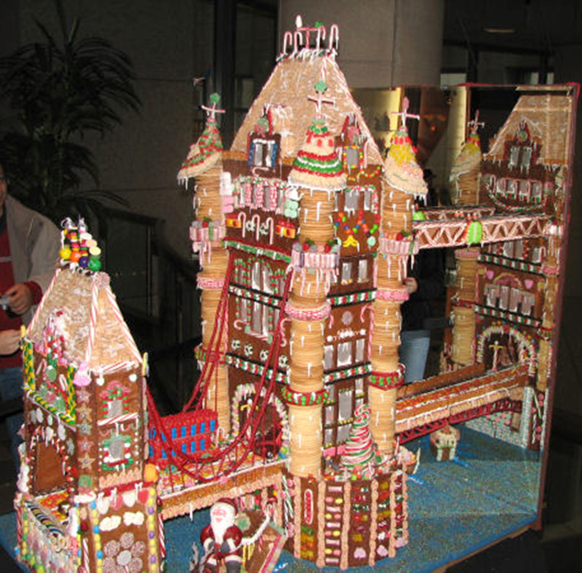

Engagement

Slide 39
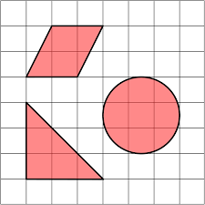


Engagement Matters

Slide 40
What is ENGAGEMENT?
  Relevant & Meaningful:
      Use course materials based on current events
      Allow choice in student topic
      Allow students to design activities

Slide 41
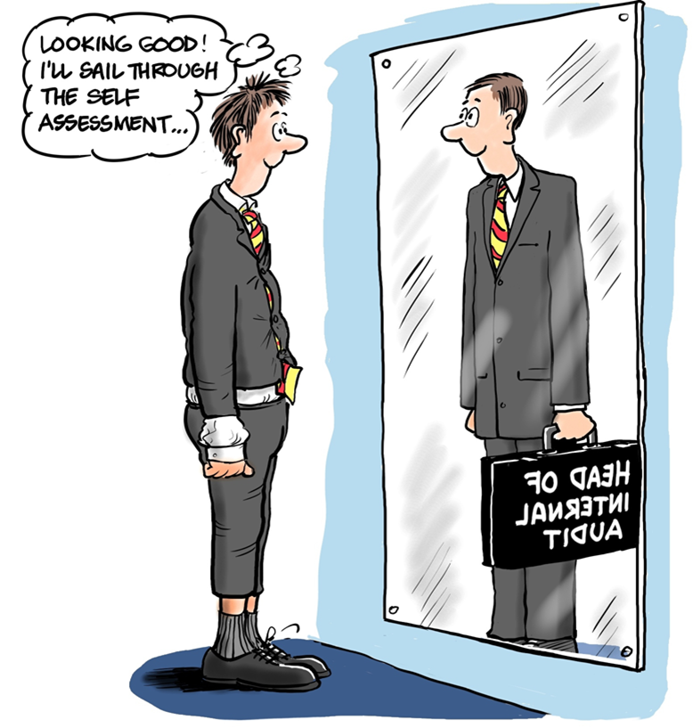
Engagement: Self-Regulation
Notes:
Good students underestimate their scores
Middle/poor students overestimate their scores

Slide 42
What is ENGAGEMENT?
  Develop Metacognition
      Utilize frequent formative assessments
      Continuous self-assessment and reflection
      Explicit coaching
      Detailed project timelines

Slide 43
Takeaway Engagement Strategy:
The Pause Procedure
What: Short (4-minute) periodic breaks to review notes and/or discuss course content.
Why: Increases accuracy of notes (Ruhl & Suritsky, 1995); higher exam scores and less need for sustained attention (Braun & Simpson, 2004).
How: Pause at natural breaks (15 minutes). Provide clear instructions, signal beginning and ending of PP and include time for unresolved questions.
Others:
  Independent review of notes
    Muddiest point
  Short writing assignment (Quick write)
    Exam wrappers
Notes:
Sample Pause Procedure: With a colleague sitting next to you, discuss how the Pause Procedure
One potential benefit of this technique
One potential drawback of this technique

Slide 44
Questions?
?

Slide 45
What is EXPRESSION?
“How do I ask my students to show what they know?”
    Variable options
      Action
      Communication
      Executive function

Slide 46


Expression: Goals vs Means

Slide 47

EXPRESSION
True/False
Matching
Fill in blank
Short answer
Long answer
Essay
Speech
Presentation
Orally

Slide 48
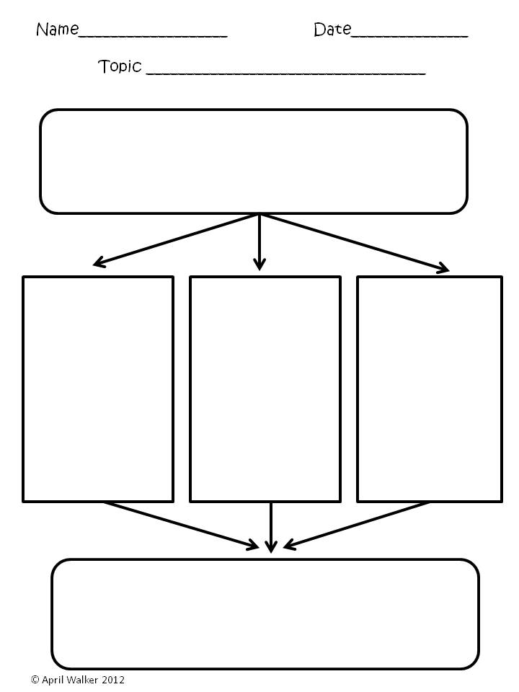
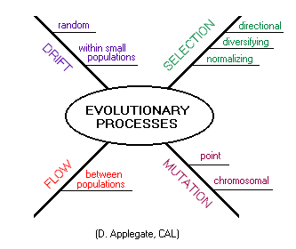
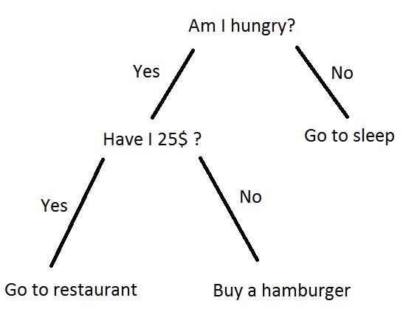
EXPRESSION: Graphic Organizers

Slide 49
What is EXPRESSION?
“How do I ask my students to show what they know?”
Best Practices:
Alternate long essay, short tests, True/False etc
Include oral assessments
Allow technological options
Allow multiple avenues of completion when possible

Slide 50
Questions?
?

Slide 51
What is REPRESENTATION?
“How do I present essential course content to my students?”
    Customize
      Content
      Language
      Comprehension

Slide 52
What is REPRESENTATION?
    Lecture
      Strength=
      Limitation=
    Discussion
      Strength=
      Limitation=
    Reading
      Strength=
      Limitation=

Slide 53
REPRESENTATION: Perception
Semi-concrete/Representational
Abstract/Symbolic
1 + x = 3
?
Notes:
As students begin to grasp the underlying concepts, one can transition to a more representational or semi-concrete format. Once students have a firm grasp of the concepts being taught, a full transition to an abstract form can be completed. Exact calculations (in blue) and approximations (in yellow)
Source: Howard-Jones, Paul. Neuroscience and Education: Issues and Opportunities. The Teaching and Learning Research Programme. London: U of London, 2007. http://www.tlrp.org/pub/documents/Neuroscience%20Commentary%20FINAL.pdf

Slide 54
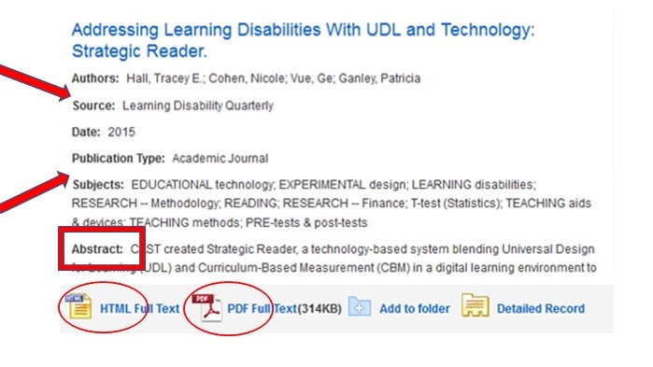
REPRESENTATION: Design

Slide 55
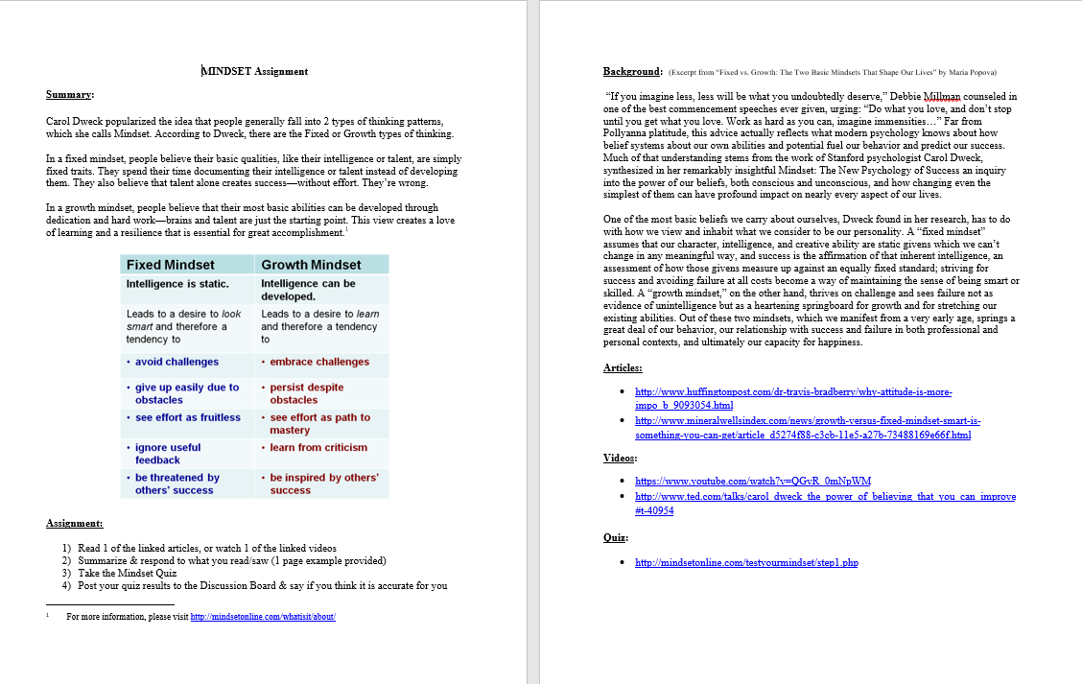

Slide 56
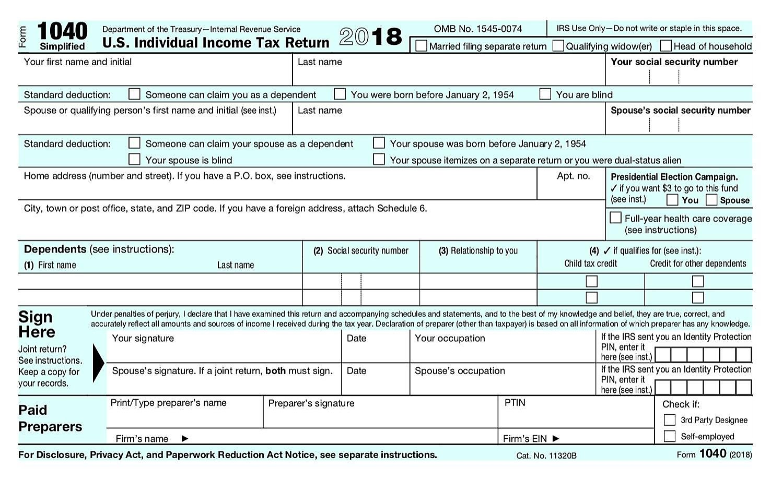
Crowding
Notes:
In a study with high school students with dyslexia, Schneps (2013) found that reading on the palm-sized screen of an iPod Touch reduced inefficiencies in the ways students’ eyes flitted across the page. The shorter lines on the screen made reading faster, without diminishing comprehension.
Source: http://journals.plos.org/plosone/article?id=10.1371/journal.pone.0075634
This reduction is screen size and increase in word size is called crowding, which specifically refers to "the difficulty in identifying a letter embedded in other letters." BUT Control groups, the "normal" readers in the studies cited, also benefit from reduced crowding.
Source: DeLamater, William E. "How Larger Font Size Impacts Reading and the Implications for Educational Use of Digital Text Readers." ereadia. April 29, 2010.

Slide 57
Representation Takeaway
  Offer ways of customizing the display of information
  Multisensory teaching
      Multiple points of access
  Short & varied activities
  Scaffold
      Outline
      Small chunks
      Explicit connections
      Levels of difficulty

Slide 58
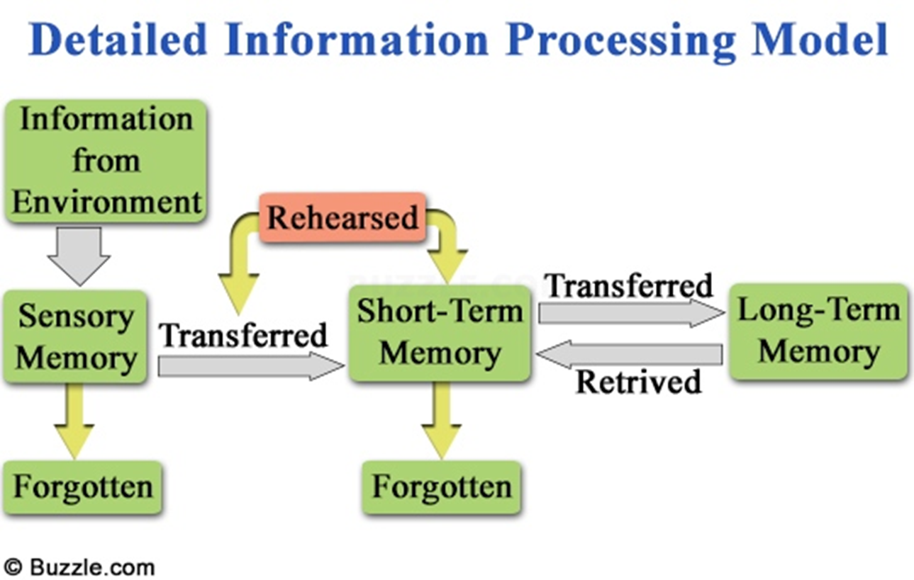
Memory: What can go wrong?
  Sensory issues
  Failure to move information to Long-term memory
  Memory decay
  Memory interference
  Failure to retrieve a stored memory
Notes:
The formation and retention of a long-term memories is quite an involved task. A breakdown anywhere along the following sequence can lead one to be unable to recall information that one has learnt.
Sensory issues: If the learner is unable to physically process the information because they cannot see it, hear it, or feel it then clearly that information will not make it into long-term memory.
Failure to move information to long-term memory: Information is moved from short-term memory to long-term memory using a process called long-term potentiation. For this process to occur, an individual has to hold information in their short-term memory for several minutes of focus attention. Therefore if a learner does not spend a significant amount of time focused on new knowledge that information will likely not transfer to their long-term memory.
Memory decay: Long-term memories that go unused decay over time. Therefore it is important for new information to be revisited periodically to ensure that it will persist in long-term memory.
Memory interference: Very similar memories may at times interfere with each other, for example we have all had the experience of parking our car in a lot and then returning to a location we had parked at previously. It is therefore important to use time, space, and context to help students keep distinct knowledge separate.
Failure to retrieve a stored memory: This is the tip of the tongue effect. Here a memory is still there in long-term memory but we are unable to retrieve it. Creating strong associations can often help us access existing memories via the examples or experiences associated with them.

Slide 59
Representation Takeaway: Comprehension
Guide information processing
  Activate or supply background knowledge with explicit links
  Highlight patterns, ideas, and relationships
Allow sufficient time for the formation of memories
Revisit information to strengthen memory
  Revisit often to increase speed and efficiency
Notes:
7 chunks of info- pieces of information

Slide 60
Next Steps = +1
  -Take 1 assignment and apply 1 UDL principle
    Assess
    Revise
    Apply 1 principle to another assignment
    Repeat
www.CAST.org
www.udlcenter.org
zach.petrea@heartland.edu

Slide 61
Questions?
?

Slide 62
Sources
Alferink, Larry and Valeri Farmer-Dougan. “Brain-(not) Based Education: Dangers of Misunderstanding and Misapplication of Neuroscience Research.” Exceptionality. 18 (2010):42-52
Banerjee, Manju & Ibrahim Dahlstrom-Hakki. “Introduction to Universal Design.” MPDL625x:Universal Design: Principles & Practice. Fall 2015 powerpoint. Landmark College.
---. “The Neuro-Cognitive Underpinnings of Learning.” MPDL625x:Universal Design: Principles & Practice. Fall 2015 powerpoint. Landmark College
Centers for Disease Control and Prevention (CDC). “CDC: 53 million adults in the US live with a disability.” http://www.cdc.gov/media/releases/2015/p0730-us-disability.html
Dekker, S., Lee, N. C., Howard-Jones, P. , & Jolles, J. (2012). Neuromyths in Education: Prevalence and predictors of misconceptions among teachers. Frontiers in Psychology, 3, 1-8.
DeLamater, William E. "How Larger Font Size Impacts Reading and the Implications for Educational Use of Digital Text Readers." ereadia. April 29, 2010.
Howard-Jones, Paul, Michela Ott, Theo van Leeuwen, Bert De Smedt. “Neuroscience and technology enhanced learning.” Futurelab. October 2010. http://www.nfer.ac.uk/publications/FUTL19/FUTL19_home.cfm

Slide 63
Sources
Howard-Jones, Paul. Neuroscience and Education: Issues and Opportunities. The Teaching and Learning Research Programme. London: U of London, 2007. http://www.tlrp.org/pub/documents/Neuroscience%20Commentary%20FINAL.pdf
International Dyslexia Association. “Dyslexia Basics.” Eida.org. 2015. http://eida.org/dyslexia-basics/
“Introduction to Universal Design for Learning- 2 hour presentation.” powerpoint. UDL-Universe (Sonoma State & U.S. Department of Education). N.d. http://enact.sonoma.edu/loader.php?type=d&id=397900
Kellingley. Nick. “The Seven Principles of Universal Design.” The Interaction Design Foundation. https://www.interaction-design.org/ux-daily/47/the-seven-principles-of-universal-design
leu, chelsea. “Scientists can now predict intelligence from brain activity.” wired. 10.12.15.http://www.wired.com/2015/10/scientists-can-now-predict-intelligence-brain-activity/
Nalewicki, Jennifer. "New Font Helps Dyslexics Read." Scientific American. October 26, 2011.

Slide 64
Sources
“'Neurotypical' in Context.” PBS. July 29, 2013. http://www.pbs.org/pov/neurotypical/photo-gallery-in-context/?photo=3
Nicolson, RI¹, AJ Fawcett, RL Brookes, and J Needle. “Procedural Learning and Dyslexia.” Dyslexia. 15.3 (2010): 194-212.
Robison, John. “What is Neurodiversity?” Psychology Today. 10.7.13. https://www.psychologytoday.com/blog/my-life-aspergers/201310/what-is-neurodiversity
Rose, D. H., Meyer, A., & Hitchcock, C. (2005). The universally designed classroom: Accessible curriculum and digital technologies. Cambridge, MA: Harvard Education Press.
Schneps MH, Thomson JM, Chen C, Sonnert G, Pomplun M (2013) E-Readers Are More Effective than Paper for Some with Dyslexia. PLoS ONE 8(9): e75634. http://journals.plos.org/plosone/article?id=10.1371/journal.pone.0075634
Shaywitz, Sally. Overcoming Dyslexia: A New and Complete Science-Based Program for Reading Problems at Any Level. Vintage Paperback, 2005.
---, Maria Mody, and Bennett A. Shaywitz. “Neural Mechanisms in Dyslexia.” Current Directions in Psychological Science. 15.6 (2006): 278-281.

Slide 65
Sources
Silberman, Steve. “Neurodiversity Rewires Conventional Thinking About Brains.” WIRED. 04.16.13. http://www.wired.com/2013/04/neurodiversity/
Stowe, Mary Murray. “Instructional Sequence for Teaching the Structure of the English Language.” William and Mary School of Education. October 2013. https://education.wm.edu/centers/ttac/resources/articles/teachtechnique/instructionalsequence/index.php
Sylvan, L. J., & Christodoulou, J. A. (2010). Understanding the role of neuroscience in brain-based products: A guide for educators an consumers. Mind, Brain, and Education, 4(1), 1-7.

