Slide 1
Connecting the Dots from Programs of Study to Career Pathways
Melissa Andrews
Associate Director for Career & Technical Education
Illinois Community College Board
Brittany Boston
Associate Director for Career & Technical Education
Illinois Community College Board

Slide 2
Agenda
Introductions
Defining Programs of Study
OCTAE’s Design Framework
Developing Your POS
Defining Career Pathways
Features and Functions of a Career Pathway
Fitting it All Together
Career Pathway Components
Understanding Career Pathways
Perkins Reauthorization
Look into the Future
Questions

Slide 3
Why Do We Care About
Programs of Study and Career Pathways?
Increasing the number of Americans with the education, skills, and training needed for the economy with multiple exits/entry points.
Some of the steps to achieve this goal include:
Language shift – (2014) WIOA gave a formal definition to Career Pathways:
Combination of rigorous & high-quality education, training and services that align with industry need concurrently with workforce prep.
Programs of Study focus more on High School transition
Makes sure there are pathways for all learners
Making teaching and learning in secondary schools more rigorous, engaging, and relevant
Ensuring that more students are college and career ready
Increasing high school graduation rates
Providing opportunities for youth to learn about and experience careers
Smoothing the transition to postsecondary success
https://cew.georgetown.edu/cew-reports/recovery-job-growth-and-education-requirements-through-2020/

Slide 4
Do Career and Technical Education Programs of Study Improve Student Achievement?
Three selected high schools were studied with one site employing a Programs of Study model.
Few differences existed across groups in 9th grade, but by the end of 10th grade, students' test scores, academic grade point averages, and progress to graduation tended to be better for the students in a program of study.
Although the programs of study model did not improve students’ graduation rates, the POS graduates outperformed their counterparts on many measures of transition to postsecondary education. POS graduates who attended the main community college serving their area outperformed their comparison group counterparts. For each academic subject, fewer pathway than non-pathway students were required to take remedial courses; however, 60% still needed remediation.
Do Career and Technical Education Programs of Study Improve Student Achievement? Preliminary Analyses from a Rigorous Longitudinal Study
Marisa Castellano, Kirsten Sundell, Laura T. Overman, and Oscar A. Aliaga
Apr 2012 International Journal of Educational Reform
http://www.nrccte.org/resources/external-reports/do-career-and-technical-education-programs-study-improve-student

Slide 5
Defining Programs of Study
The Carl D. Perkins Career and Technical Education Act of 2006 calls for states to have Programs of Study which local educational agencies and postsecondary institutions offer as options for students to complete in CTE.
Brief History
1970s – Career Clusters/CIP Codes
1980s – Switches to Performance Focus
1990s – Switches to Quality of Programs/ROI * Accountability Standards/Not just enrollment but Learning
1998s – College & Career Readiness* National Models for Rigor emerge
2009– Race to the Top
Adult Career Pathways Providing a Second Chance in Education – Dan Hull, Richard Hinckley (2007)

Slide 6
Defining Programs of Study
All Perkins programs must offer at least one Program of Study (POS) that:
Incorporates and aligns secondary and postsecondary education elements.
Includes academic and CTE content in a coordinated, non-duplicative progression of courses.
Offers opportunities for secondary students to acquire postsecondary credits.
Leads to an industry-recognized credential or certificate at the postsecondary level, or an associate, or baccalaureate degree.
Carl D. Perkins Career and Technical Education Act of 2006 [Section 122(c)(1)(A)]

Slide 7
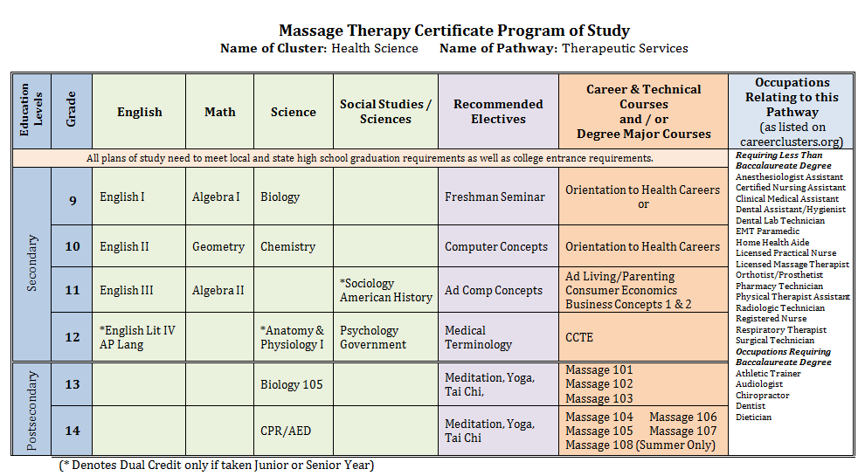
Program of Study in Illinois
Non-Duplicative
Doesn’t stop at 2-year

Slide 8
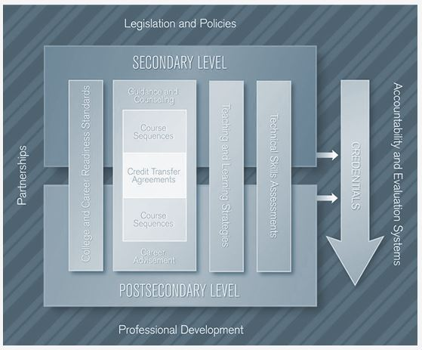
OCTAE’s Programs of Study
Design Framework
Framework Supporting Elements
The framework contains 10 supporting elements* that are viewed by CTE practitioners as instrumental for creating and implementing high quality, comprehensive programs of study.
Legislation & Policies
Partnerships
Course Sequences
College & Career Readiness Standards
Teaching & Learning Strategies
Guidance and Academic Counseling/Advisement
Credit Transfer Agreements
Professional Development
Technical Skill Assessments
Accountability & Evaluation Systems
http://cte.ed.gov/initiatives/octaes-programs-of-study-design-framework

Slide 9
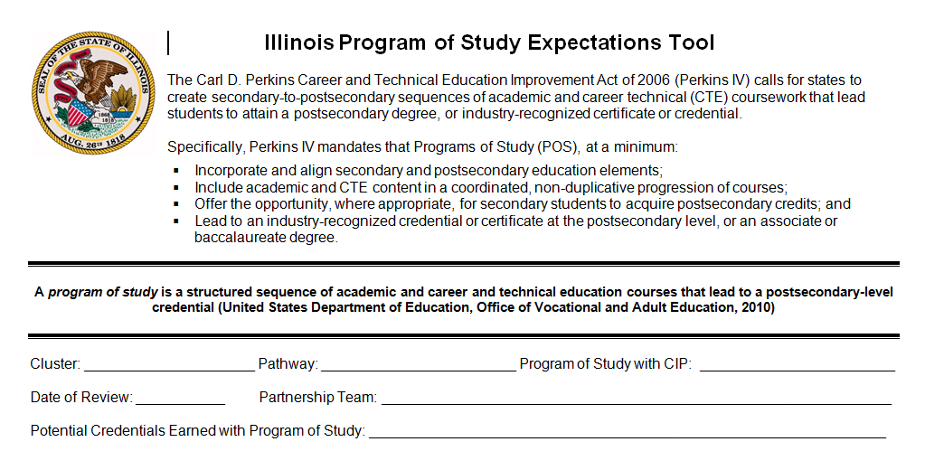
Developing your POS
Create a Partnership
Building the POS foundation
Design the POS
Develop Articulation/Dual Credit
Implement the POS
Assessments
Evaluating and Improving the POS
https://www.iccb.org/cte/?page_id=133
The Illinois Programs of Study Expectations Tool was created as a way to proceed with the development process. It is designed to:
Be interactive
Meet Federal requirements
Meet Illinois Standards
Guide the users in designing and implementing programs of study
Provide examples of evidence
Suggest examples of supporting materials
Re-evaluate existing Programs of Study

Slide 10
Recap of Programs of Study
Re-authorization
All Perkins programs must offer at least 1 POS
Definition of a POS encourages alignment and transition toward a degree or certificate
Programs of Study incorporate and align secondary and post secondary education elements. Include academic and CTE content in a coordinated, non duplicative progression of courses
Using the POS Expectations Tool will allow you to evaluate needs, existing programs, requirements

Slide 11
Defining Career Pathways Workforce Innovation and Opportunity Act (WIOA)
The term ‘‘career pathway’’ means a combination of rigorous and high-quality education, training, and other services that—
Align with the skill needs of industries in the economy of the State or regional economy involved;
Prepare an individual to be successful in any of a full range of secondary or postsecondary education options;
Include counseling to support an individual in achieving the individual’s education and career goals;
Include, as appropriate, education offered concurrently with and in the same context as workforce preparation activities and training for a specific occupation or occupational cluster;
Organize education, training, and other services to meet the particular needs of an individual in a manner that accelerates the educational and career advancement of the individual to the extent practicable;
Enable an individual to attain a secondary school diploma or its recognized equivalent, and at least one recognized postsecondary credential; and

Slide 12
Career Pathway Programs
The Alliance for Quality Career Pathways
Three Features of a Quality Career Pathway:
Well-connected and transparent education, training, support services, and credentials;
Multiple entry points that enable well-prepared students to successfully enter the career pathway, and;
Multiple exit points at successively higher levels.
The Four Essential Functions of a Quality Career Pathway:
Participant-focused education and training;
Consistent and non-duplicative assessments of participants’ education, skills, and assets/ needs;
Support services and career navigation assistance to facilitate transitions, and;
Employment services and work experiences.
CLASP, 2014

Slide 13
Three Essential Features of Career Pathways
2. Multiple entry points – for both well-prepared students and targeted populations
e.g., apprenticeship
e.g., postsecondary system
informed by industry/employers
e.g., military or civilian workplace
credentials
e.g., high school or CTE
competencies, and
e.g., 4-year degree
skills,
e.g., 2-year degree
e.g., adult education or workforce system
Increasing
e.g., certificate, diploma
N^{th} Job in Career Path
3rd Job in Career Path
bridge(s)
e.g., license, industry credential
2nd Job in Career Path
1st Job in Career Path
1. Well-connected and transparent education, training, credentials, and support services
3. Multiple exit points
http://www.clasp.org/resources-and-publications/files/aqcp-framework-version-1-0/AQCP-Framework.pdf

Slide 14
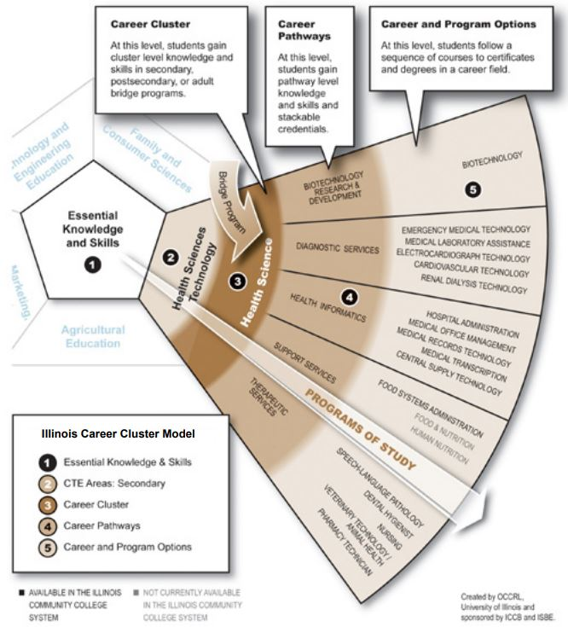
How Does It All Fit Together?
This example of the Illinois Career Cluster Model shows the relationship
between one of Illinois’ five secondary career and technical education areas
(Health Sciences Technology), the related career cluster (Health Science),
the five pathways within that cluster, and sample programs of study within
the pathway.
http://occrl.illinois.edu/

Slide 15
Sample Career Pathway Program Components
Adult Education and English as a Second Language | High School | Offenders and Ex-Offenders | Returning Adults
Bridge Programs Integrated Education and Training (IET) Opportunities Stackable credentials Integrated literacy and civics education | Dual Credit Early College Credit Co-requisite remediation Youth apprenticeship Pre-Apprenticeship Work-Based Learning | Re-entry Counseling Transition to re-entry initiatives Tutoring services such as Peer Tutoring Child-care services Secondary school credit | Math Refreshers Placement Testing Career Counseling Financial Aid Counseling

Slide 16
Understanding Career Pathways
Career Pathways ARE about continuously improving connections between education, the economy, and workforce systems.
Programs of study are an essential element of career pathways. They represent federal efforts to better align high school and postsecondary education with the demands of the changing global economy and provide a more coherent pathway.

Slide 17
Perkins Reauthorization
The Strengthening Career and Technical Education for the 21st Century Act (H.R. 2353) was introduced in May of 2017.
Passed by the House in June 2017.
Maintains Program of Study requirement but modifies definition to align with career pathways and other existing initiatives (employability skills, labor market alignment, etc.)
Alignment with WIOA and ESSA, specifically around career pathways

Slide 18
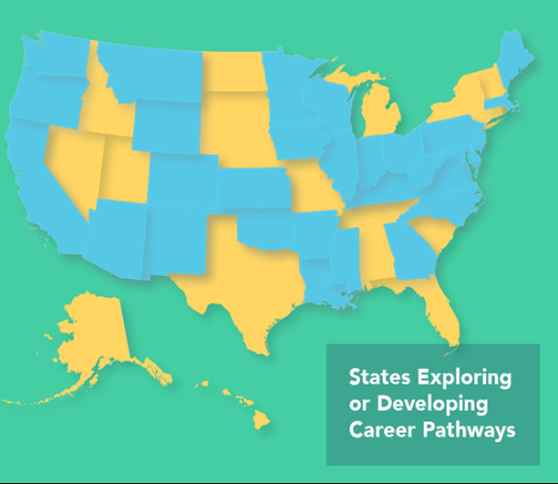
Future?
Perkins reauthorization
More states adopting Career Pathways Model
Increased WIOA requirements/work force and industry demands
Resources and tools to assist local areas in Career Pathway development

Slide 19
Questions?

Slide 20
Contact Information
Melissa Andrews
Associate Director for Career and Technical Education
Illinois Community College Board
melissa.andrews@illinois.gov
Brittany Boston
Associate Director for Career and Technical Education
Illinois Community College Board
brittany.boston@illinois.gov

